Slide 1
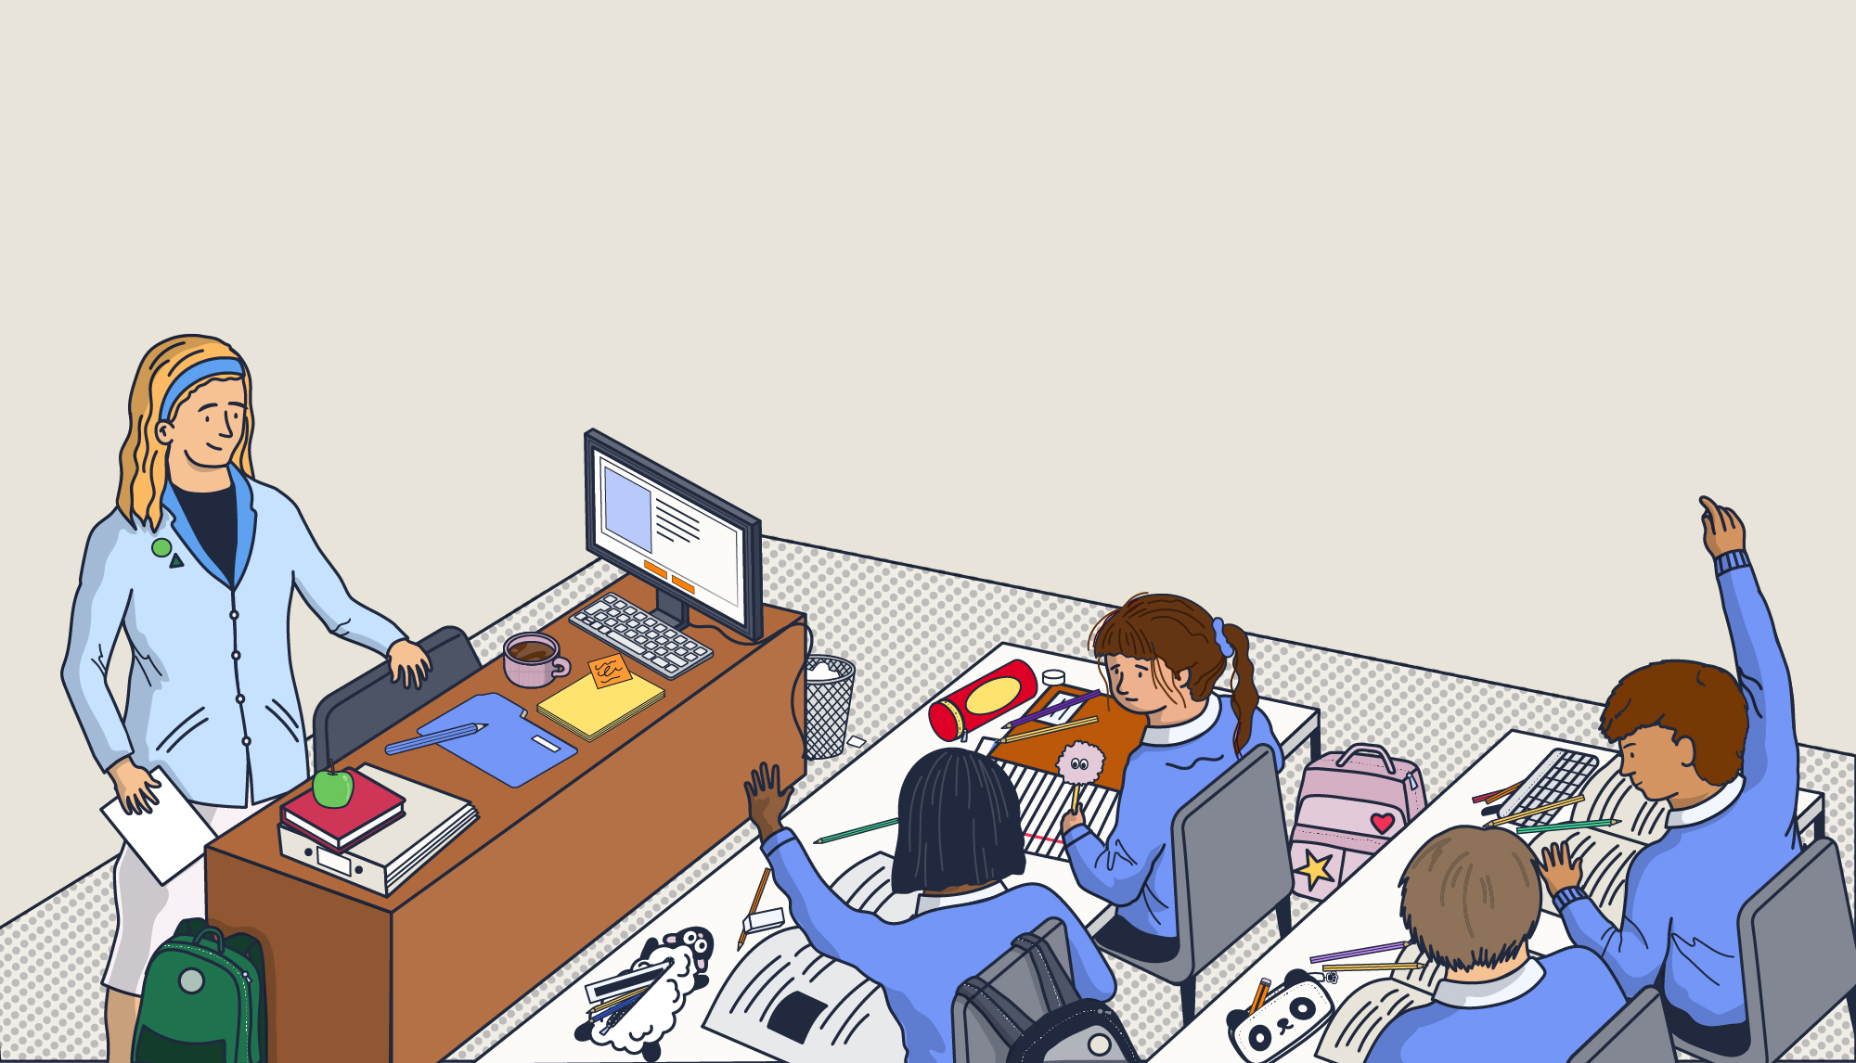

Write your school name here
INSET 2025
Safeguarding
Notes:
Please note: a document containing the facilitator notes can be found in your INSET pack and you can refer to these throughout the presentation.
Welcome staff to your Safeguarding INSET.
Point out that staff may take a break from today’s session at any point if they find any details distressing.

Slide 2

What we’ll explore today
Recent updates to statutory safeguarding guidance
The four main types of abuse and signs to look out for
How we should respond to, and report
any concerns
A variety of specific safeguarding issues
Creating and maintaining an effective safeguarding culture
Notes:
Read out the topics to cover in today’s session.
Throughout the presentation, there will be a number of opportunities for interactivity with video content, scenarios, discussion points and activities to test your knowledge.
If staff have questions at any point, advise that they can ask them in front of the group during the session, or wait until the end to speak to a member of the safeguarding team.

Slide 3

Discussion point
What does safeguarding truly mean for us, in our school community?
Notes:
Discussion point
Remind staff that every member of staff has a responsibility to promote the welfare of, and to safeguard, children and young people. With this in mind, present the first discussion point of today’s session.
Ask staff: What does safeguarding truly mean for us, in our school community?
Allow time for discussion and then take some of the answers to summarise thoughts from the group.

Slide 4
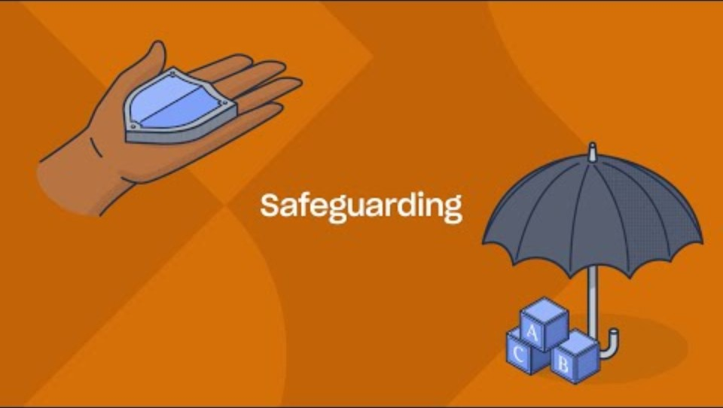
Notes:
Video content - when presenting the slide, click on the play icon to start the video (duration of 2:36). To enable captions, simply click on the ‘subtitles/closed captions’ icon that appears to the bottom right of the controls once the video begins to play.
In today’s session, you will be presented with a variety of video content including two safeguarding experts.
Joanna Nicolas - a highly regarded safeguarding consultant, trainer and social worker with 30 years of experience in the sector.
Ian Curry - a former Deputy Headteacher and DSL with over 25 years of teaching experience.
This video will cover what safeguarding is, why it is so important, and your role in safeguarding children and young people.
If you need the link to access the video, you can find it here: https://youtu.be/Rq-rexeWH0g

Slide 5


Write your school name here
Safeguarding team
>>INSERT NAME<< - Designated Safeguarding Lead (DSL)
>>INSERT NAME<< - Deputy DSL
If you have any questions or concerns, please contact your Safeguarding team.
Notes:
Please note: you should edit the details regarding your safeguarding team before presenting this slide.
Remind staff that your safeguarding team is here to help.
Go through the details of team members that you have added into the slides, making sure staff are aware of who they should speak to about safeguarding.

Slide 6

Recent updates to statutory safeguarding guidance
Write your school name here
1
Notes:
The first section of today’s session will focus on key updates to statutory safeguarding guidance, including Keeping Children Safe in Education (KCSIE) and Working Together to Safeguard Children (WTSC).
You’ll cover the key updates and what the changes mean for your school.
It also includes a useful pull-out document for easy access to more detailed information which can be forwarded onto staff.

Slide 7

Working Together to Safeguard Children (WTSC)
Updates from the 2023 guidance:
Recognising that improvements must be made to involve families more closely.
Emphasis on securing ‘positive, trusting and cooperative relationships’ with parents and carers.
New multi-agency practice standards to strengthen cooperation between services.
Revised guidance on improving provision for disabled children and their families.
Guidance on recognising and responding to risk of harm to children outside the home.
Key changes for 2024:
Amending the definition of ‘safeguarding and promoting the welfare of children’ to reflect the updated Working Together to Safeguard Children 2023.
Added information about ‘early help’ in line with Working Together to Safeguard Children 2023.
The term ‘exploitation’ has been included throughout the guidance, amended from just abuse and neglect.
Two separate age-appropriate guides have now been included for schools to support children in the court system.
Clarification that schools remain responsible for the pupils they place in alternative provision.
Recognises that safeguarding is most effective when everyone involved works together collaboratively.
Documents linked here
Notes:
Working Together to Safeguard Children (WTSC)
Working Together to Safeguard Children highlights the importance of multi-agency working and outlines the value of involving the whole family in the process, including the child.
The 2023 guidance update emphasises securing ‘positive, trusting and cooperative relationships’ with parents and carers.
It also explains the importance of considering the needs of the whole family. For example, families with English as an additional language (EAL) may require more specialist support to keep them involved and informed.
In addition, the new version of the guidance outlines new roles within the local authority, the police and health services. It states that the head of each sector will be named the Lead Safeguarding Partner (LSP), and they must appoint a Delegated Safeguarding Partner (DSP). It is expected that LSPs will form close relationships with representatives from the education sector, who should also be involved in any strategic decisions and planning.
Sources of information:
https://www.gov.uk/government/publications/working-together-to-safeguard-children--2
https://www.highspeedtraining.co.uk/hub/working-together-to-safeguard-children/?utm_source=inset-pack-2025&utm_medium=inset-pack-2025&utm_campaign=inset-pack-2025

Slide 8
Keeping Children Safe in Education (KCSIE)
Key changes for 2025:
In the four areas of risk regarding online safety, it now includes “misinformation, disinformation, and conspiracy theories” as examples of content risks.
Explains how filtering and monitoring requirements apply to the use of generative AI in education.
Corrected terminology around autism.
Information has been added that clarifies and reflects existing AP Guidance.
Working Together to Improve School Attendance is now specified as statutory guidance.
Key changes for 2024:
Amending the definition of ‘safeguarding and promoting the welfare of children’ to reflect the updated Working Together to Safeguard Children 2023.
Added information about ‘early help’ in line with Working Together to Safeguard Children 2023.
The term ‘exploitation’ has been included throughout the guidance, amended from just abuse and neglect.
Two separate age-appropriate guides have now been included for schools to support children in the court system.
Clarification that schools remain responsible for the pupils they place in alternative provision.
Statutory guidance for schools and colleges on safeguarding children.
Documents linked here
Notes:
Keeping Children Safe in Education (KCSIE)
KCSIE is statutory guidance for schools and colleges on safeguarding children.
Some of the key changes for 2025 have been highlighted on this slide, but you can find a more detailed overview below (and we have also put together a summary sheet for you to provide to staff).
Part one: Safeguarding information for all staff
No changes.
Part two: The management of safeguarding
The DfE expects to publish revised guidance on Relationships, Sex, and Health Education this summer and if published, will signpost to this guidance in September 2025.
In the four areas of risk regarding online safety, it now includes “misinformation, disinformation, and conspiracy theories” as examples of content risks.
A link to the plan technology for your school service has been added to support schools in self-assessing and meeting filtering and monitoring standards.
The DfE has published Generative AI: product safety expectations to support schools to use generative artificial intelligence safely, and explains how filtering and monitoring requirements apply to the use of generative AI in education.
Clarity that the cybersecurity standards for schools and colleges advice was developed to help schools improve their cyber resilience.
Information has been added that clarifies and reflects existing AP Guidance.
Working Together to Improve School Attendance is now specified as statutory guidance, strengthening the link between attendance and safeguarding.
Clarity that the role of the virtual head has been extended to include responsibility for promoting the educational achievement of children in kinship care.
The DfE expects to publish revised guidance on gender questioning children this summer and if published, will signpost to this guidance in September 2025.
The terms “spectrum” and “disorder” have now been replaced with the term “autism” to align with the SEND code of practice.
Part three: Safer recruitment
Information has been added that clarifies and reflects existing AP Guidance.
Part four: Safeguarding concerns or allegations made about staff, including supply teachers, volunteers and contractors
Amended to correct the title of the Information Commissioner’s employment practice guidance.
Part five: Child-on-child sexual violence and sexual harassment
A link has been added to the Lucy Faithfull Foundation ‘Shore Space’, an online resource which works to prevent harmful sexual behaviour.
Sources of information:
https://www.gov.uk/government/publications/keeping-children-safe-in-education--2
https://assets.publishing.service.gov.uk/media/686b94eefe1a249e937cbd2d/Keeping_children_safe_in_education_2025.pdf
https://www.highspeedtraining.co.uk/hub/keeping-children-safe-in-education-changes/?utm_source=inset-pack-2025&utm_medium=inset-pack-2025&utm_campaign=inset-pack-2025

Slide 9

Test your knowledge
According to KCSIE, which of the following is an essential safeguarding responsibility for all school staff members?
A: Managing the school's Child Protection Policy database.
B: Leading the annual safeguarding audit for the school.
C: Recognising signs of abuse and knowing how to report concerns.
C: Recognising signs of abuse and knowing how to report concerns.
D: Personally investigating allegations made against staff members.
Notes:
Test your knowledge
Explain to staff that you have a quick quiz question to test their knowledge, and present the multiple-choice question.
Once staff have answered, click to reveal the answer on the slide.
You will follow-up on this quiz question on the next slide where you can direct staff to a KCSIE quiz to complete.

Slide 10
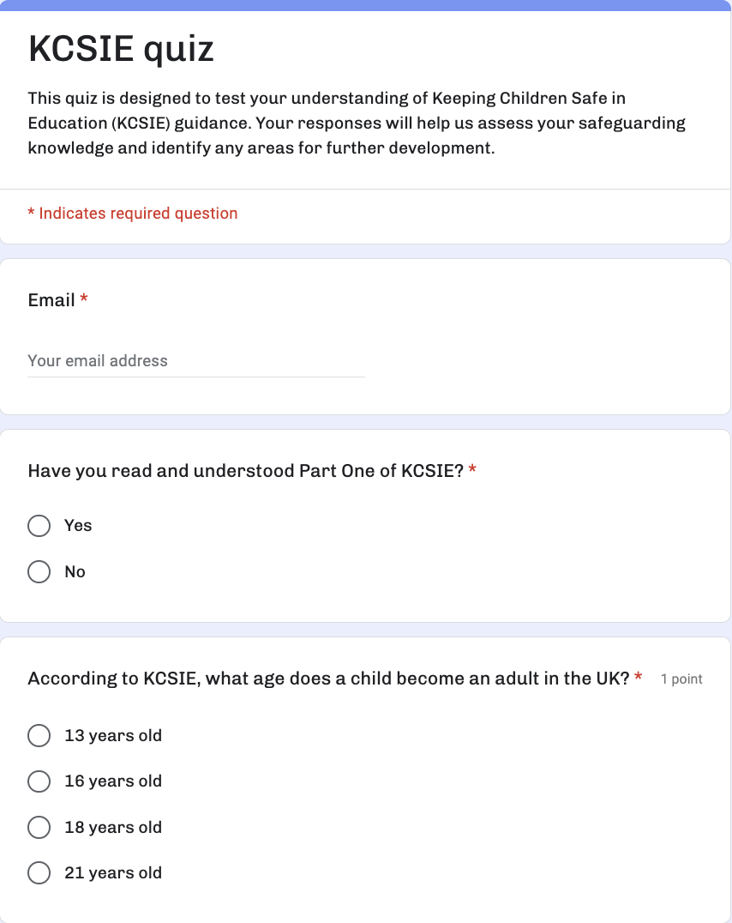

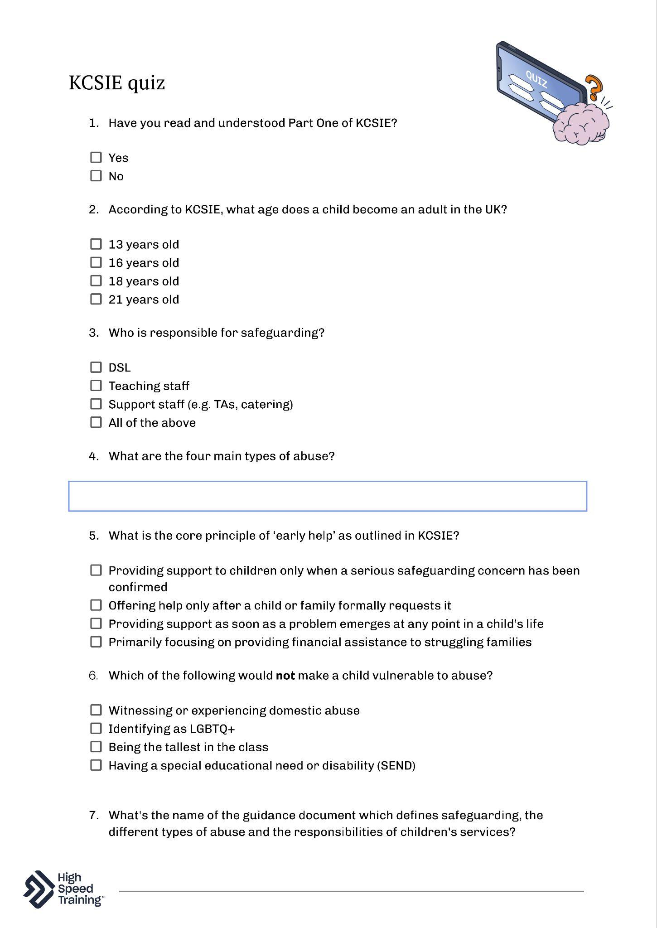
KCSIE quiz
Staying up-to-date with KCSIE is crucial for all members of staff and this quiz is a great way to assess and reinforce our understanding.
Notes:
Please note: you can find our KCSIE quiz page within your pack and on the following link: http://www.highspeedtraining.co.uk/campaign/inset-teacher-training-pack/kcsie-quiz/?utm_source=inset-pack-2025&utm_medium=inset-pack-2025&utm_campaign=inset-pack-2025
Remind staff it is essential that everybody working in a school or college understands their safeguarding responsibilities.
Governing bodies and proprietors should ensure that those staff who work directly with children read at least Part one of KCSIE.
Governing bodies and proprietors, working with their senior leadership teams and especially their designated safeguarding lead, should ensure that those staff who do not work directly with children read either Part one or Annex A (a condensed version of Part one) of KCSIE.
This quiz is designed to test understanding of Keeping Children Safe in Education (KCSIE) guidance. The responses will help you to assess staff safeguarding knowledge and identify any areas for further development.
You can inform staff that they will be invited to complete the quiz and explain how the safeguarding team is going to look at the results.

Slide 11

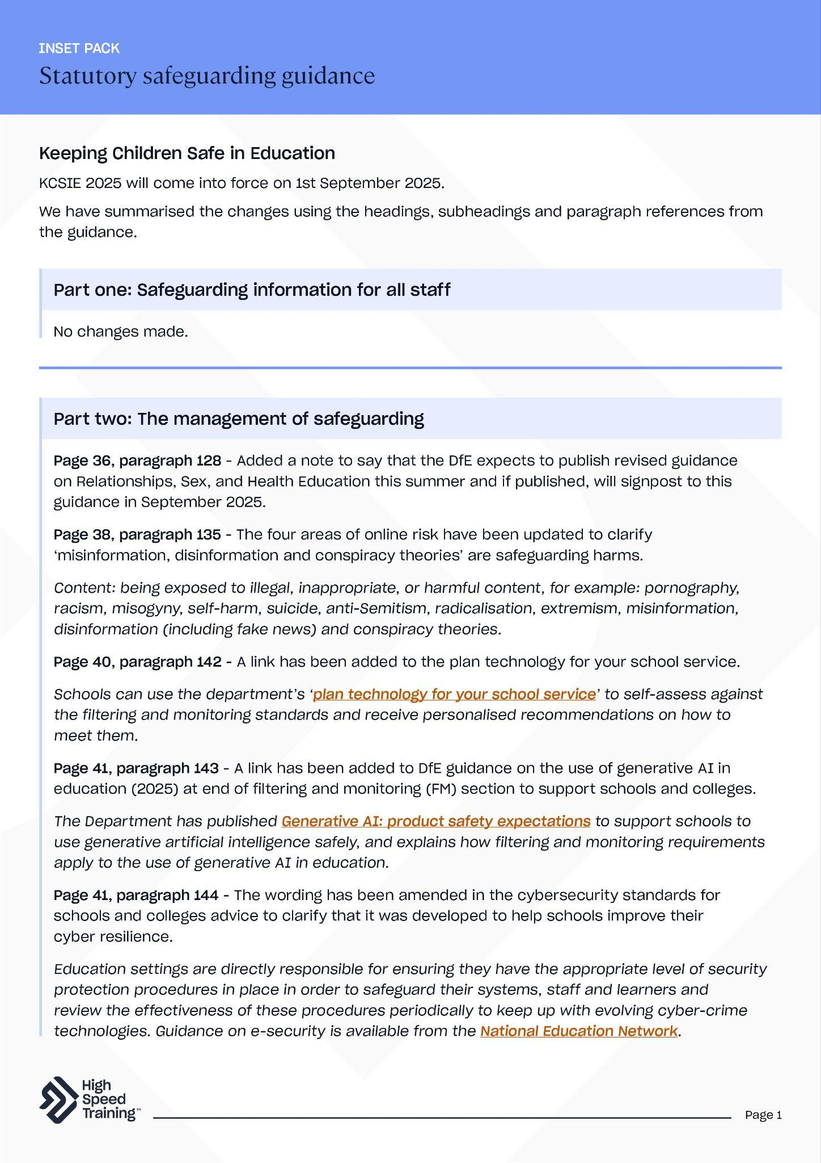
Updates to both KCSIE and WTSC have been compiled in this document, using the headings, subheadings and paragraph references from the guidance.
Notes:
Please note: you can find this document within your pack.
This pull-out document contains more detailed information on the updates.

Slide 12
Key takeaways
It’s important that you keep up to date with legislation and statutory safeguarding guidance.
We must ensure that staff who work directly with children read at least Part One of KCSIE, and staff who do not work directly with children read either Part One or Annex A.
Please ask questions to your safeguarding team if you are unclear about anything in the guidance.
https://www.gov.uk/education/safeguarding-pupils
Notes:
Provide a summary of the section that you have just covered on statutory safeguarding guidance.
Offer the opportunity for staff to ask any questions that they may have following this section.

Slide 13

Further resources and support
If you’d like to learn more about the topics covered in this section, here are some useful resources:
Essential guide
to KCSIE
KCSIE staff knowledge quiz
Essential guide
to WTSC
Guidance on the levels of need in safeguarding
Key legislation and statutory safeguarding guidance
Safeguarding courses
Statutory safeguarding guidance (PDF)
Notes:
If staff would like to find out more about topics covered in this section, advise them that they can visit the links as shown.
There’s a PDF summary of this section available for all staff included in the pack (you could send the summary sheets PDF to staff following the session).

Slide 14
The four main types of abuse
and signs to look out for
Write your school name here
2
Notes:
The second section of today’s session will focus on the four main types of abuse.
You’ll cover the different types of abuse and the signs to look out for that may suggest a cause for concern.

Slide 15




What are the four main types of abuse?
Physical abuse
Emotional abuse
Sexual abuse
Neglect
Notes:
The question will appear first, so you can encourage staff to say the four main types of abuse aloud before you click to reveal them one-by-one.
This includes physical abuse, emotional abuse, sexual abuse and neglect.
These should not be thought of as clear-cut categories and it’s important to remember that there is often significant overlap between these.
Keep in mind that sometimes a child may be experiencing different forms of maltreatment at the same time.

Slide 16

Notes:
Video content - when presenting the slide, click on the play icon to start the video (duration of 2:21). To enable captions, simply click on the ‘subtitles/closed captions’ icon that appears to the bottom right of the controls once the video begins to play.
This video will focus on spotting the signs that could suggest a cause for concern and how children might communicate abuse.
If you need the link to access the video, you can find it here: https://youtu.be/V0qhY-vmijk

Slide 17

Physical abuse
A form of abuse which may involve hitting, shaking, throwing, poisoning, burning or scalding, drowning, suffocating, or otherwise causing physical harm to a child. Physical harm may also be caused when a parent or carer fabricates the symptoms of, or deliberately induces, illness in a child.
Signs to look out for:
Bruises
Fractures or broken bones
Burns or scalds
Bite marks
Refusal to discuss injuries
Keeping the body covered, even in hot weather
Descriptions of excessive punishment
Notes:
Physical abuse
Define what physical abuse is.
It may involve hitting, shaking, throwing, poisoning, burning or scalding, drowning, suffocating, or otherwise causing physical harm to a child.
Click to reveal the signs to look out for.
All children can have accidents, trips and falls. However, regular injuries, those unusual for their developmental age, when there seems to be a pattern, on the soft parts of the body or where the explanation doesn't match the injury, may be cause for concern.
Sources of information:
https://assets.publishing.service.gov.uk/media/6849a7b67cba25f610c7db3f/Working_together_to_safeguard_children_2023_-_statutory_guidance.pdf

Slide 18

Emotional abuse
The persistent emotional maltreatment of a child such as to cause severe and adverse effects on the child’s emotional development.
Signs to look out for:
Lack of confidence
Being overly affectionate or clingy towards strangers
Having few social skills and friends
Cruelty towards other children
Difficulty regulating their emotions
Lack of close relationship to a parent or carer
Notes:
Emotional abuse
Define what emotional abuse is.
The persistent emotional maltreatment of a child such as to cause severe and adverse effects on the child’s emotional development.
Some level of emotional abuse is involved in all types of maltreatment of a child, though it may occur in isolation.
Click to reveal the signs to look out for.
Sources of information:
https://assets.publishing.service.gov.uk/media/6849a7b67cba25f610c7db3f/Working_together_to_safeguard_children_2023_-_statutory_guidance.pdf

Slide 19
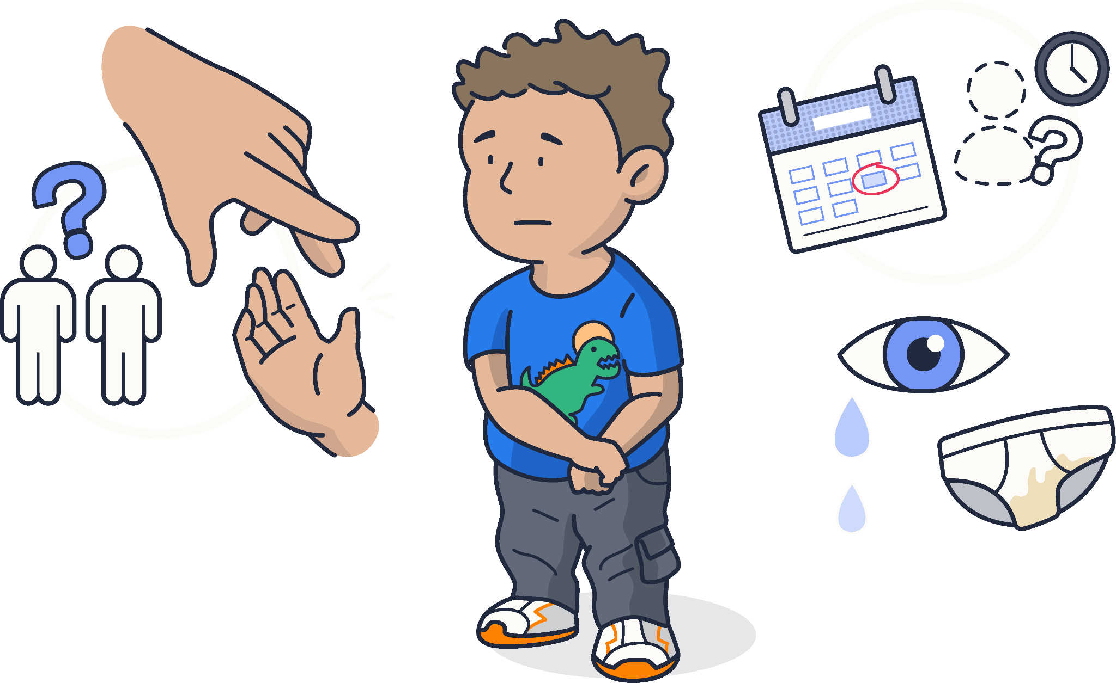
Sexual abuse
Involves forcing or enticing a child or young person to take part in sexual activities, not necessarily involving a high level of violence, whether or not the child is aware of what is happening.
Signs to look out for:
Soreness of the genital area
Recurrent abdominal pains
Sexually transmitted infections
Age inappropriate sexual knowledge and language
Avoiding being alone with particular people
Fear of particular people
Pregnancy
Notes:
Sexual abuse
Define what sexual abuse is.
Involves forcing or enticing a child or young person to take part in sexual activities, not necessarily involving a high level of violence, whether or not the child is aware of what is happening.
Child sexual abuse includes both contact and non-contact abuse:
Contact abuse is where an abuser makes physical contact with a child. It includes assault by penetration, including rape or oral sex, as well as non-penetrative sexual acts such as masturbation, kissing and sexual touching.
Non-contact abuse involves non-touching activities, such as forcing a child to look at sexual images or witness sexual activity, grooming and sharing pornographic images. It can happen both in person and online.
Click to reveal the signs to look out for.
Sources of information:
https://assets.publishing.service.gov.uk/media/6849a7b67cba25f610c7db3f/Working_together_to_safeguard_children_2023_-_statutory_guidance.pdf
https://www.highspeedtraining.co.uk/hub/child-sexual-abuse-guidance-for-schools/?utm_source=inset-pack-2025&utm_medium=inset-pack-2025&utm_campaign=inset-pack-2025

Slide 20
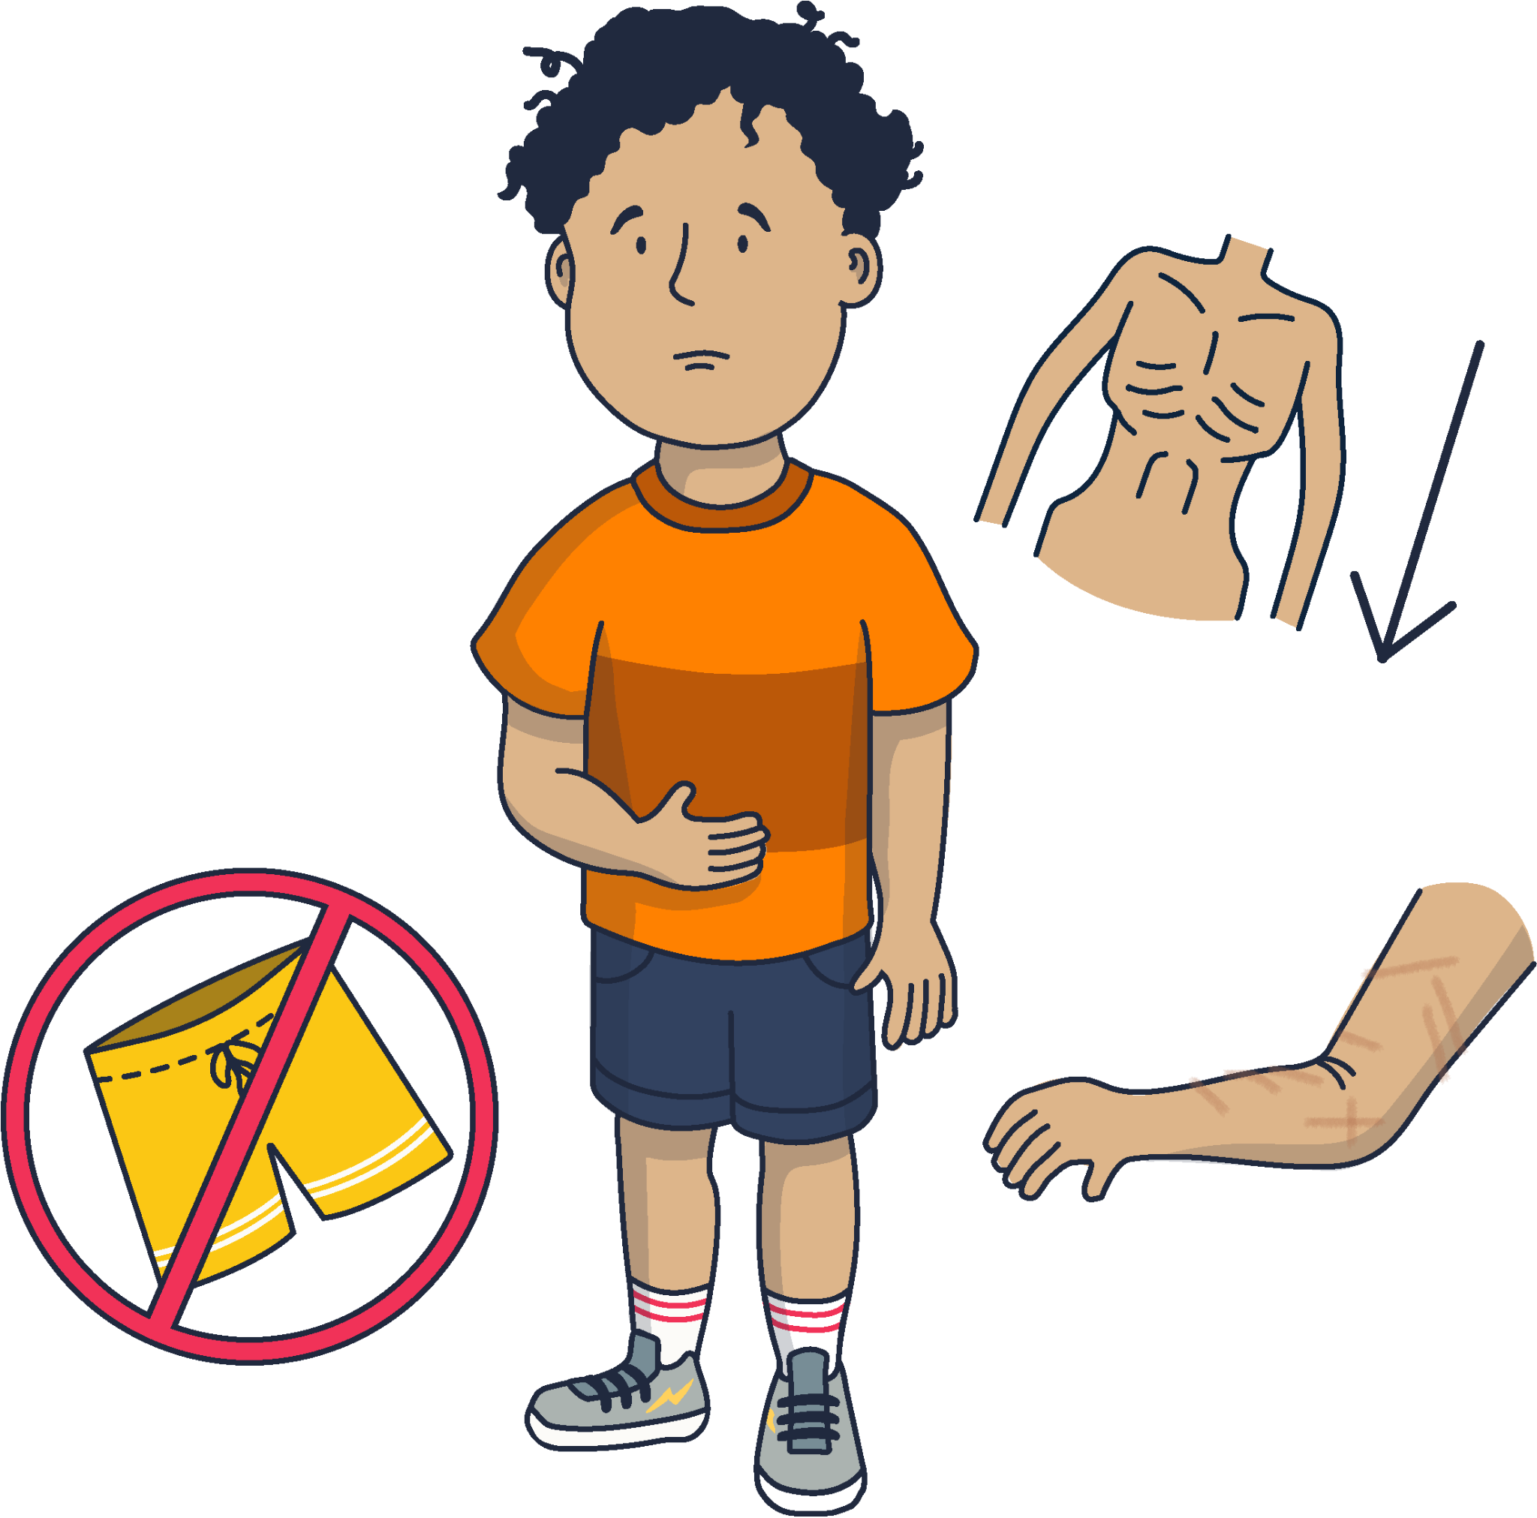
Neglect
The persistent failure to meet a child’s basic physical and/or psychological needs, likely to result in the serious impairment of the child’s health or development.
Signs to look out for:
Poor personal hygiene
Ill-fitting clothes or shoes
Untreated injuries or medical issues
Constant hunger
Missing developmental milestones
Tiredness
Poor muscle tone
Recurring accidental injuries or illnesses
Notes:
Neglect
Define what neglect is.
This refers to the persistent failure to meet a child’s basic physical and/or psychological needs.
There are four main types of neglect: physical neglect, emotional neglect, educational neglect and medical neglect.
Click to reveal the signs to look out for.
It's important to be clear that poverty does not equal neglect, but there are often strong links between the two.
Some professionals may be unsure whether to share concerns about neglect, especially in light of the current economic pressures that families may be facing. The child's welfare should always be central. Sharing concerns can mean that the child and family get help.
Sources of information:
https://assets.publishing.service.gov.uk/media/6849a7b67cba25f610c7db3f/Working_together_to_safeguard_children_2023_-_statutory_guidance.pdf
https://www.highspeedtraining.co.uk/hub/what-is-child-neglect/?utm_source=inset-pack-2025&utm_medium=inset-pack-2025&utm_campaign=inset-pack-2025

Slide 21
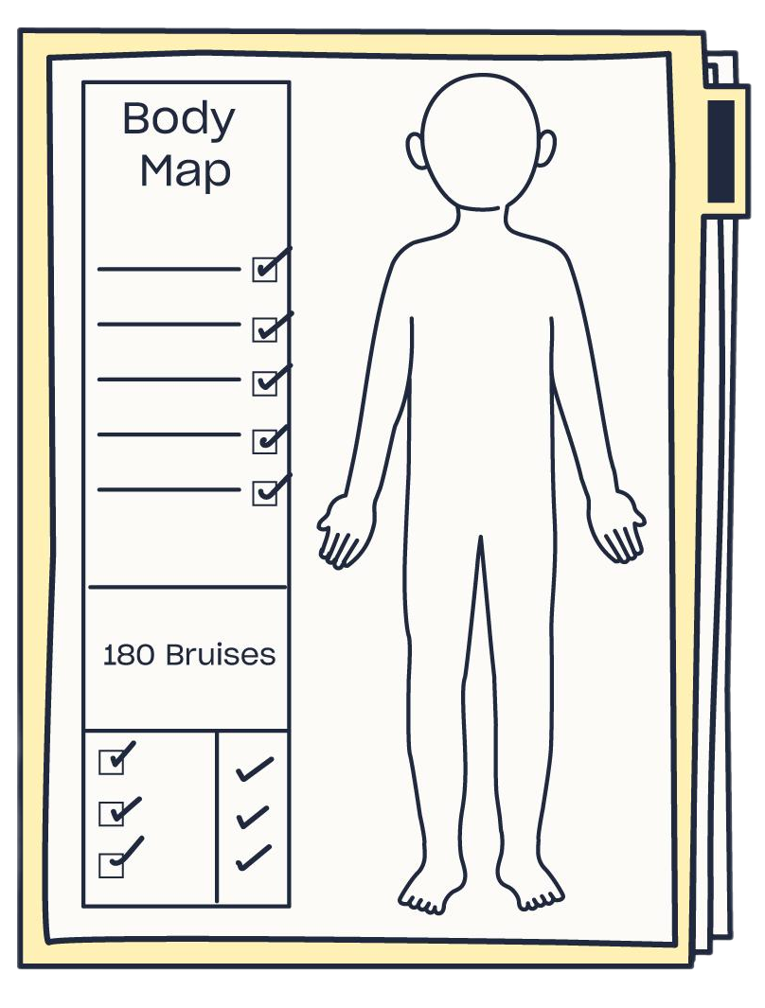
The consequences of a lack of safeguarding training, failing to share information and not working closely enough with other agencies can be devastating.
CASE STUDY: ARTHUR LABINJO-HUGHES
Arthur tragically died at just the age of six, as a result of sustaining a fatal head injury.
There was evidence of serious physical abuse and neglect, with 130 bruises found on his body and evidence of salt poisoning.
Arthur had been known to children's social care and other agencies, having been the subject of two child in need assessments. Concerned family members had contacted children's social care, his school and the police.
Notes:
Case study: Arthur Labinjo-Hughes
Tell staff that you are going to present the case study of Arthur Labinjo-Hughes.
This case demonstrates the consequences of a lack of safeguarding training, failing to share information and not working closely enough with other agencies.

Slide 22

Discussion point
Thinking about the signs we've discussed, what's one area of your practice where you feel you could be even more vigilant? And what support might help us in those situations?
Notes:
Discussion point
Now that you’ve explored the four main types of abuse and some of the signs to look out for, encourage staff to take a moment to reflect.
Ask staff: Thinking about the signs we’ve discussed, what’s one area of your practice where you feel you could be even more vigilant? And what support might help us in those situations?
Allow time for discussion and then take some of the answers to summarise thoughts from the group.

Slide 23

This is the equivalent of 7 children in every classroom experiencing abuse before they turn 18.
Always maintain an attitude of ‘it could happen here… and may well be happening’ where safeguarding is concerned.
Half a million children in
the UK experience abuse every year
Notes:
Half a million children in the UK experience abuse every year.
Click to reveal that this is the equivalent of 7 children in every classroom experiencing abuse before they turn 18.
Always maintain an attitude of ‘it could happen here… and may well be happening’ where safeguarding is concerned.
Sources of information:
https://www.nspcc.org.uk/about-us/news-opinion/2023/more-safeguarding-referrals-risen-childhood-day-2023/

Slide 24
Key takeaways
The four main types of abuse are physical abuse, emotional abuse, sexual abuse and neglect.
There is often significant overlap between these
- rarely would you be able to apply a single label to a child's situation.
Children may experience maltreatment within the home (familial), outside the home (known as extra-familial or contextual) or online.
Always remain alert to any indicators that may suggest
a cause for concern. This could relate to a single event or an accumulation of concerns or patterns that only emerge over time.
Notes:
Provide a summary of the section that you have just covered on the four main types of abuse and signs to look out for.
Offer the opportunity for staff to ask any questions that they may have following this section.

Slide 25
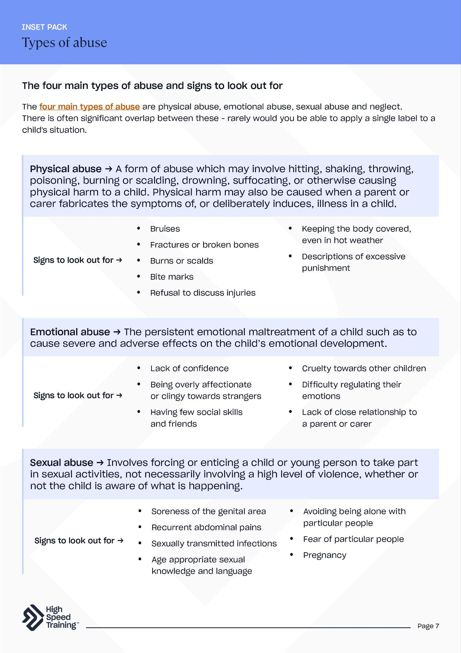
Further resources and support
If you’d like to learn more about the topics covered in this section, here are some useful resources:
PLACEHOLDER IMAGE
Safeguarding Children In Education course
Signs of abuse in children
Guidance on child neglect
Guidance on child sexual abuse
How to teach children about healthy relationships
Understanding why children may stay quiet about abuse
The four main types of abuse (PDF)
Notes:
If staff would like to find out more about topics covered in this section, advise them that they can visit the links as shown.
There’s a PDF summary of this section available for all staff included in the pack.

Slide 26
How we should respond to,
and report any concerns
Write your school name here
3
Notes:
The third section of today’s session will focus on how we should respond to, and report any safeguarding concerns.
You’ll cover the do’s and don’ts of responding to a disclosure and understand your school’s procedures for reporting concerns.

Slide 27

Test your knowledge
What are some of the different ways in
which you might be alerted to a concern?
Why might a child not disclose abuse?
Can you think of any reasons why a member of staff might fail to report
their concerns?
Notes:
Test your knowledge
Explain to staff that you are going to present a number of questions, aiming to test their knowledge and encourage discussion.
Click to reveal the first question: What are some of the different ways in which you might be alerted to a concern?
You can ask an individual member of staff to provide an answer, or put the question to the group.
There are several ways in which you might be alerted to a potential concern. This might include witnessing something first hand such as noticing physical signs of maltreatment or changes in behaviour. Alternatively, you may receive information from another source such as being directly alerted to information by a parent, or a disclosure from a child.
Click to reveal the second question: Why might a child not disclose abuse?
You can ask an individual member of staff to provide an answer, or put the question to the group.
Reasons might include: the child may not understand what’s happening to them, the child may feel guilty or to blame for the abuse, the child feels ashamed or embarrassed, the child worries that you won’t believe them, the child is afraid of the consequences of speaking up, the child may be hoping that the abuse will stop.
Children who are more at risk of safeguarding/child protection concerns may have difficulty disclosing. Children with SEND and those who identify as LGBT, for example, should be given safe spaces in which to speak out.
Click to reveal the third question: Can you think of any reasons why a member of staff might fail to report their concerns?
You can ask an individual member of staff to provide an answer, or put the question to the group.
It might be that the adult thinks the concern will be picked up by someone else, or worrying that they might have got it wrong.
This would be a good opportunity to reinforce that data protection law does not stop you from sharing data for child protection purposes.
The most important thing to remember is that if you have a concern, you must respond to it and share that concern.
Sources of information:
https://www.highspeedtraining.co.uk/hub/disclosure-child-abuse/?utm_source=inset-pack-2025&utm_medium=inset-pack-2025&utm_campaign=inset-pack-2025

Slide 28
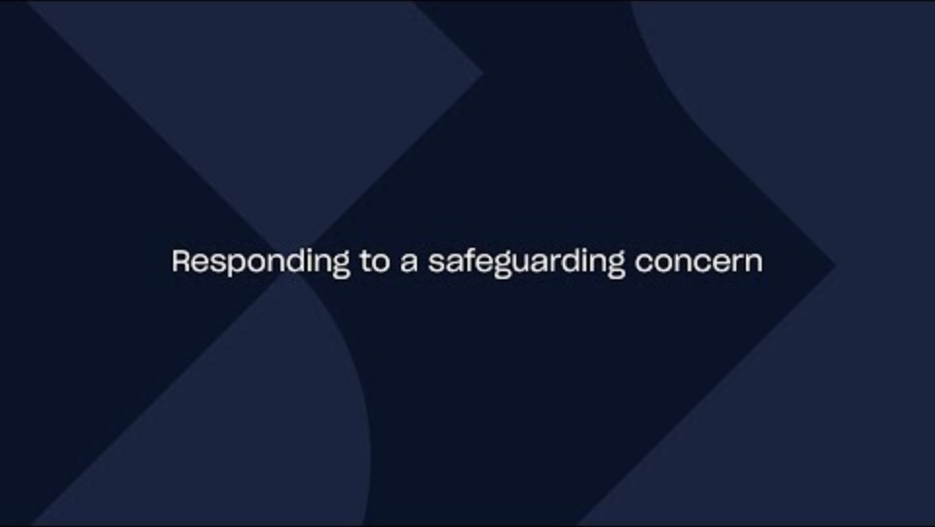
Notes:
Video content - when presenting the slide, click on the play icon to start the video (duration of 3:29). To enable captions, simply click on the ‘subtitles/closed captions’ icon that appears to the bottom right of the controls once the video begins to play.
This video will provide guidance on the steps to take when responding to, and reporting a safeguarding concern.
If you need the link to access the video, you can find it here: https://youtu.be/NuZ57CEk7-g

Slide 29
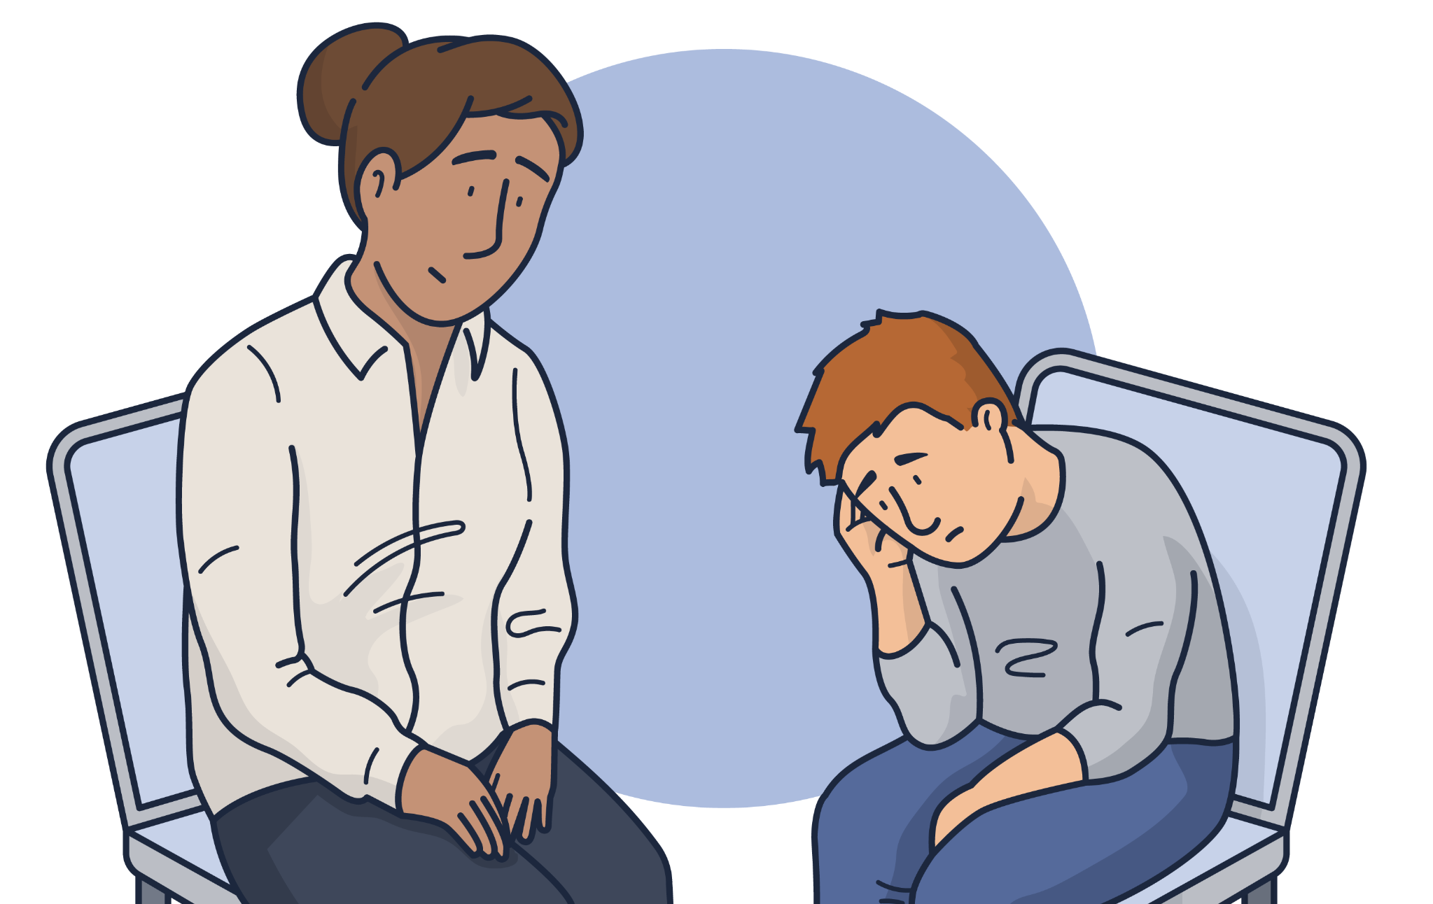
Responding to a disclosure
Do’s
Don'ts
✓ Remain calm and level-headed
✓ Reassure the child
✓ Listen carefully and actively
✓ Ask open-ended questions to clarify the
child’s version of events
✓ Let them know that you are taking what
they say seriously
✓ Tell them what will happen next
✓ Make a note of exactly what they
have told you as soon as possible
with dates and times
✓ Share the concern
following procedure
✘ Promise to keep secrets
✘ Rush the child’s account
✘ Ask leading questions or try to interview the child
✘ Make assumptions
✘ Show that you are upset
or angry
✘ Show disbelief or dismiss them
✘ Talk negatively about the potential abuser
Notes:
Explain to staff that your school should aim to create an effective culture of safeguarding where children feel able to share their concerns and where they know that they will be listened to and taken seriously.
Children - especially young children - may repeat or re-enact something that has happened to them.
It is important that you are aware of how a child might disclose information and be confident about what to do if they did.
Click to reveal the do’s.
Click to reveal the don’ts.

Slide 30

Discussion point
When recording a concern, what details should we make sure to include?
Notes:
Discussion point
Ask staff: When recording a concern, what details should we make sure to include?
Please note that you will move onto a slide which covers what information to record about a concern in more detail.

Slide 31

What information to record about a concern
The name, age, gender, religion and ethnicity of the child
Any contextual information you know about the child or their life
Details of the concern
The date and time of the incident or disclosure
Who was involved or present
at the time
Who said what: use their
exact words
Your name, role and contact details, as the person sharing the concern
Details of any immediate or agreed actions taken and whether or not a referral was made
Any conclusions that were drawn from the concern, incident or disclosure
If you are sharing with the DSL, they will also add details of their decision process
Notes:
What information to record about a concern
Here, you are going to list the relevant information you should include when recording a concern.
Click to reveal the first list on the left, and then click to reveal the remaining information on the right.
It may be worthwhile for you to also speak to staff about where to record the information and how to follow your school’s procedures e.g. CPOMS, MyConcern.

Slide 32

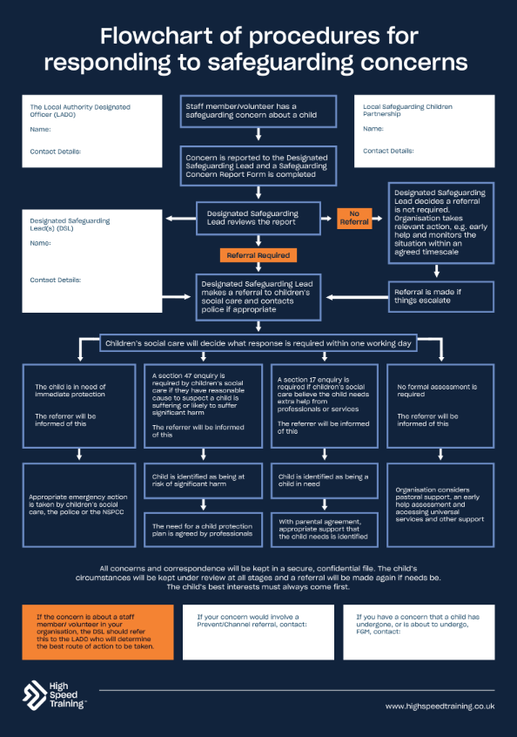
The procedure for responding to safeguarding concerns
Staff member/volunteer has a
safeguarding concern about a child
Concern is reported to the Designated
Safeguarding Lead and a Safeguarding
Concern Report Form is completed
Designated Safeguarding Lead decides a referral is not required. Organisation takes relevant action, e.g. early help and monitors the situation within an agreed timescale.
Designated Safeguarding Lead
reviews the report
No referral
Referral required
Designated Safeguarding Lead
makes a referral to children’s social care and contacts police if appropriate
Displaying a safeguarding flowchart helps to show what you should
do if you have a concern about a child, who you should report it to,
and the lines of enquiry and procedure that will be taken.
Notes:
Please note: you can download this editable safeguarding flowchart within your pack.
If a member of staff has any concerns about a child, or the child discloses information to them, then they should report concerns to the DSL straight away.
Explain to staff what happens when a member of staff reports a concern, reflecting on your school’s procedures. Make sure that staff feel confident in their understanding of the procedure and your role within it.
Sources of information:
https://www.highspeedtraining.co.uk/hub/safeguarding-flowchart/?utm_source=inset-pack-2025&utm_medium=inset-pack-2025&utm_campaign=inset-pack-2025
https://www.highspeedtraining.co.uk/hub/wp-content/uploads/2024/04/flowchart-procedures-for-responding-to-safeguarding-concerns.pdf?utm_source=inset-pack-2025&utm_medium=inset-pack-2025&utm_campaign=inset-pack-2025

Slide 33
Key takeaways
If you have any concerns about a child, or they disclose information to you, then you should report your concerns to the DSL as soon as possible.
Children who are more at risk of safeguarding concerns (e.g. children with SEND) may have difficulty disclosing.
Make sure that you are alert to the different ways in which a child might try to communicate abuse.
The most important thing to remember is never to ignore a concern. You do not have to be right or sure or have definitive evidence.
Notes:
Provide a summary of the section that you have just covered on how we should respond to, and report any concerns.
Offer the opportunity for staff to ask any questions that they may have following this section.

Slide 34
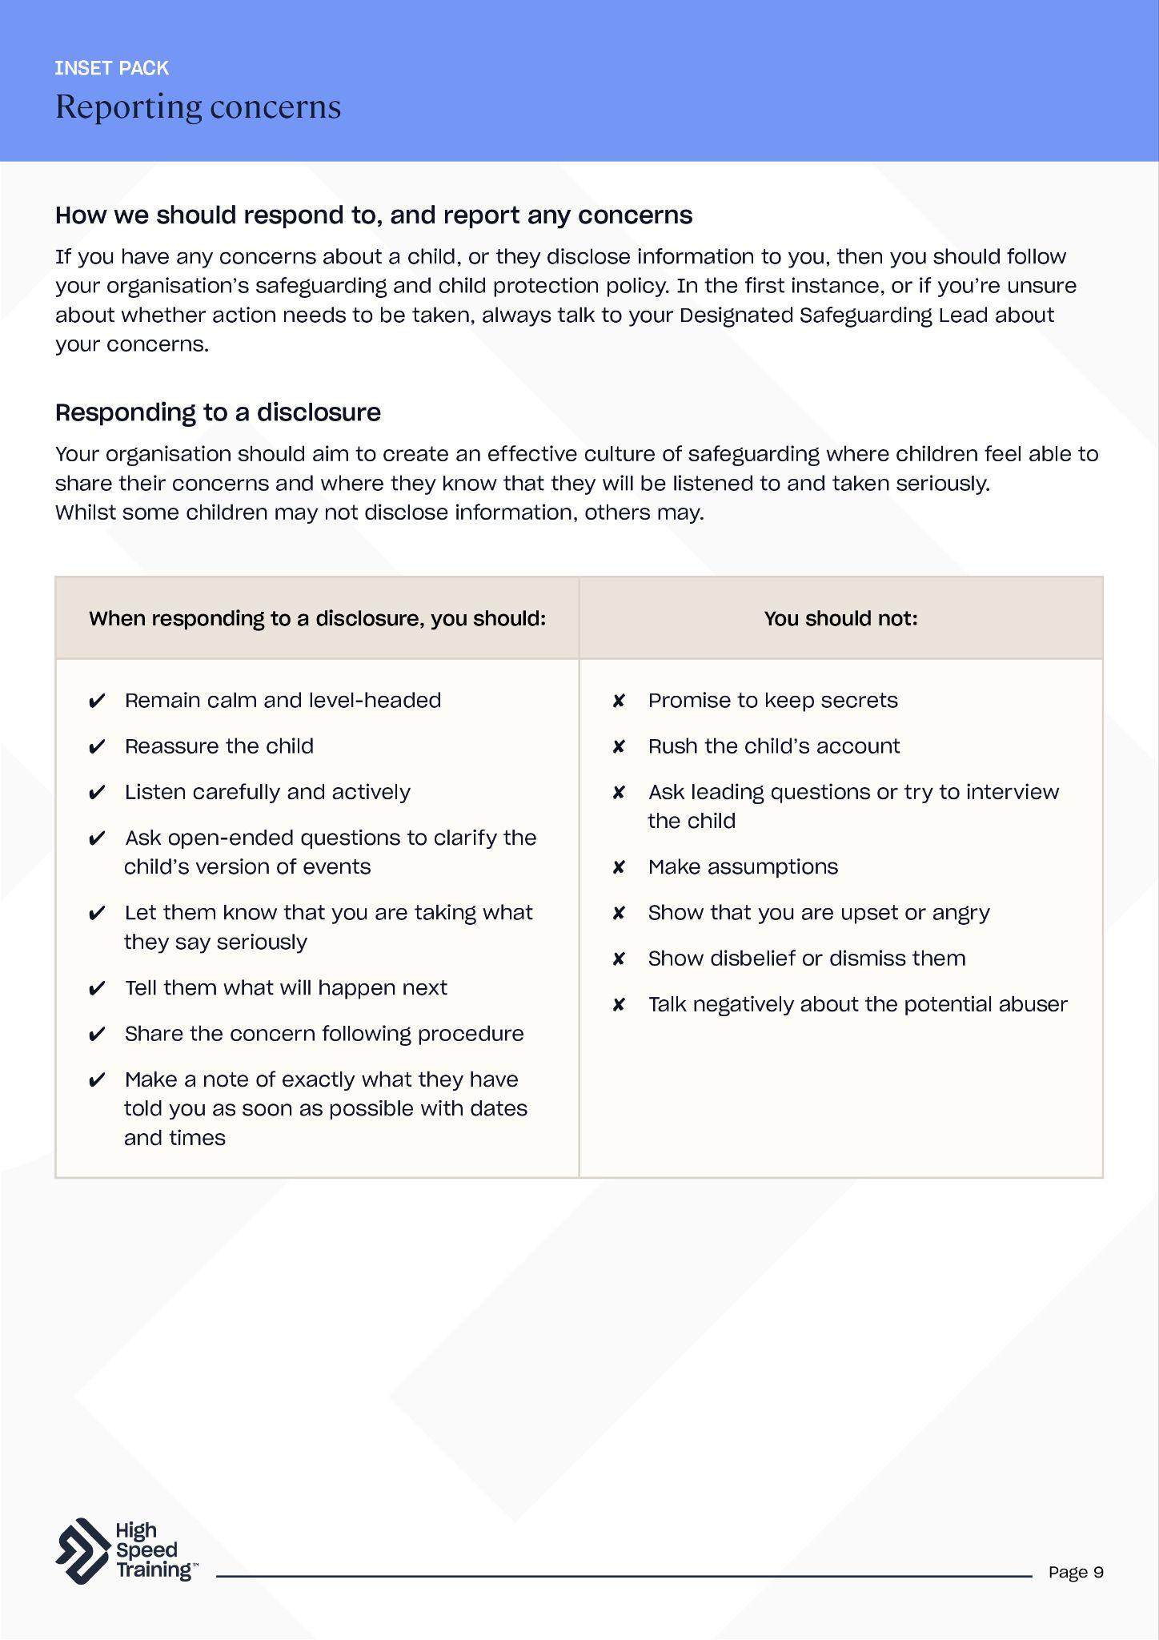
Further resources and support
If you’d like to learn more about the topics covered in this section, here are some useful resources:
Safeguarding flowchart (PDF)
Answering common questions about whistleblowing
Child protection body map template (PDF)
Understanding children missing education
Safeguarding scenarios and answers for education
Advanced safeguarding children training
Responding and reporting to concerns (PDF)
Notes:
If staff would like to find out more about topics covered in this section, advise them that they can visit the links as shown.
There’s a PDF summary of this section available for all staff included in the pack (you could send the summary sheets PDF to staff following the session).

Slide 35
Safeguarding issues
Write your school name here
4
Notes:
The fourth section of today’s session will focus on safeguarding issues.
You’ll cover a variety of specific safeguarding issues, including online safety, child-on-child abuse, radicalisation and extremism, mental health and domestic abuse.

Slide 36


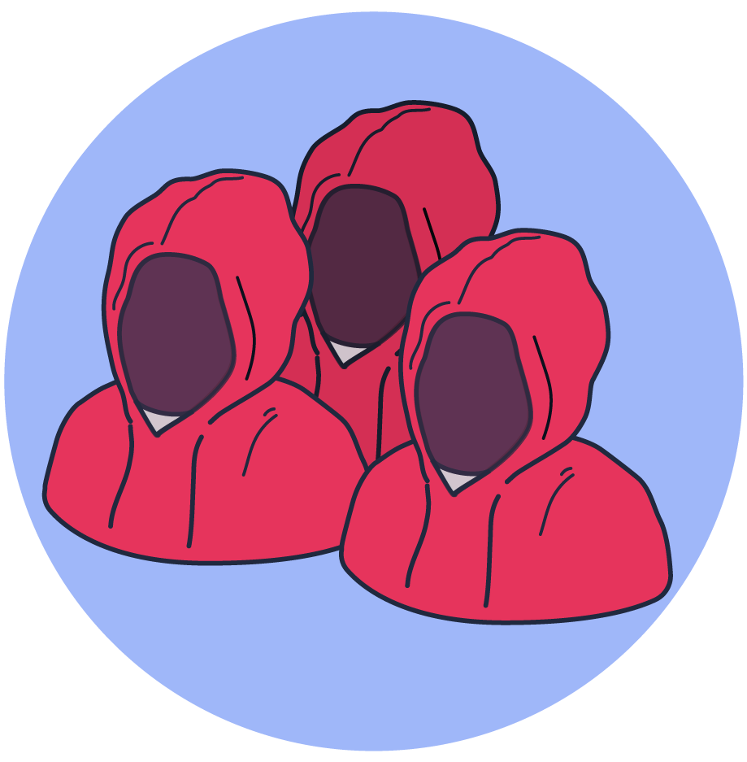

The four categories of online risks as defined by KCSIE:
ONLINE SAFETY
Content risks –
being exposed to illegal, inappropriate or
harmful content.
Conduct risks –
online behaviour that increases the likelihood of, or causes, harm.
Contact risks –
being subjected to harmful online interaction with
other users.
Commerce risks –
risks such as online gambling, inappropriate advertising, phishing and or financial scams.
Notes:
Online safety
Being online can bring huge benefits to children and young people, but it can also pose significant risks.
Click to reveal the four categories of online risks as defined by KCSIE.
You could encourage staff to say these aloud before you reveal them on screen.
This includes content, contact, conduct and commerce risks.
Please note that the 2025 edition of KCSIE has added ‘misinformation, disinformation (including fake news) and conspiracy theories’ as examples of content risks. The full text can be found below.
Content: being exposed to illegal, inappropriate, or harmful content, for example: pornography, racism, misogyny, self-harm, suicide, anti-Semitism, radicalisation, extremism, misinformation, disinformation (including fake news) and conspiracy theories.
Contact: being subjected to harmful online interaction with other users; for example: peer to peer pressure, commercial advertising and adults posing as children or young adults with the intention to groom or exploit them for sexual, criminal, financial or other purposes.
Conduct: online behaviour that increases the likelihood of, or causes, harm; for example, making, sending and receiving explicit images (e.g. consensual and non-consensual sharing of nudes and semi-nudes and/or pornography, sharing other explicit images and online bullying.
Commerce: risks such as online gambling, inappropriate advertising, phishing and or financial scams. If you feel your pupils, students or staff are at risk, please report it to the Anti-Phishing Working Group (https://apwg.org/).
All school staff should be aware that technology is a significant component in many safeguarding and wellbeing issues.
Sources of information:
https://www.gov.uk/government/publications/keeping-children-safe-in-education--2

Slide 37

Adults posing as children
Child-on-child abuse
Live chat
Artificial intelligence (AI)
Sending and receiving explicit images
Inappropriate language
Risks
Fake news
Grooming
Radicalisation and extremism
Cyberbullying
Financial scams
Sextortion
Notes:
Tell staff that you are now going to look at some of the risks associated with being online.
You could ask staff to think about what comes to their mind.
Click to reveal a variety of online safety risks.

Slide 38

Test your knowledge
Emojis and text abbreviations that might indicate a safeguarding risk
SDR
🐸
🔴 / 💊
💜
KYS
🔌
This stands for “kill yourself” and is used to make of fun of someone after they do something embarassing, or can be used as a form of harassment
The plug emoji can refer to
a drug dealer
Refers to the ‘red pill’ and a reference to the film The Matrix.
To have ‘taken the red pill’ means to have realised the ‘truth’ about women and society
The purple heart emoji can be used to show a message was sent in a flirtatious way, or that the sender
is horny
Send to receive
(in relation to explicit photographs)
The frog emoji can imply that you/they are ugly
Notes:
Test your knowledge
Emojis and text abbreviations are forming a fast-growing hidden language amongst young people - of which many adults are completely unaware.
This can bring a variety of complex safeguarding risks, so it is important that anyone who works with, or cares for, young people is aware of the potential hidden meanings of these messages.
Explain to staff that you are going to present a number of emojis and text abbreviations that might indicate a safeguarding risk.
Click to reveal the first emoji and take answers from staff on what they think this means. Then click to reveal the answer on screen. You should have a total of 6 emojis/abbreviations to reveal one at a time.
The emojis and abbreviations that you will cover include:
SDR - Send to receive (in relation to explicit photographs).
🐸 - The frog emoji can imply that you/they are ugly.
💜 - The purple heart emoji can be used to show a message was sent in a flirtatious way, or that the sender is horny.
KYS - This stands for “kill yourself” and is used to make of fun of someone after they do something embarassing, or can be used as a form of harassment.
🔌 - The plug emoji can refer to a drug dealer.
🔴 / 💊 - Refers to the ‘red pill’ and a reference to the film The Matrix. To have ‘taken the red pill’ means to have realised the ‘truth’ about women and society. You might’ve recently seen this mentioned in the Netflix series ‘Adolescence’.
We have produced a downloadable emoji guide, alongside an abbreviations download. It may be useful to provide these PDFs to staff.
Sources of information:
https://www.highspeedtraining.co.uk/hub/a-guide-to-emojis-and-texting-abbreviations/?utm_source=inset-pack-2025&utm_medium=inset-pack-2025&utm_campaign=inset-pack-2025

Slide 39
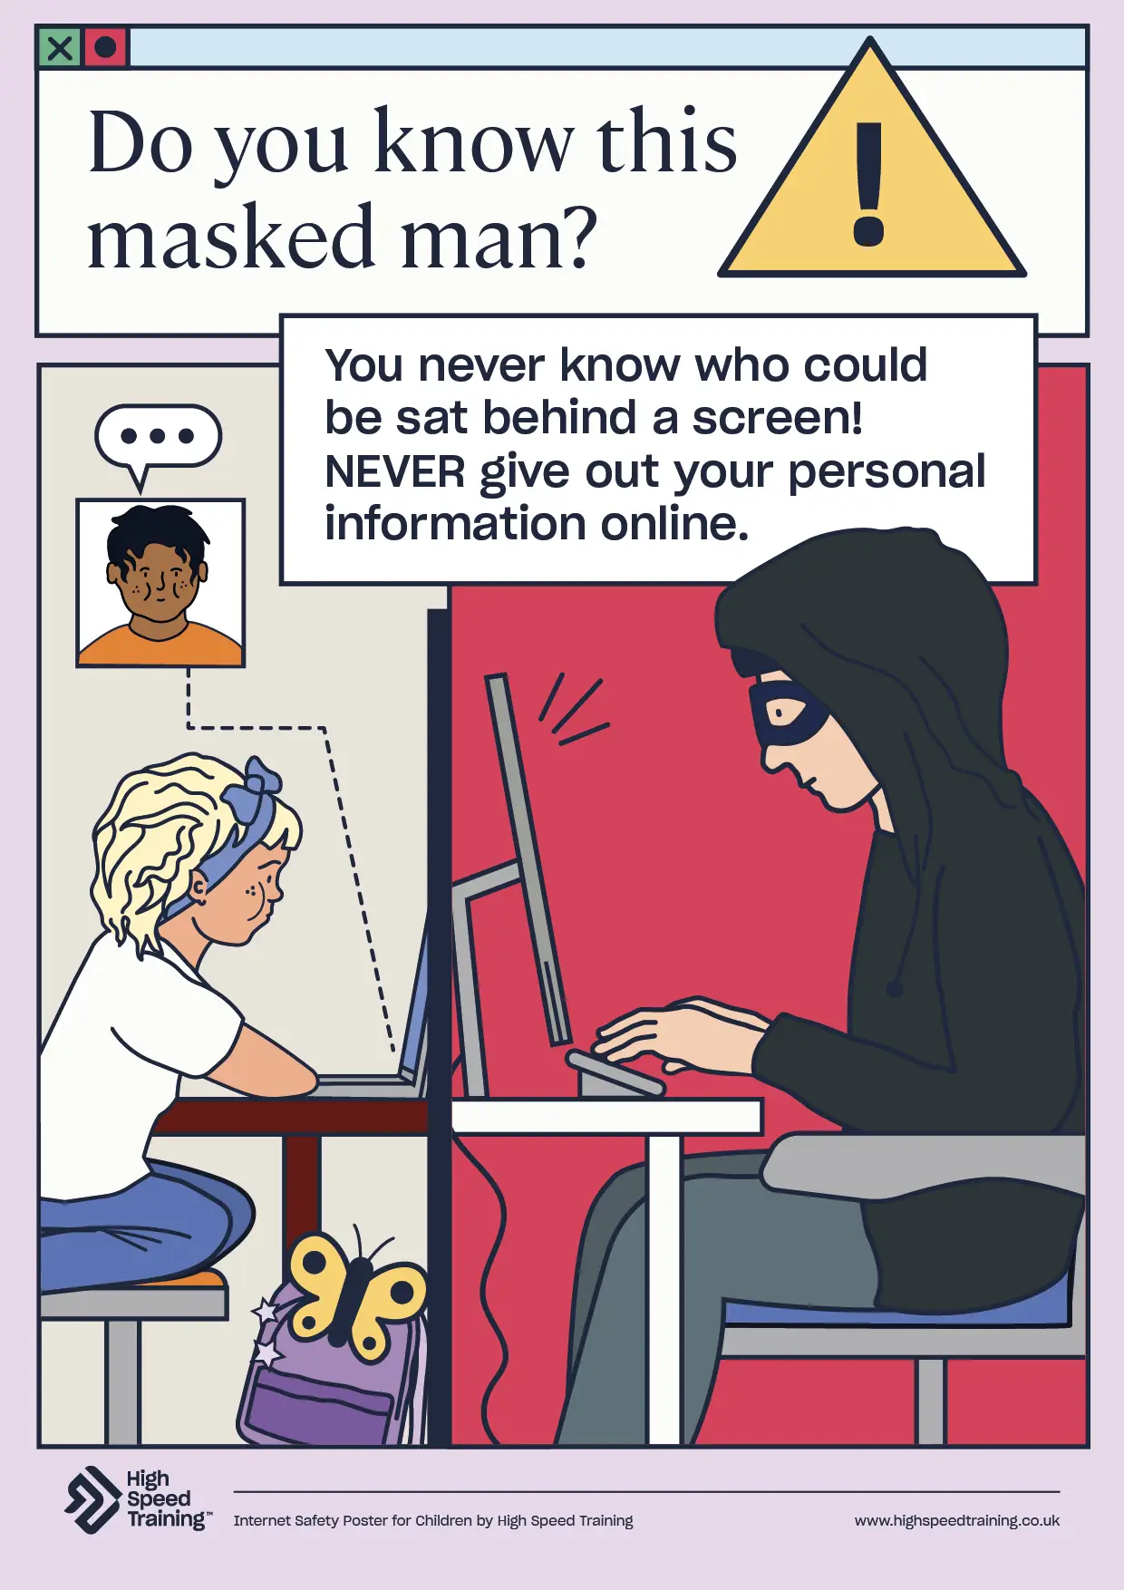



What actions can we take to help ensure online safety?
Build your awareness of the ‘hidden’ online language
Keep the conversation open and share online safety guidance
Understand our schools filtering and monitoring systems and procedures
Display, and reference, internet safety posters in the classroom
Notes:
Here, you are going to look at actions that you can take regarding online safety.
Some ideas might include:
Build your awareness of the ‘hidden’ online language
By recognising that emojis and text abbreviations can carry a hidden meaning, you are more likely to be able to spot communications that may be concerning. Access our downloadable emoji guide, alongside an abbreviations download.
Keep the conversation open and share online safety guidance
Make sure that children and young people are aware of the risks that come with online activity and know what to do if they are experiencing online harm. Work as a team to create a safe online culture in schools.
Understand our schools filtering and monitoring systems and procedures
Filtering and monitoring systems are an important part of safeguarding and are designed to protect students from harm when they use the internet at school. The ‘filtering’ part of ‘filtering and monitoring’ refers to the preventative measures taken to protect students from accessing inappropriate material online. The ‘monitoring’ part of ‘filtering and monitoring’ refers to the reactive measures taken to keep an eye on what students are accessing online. It may be useful to provide staff with a downloadable filtering and monitoring checklist to ensure that they fully understand their responsibilities.
Display, and reference, internet safety posters in the classroom
This can act as a constant reminder of online risks and how children can protect themselves from harm. You can find a set of internet safety posters for schools to download, print and display as you wish here.
Schools must follow the Keeping Children Safe in Education statutory guidance in order to safeguard children from online harms.
Sources of information:
https://www.highspeedtraining.co.uk/hub/internet-safety-posters-for-schools/?utm_source=inset-pack-2025&utm_medium=inset-pack-2025&utm_campaign=inset-pack-2025
https://www.highspeedtraining.co.uk/hub/a-guide-to-emojis-and-texting-abbreviations/?utm_source=inset-pack-2025&utm_medium=inset-pack-2025&utm_campaign=inset-pack-2025
https://www.highspeedtraining.co.uk/hub/filtering-and-monitoring-in-schools/?utm_source=inset-pack-2025&utm_medium=inset-pack-2025&utm_campaign=inset-pack-2025

Slide 40

Child-on-child abuse
All staff should be aware that children can abuse other children at any age, and that it can happen both inside and outside of school and online.
Sexual Violence and Sexual Harassment is a form of child-on-child abuse.
Examples of child-on-child abuse include:
Abuse in intimate personal relationships between children
Bullying, including cyberbullying
Coercive control
Emotional abuse
Physical abuse
Harmful sexual behaviour
Initiation, ‘hazing’ violence or rituals
Sexting and sextortion
‘Upskirting’
Sharing naked or semi-naked photos or videos without permission
Notes:
Child-on-child abuse
All staff should be aware that children can abuse other children at any age, and that it can happen both inside and outside of school and online.
Click to reveal some examples of child-on-child abuse.
Sources of information:
https://www.highspeedtraining.co.uk/hub/child-on-child-abuse/?utm_source=inset-pack-2025&utm_medium=inset-pack-2025&utm_campaign=inset-pack-2025

Slide 41

80% of girls of girls have been pressured to provide sexual images of themselves
92% of girls and 74% of boys have experienced sexual name calling
Some children are facing harmful sexual behaviours
so frequently that they consider them ‘normal’
80% of girls and 55% of boys have experienced unwanted or inappropriate comments of a sexual nature
79% of girls and 38% of boys
have experienced sexual assault
Notes:
Harmful Sexual Behaviour (HSB) can take the form of child-on-child sexual violence and/or sexual harassment - which can occur between two or more children of any age and gender.
The Ofsted Review of Sexual Abuse in Schools and Colleges uncovered that some children are facing harmful sexual behaviours so frequently that they consider them ‘normal’.
Click to reveal the statistics from the report:
92% of girls and 74% of boys have experienced sexual name calling
80% of girls and 55% of boys have experienced unwanted or inappropriate comments of a sexual nature
80% of girls of girls have been pressured to provide sexual images of themselves
79% of girls and 38% of boys have experienced sexual assault
The report also found that children and young people, especially girls, do not want to talk about sexual abuse for several reasons, even where their school encourages them to. For example, the risk of being ostracised by peers or getting peers into trouble is not considered to be worth it for something perceived by children and young people to be commonplace. They worry about how adults will react, because they think they will not be believed, or that they will be blamed. They also think that once they talk to an adult, the process will be out of their control. You can find the executive summary and recommendations from the report here.
Everyone’s Invited is a useful link to share with staff (a charity dedicated to exposing and eradicating rape culture with empathy, compassion and understanding). When Everyone’s Invited published their primary school list they also included a variety of testimonials. These testimonials included accounts from people who experienced sexual assault as young as 5. What stands out in a lot of these testimonials is how readily the behaviour was dismissed by teachers which subsequently led to more extreme assault in secondary school. Their purpose is to emphasise that rape culture exists everywhere, not to point a finger at selected primary schools.
Sources of information:
https://www.gov.uk/government/publications/review-of-sexual-abuse-in-schools-and-colleges/review-of-sexual-abuse-in-schools-and-colleges
https://www.everyonesinvited.uk/primary
https://www.theguardian.com/education/2021/jun/10/sexual-harassment-is-a-routine-part-of-life-schoolchildren-tell-ofsted

Slide 42




How can we prevent child-on-child abuse?
Be clear and consistent about what is considered unacceptable behaviour and language
Create an environment where children understand equality, consent and healthy relationships
Ensure that children feel safe and able to share their concerns about child-on-child abuse
It should never be ignored, accepted, dismissed or downplayed as “just having a laugh”, “part of growing up” or “boys being boys”
Notes:
Here, you are going to look at actions that you can take to prevent child-on-child abuse.
Some ideas might include:
Be clear and consistent about what is considered unacceptable behaviour and language.
Children and teachers both should recognise what is acceptable and what will trigger consequences. It should always be challenged and victims need to know that they will be taken seriously, supported and kept safe.
Create an environment where children understand equality, consent and healthy relationships.
Giving children and young people the right advice, teaching them healthy attitudes and behaviours, and training them to identify and deal with unhealthy relationships is vital.
Ensure that children feel safe and able to share their concerns about child-on-child abuse.
It is vital that children know that they won’t be judged and will be taken seriously.
It should never be ignored, accepted, dismissed or downplayed.
KCSIE guidance states that that child-on-child abuse should never be ignored, accepted, dismissed or downplayed as “just banter”, “just having a laugh”, “part of growing up” or “boys being boys.” This dismissal can lead to an unsafe environment for children and a culture that normalises abusive and unacceptable behaviour.
It’s important to practice contextual safeguarding and recognise that child-on-child abuse doesn’t only happen in supervised educational settings, but also at home and within the community.
Sources of information:
https://www.highspeedtraining.co.uk/hub/child-on-child-abuse/?utm_source=inset-pack-2025&utm_medium=inset-pack-2025&utm_campaign=inset-pack-2025
https://www.highspeedtraining.co.uk/hub/teaching-children-about-healthy-relationships/?utm_source=inset-pack-2025&utm_medium=inset-pack-2025&utm_campaign=inset-pack-2025

Slide 43
Radicalisation
and extremism
Local authority
582 (8%)
HMPSS¹
225 (3%)
Health
672 (10%)
Other²
435 (6%)
Radicalisation is the process by which someone comes to believe or support extremist ideologies. Recognising signs of radicalisation and extremism is part of your safeguarding duty.
Education
2,788 (40%)
Friends & family
143 (2%)
PREVENT REFERRALS
Police
1,921 (28%)
Community
156 (2%)
Extremist views can be political, religious or ideological.
Any concerns regarding radicalisation and extremism may result in a Prevent referral.
Source: Home Office, Individuals referred to and supported through the Prevent programme, England and Wales, April 2023 to March 2024, Table 2
Notes:
Radicalisation and extremism
Radicalisation is the process by which someone comes to believe or support extremist ideologies. These views can be political, religious or ideological.
Any concerns regarding radicalisation and extremism may result in a Prevent referral.
Click to reveal the table to the left of the screen which shows the sector of referral.
In the year ending 31 March 2024, there were 6,922 referrals to Prevent due to concerns that an individual was susceptible to radicalisation. This year, the Education sector made the most referrals (2,788; 40%), which is also the highest proportion for any source of referral since data was first published.
Sources of information:
https://www.gov.uk/government/statistics/individuals-referred-to-prevent-to-march-2024/individuals-referred-to-and-supported-through-the-prevent-programme-april-2023-to-march-2024

Slide 44

Seeming withdrawn, isolated or excluded
Appearing to make less effort at school
Experiencing family pressure or upheaval
Indicators of radicalisation
Showing signs of being influenced or controlled by a group or individual
Fixated on one new subject, such as immigration
Adopting speech that sounds scripted
Expressing a disregard for differing opinions
Changing their friendship groups
Lying to their family or other trusted adults
Drawing symbols linked to extremist ideologies
Notes:
Tell staff that you are now going to look at some of the indicators of radicalisation.
You could ask staff to think about what comes to their mind.
Click to reveal some examples of the indicators of radicalisation.

Slide 45

Misogynist and incel ideologies
Incel ideology includes elements of racial hatred, alongside the characteristic misogyny. It centres around the notion that incels are denied sexual and romantic relationships, and that women are to blame for this.
This promotes an extremist ideology, and presents a risk of radicalisation.
In a recent report, 60% of primary school teachers said that they were extremely concerned about the influence of online misogyny in their school.
Notes:
This slide will look at misogynist and incel ideologies.
Incel ideology includes elements of racial hatred, alongside the characteristic misogyny. It centres around the notion that incels are denied sexual and romantic relationships, and that women are to blame for this.
The University of York published a report in 2025 that explored the influence of misogyny in schools. They gathered data from 200 teachers, 100 of whom were based in secondary schools and 100 of whom were based in primary schools.
60% of primary school teachers reported that they were extremely concerned about the influence of online misogyny in their school.
This may be a good opportunity to ask staff if they are concerned about this influence.
When young pupils see sexist content online and then come to school to share and discuss it, they echo the same views and biases. If this is then left unchallenged, the attitude is normalised and female pupils are subjected to increasingly misogynistic behaviour. This contributes to the normalisation of rape culture.
In 2025 Stephen Graham released a series called Adolescence about a young boy who kills a young girl after being indoctrinated by incel propaganda online. The show has received acclaim for highlighting the insidious nature of misogyny and how easily young people can become swept up in violent misogynistic views. Off the back of the show, educators are calling for anti-misogyny lessons to be introduced in schools as well as for the series to be shown in schools to highlight to young people the dangers of incel/manosphere culture. The series highlights the need for a targeted approach to challenge misogyny in schools in order to change attitudes embedded in youth culture.
Sources of information:
https://journals.plos.org/plosone/article?id=10.1371/journal.pone.0299339
https://www.highspeedtraining.co.uk/hub/misogyny-in-schools/?utm_source=inset-pack-2025&utm_medium=inset-pack-2025&utm_campaign=inset-pack-2025
https://www.highspeedtraining.co.uk/hub/incel-culture-in-schools/?utm_source=inset-pack-2025&utm_medium=inset-pack-2025&utm_campaign=inset-pack-2025

Slide 46


Test your knowledge
Are you aware of the meaning behind any of the following signs, symbols, acronyms and phrases?
88 →
ORION →
88 → this stands for Heil Hitler,
where each 8 represents the letter H
(being the eighth letter of the alphabet)
ORION → Our Race is Our Nation
Chad →
Stacy →
Blue pill →
The following terms are used commonly in the incel community:
Chad → a man who is sexually attractive to women (an alpha)
Stacy → a sexually attractive woman, unintelligent and promiscuous
Blue pill → people who incels see as being unaware of the ‘truth’
The following are in relation to extreme right-wing ideologies:
You may see these in the form of graffiti, doodles in books, badges or stickers.
Notes:
Test your knowledge
Explain to staff that you are going to test their knowledge of some signs, symbols, acronyms and phrases that may indicate affiliation with an extremist ideology.
Click to reveal that the first terms are in relation to extreme right-wing ideologies. Click to reveal two terms and ask staff whether they are aware of the meanings. Both of the following answers will be revealed on screen once you click to reveal.
88 - this stands for Heil Hitler, where each 8 represents the letter H (being the eighth letter of the alphabet)
ORION - Our Race is Our Nation
Click to reveal that the next set of terms are used commonly in the incel community. Click to reveal three terms and ask staff whether they are aware of the meanings. All of the following answers will be revealed on screen once you click to reveal.
Chad - a man who is sexually attractive to women (an alpha)
Stacy - a sexually attractive woman, unintelligent and promiscuous.
Blue pill - people who incels see as being unaware of the ‘truth’.
You may see these in the form of graffiti, doodles in books, tattoos, stickers or badges.

Slide 47




How can schools prevent radicalisation and extremism?
A whole-school, zero tolerance approach to raise standards and set expectations
Develop pupils critical thinking, media literacy and resilience skills
Promoting British values should be embedded throughout the school curriculum and at every stage of education
Make sure that you understand your
Prevent duty
Notes:
Here, you are going to look at actions that you can take to prevent radicalisation and extremism.
Some ideas might include:
A whole-school, zero tolerance approach to raise standards and set expectations.
By implementing a whole school, zero tolerance policy you can raise standards across the entire school and set the expectation from a young age that extremist views will not be tolerated.
Develop pupils critical thinking, media literacy and resilience skills.
When taught in schools, critical thinking can provide a student with life long transferable skills that can help them to identify extremist content and misinformation before it causes harm. By developing children’s media literacy skills, you are better enabling them to both recognise, and respond to, online risk and harm.
Promoting British values should be embedded throughout the school curriculum and at every stage of education.
Part of the Prevent duty involves schools and further education providers promoting British values as part of their curriculum and as part of their everyday culture. You should have a clear strategy for promoting these values in your work, as well as methods of showing how this strategy has been effective (for example, through lesson plans or pupil voice).
Make sure that you understand your Prevent duty.
The Prevent duty requires all education providers ‘to help prevent the risk of people becoming terrorists or supporting terrorism’. This includes safeguarding learners from extremist ideologies and radicalisation. Providers should consider radicalisation concerns in line with their existing safeguarding processes, skills and experience. All staff should look out for concerning changes in behaviour and report them to the DSL.
Sources of information:
https://www.highspeedtraining.co.uk/hub/british-values-lesson-plan/?utm_source=inset-pack-2025&utm_medium=inset-pack-2025&utm_campaign=inset-pack-2025
https://www.highspeedtraining.co.uk/hub/misogyny-in-schools/?utm_source=inset-pack-2025&utm_medium=inset-pack-2025&utm_campaign=inset-pack-2025
https://www.highspeedtraining.co.uk/hub/critical-thinking-in-schools/?utm_source=inset-pack-2025&utm_medium=inset-pack-2025&utm_campaign=inset-pack-2025
https://www.highspeedtraining.co.uk/hub/what-is-media-literacy/?utm_source=inset-pack-2025&utm_medium=inset-pack-2025&utm_campaign=inset-pack-2025
https://www.gov.uk/government/publications/the-prevent-duty-safeguarding-learners-vulnerable-to-radicalisation/the-prevent-duty-an-introduction-for-those-with-safeguarding-responsibilities

Slide 48
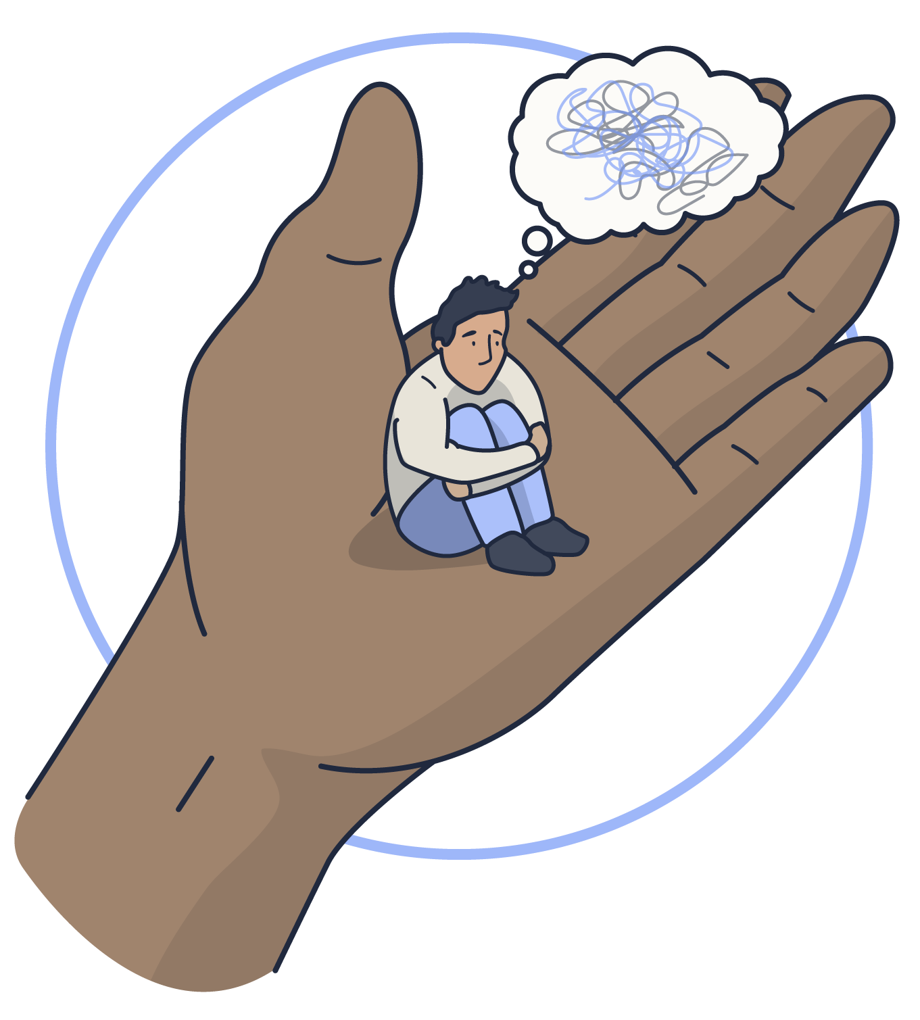
More than 1 in 10 primary school children aged 5 to 10 has an identifiable mental health condition – that’s around three children in every class.
Mental health
Can we think of any ways to help promote positive mental health in our school?
Let’s consider classroom activities, awareness days, and scenarios that we can learn from.
Notes:
Mental health
Young people’s mental health is something we all must take seriously.
School staff have a responsibility to promote positive mental health. Often, even small changes can go a long way in helping somebody feel better.
Click to reveal the statistic that more than 1 in 10 primary school children aged 5 to 10 has an identifiable mental health condition – that’s around three children in every class.
Click to reveal a discussion point and ask staff: How do you feel about our efforts to promote positive mental health in this school? You could consider classroom activities, awareness days, and scenarios.
Sources of information:
https://www.mentallyhealthyschools.org.uk/getting-started/whats-mental-health/
https://www.highspeedtraining.co.uk/hub/promoting-mental-health-in-schools/?utm_source=inset-pack-2025&utm_medium=inset-pack-2025&utm_campaign=inset-pack-2025

Slide 49
Destructive behaviour
Changes in eating habits
Having educational difficulties
Withdrawal and lack of enthusiasm for things previously enjoyed
Signs to look out for
Tiredness and stress
Heightened emotions, such as excessive crying or hyperactivity
All staff should be aware that mental health problems can, in some cases,
be an indicator that a child has suffered or is at risk of suffering abuse, neglect or exploitation.
Lack of confidence
Notes:
Tell staff that you are now going to look at some signs to look out for that may indicate a mental health issue.
You could ask staff to think about what comes to their mind.
Click to reveal a number of signs that you should look out for regarding mental health.

Slide 50

Primary school pupils should know:
That mental wellbeing is a normal part of daily life, in the same way as physical health.
How to recognise and talk about their emotions, including having a varied vocabulary of words to use when talking about feelings.
How to judge whether what they are feeling and how they are behaving is appropriate and proportionate.
The benefits of physical exercise, time outdoors, community participation and voluntary and service-based activity on mental wellbeing.
Simple self-care techniques, including the importance of rest, time spent with friends and family, and the benefits of hobbies.
That bullying has a negative and often lasting impact on mental wellbeing.
Where and how to seek support.
It is common for people to experience mental ill-health.
Notes:
The statutory guidance for relationships education, relationships and sex education (RSE) and health education covers what needs to be taught in schools. You can access the full guidance here.
Pupils should know:
that mental wellbeing is a normal part of daily life, in the same way as physical health.
that there is a normal range of emotions (e.g. happiness, sadness, anger, fear, surprise, nervousness) and scale of emotions that all humans experience in relation to different experiences and situations.
how to recognise and talk about their emotions, including having a varied vocabulary of words to use when talking about their own and others’ feelings.
how to judge whether what they are feeling and how they are behaving is appropriate and proportionate.
the benefits of physical exercise, time outdoors, community participation, voluntary and service-based activity on mental wellbeing and happiness.
simple self-care techniques, including the importance of rest, time spent with friends and family and the benefits of hobbies and interests.
isolation and loneliness can affect children and that it is very important for children to discuss their feelings with an adult and seek support.
that bullying (including cyberbullying) has a negative and often lasting impact on mental wellbeing.
where and how to seek support (including recognising the triggers for seeking support), including whom in school they should speak to if they are worried about their own or someone else’s mental wellbeing or ability to control their emotions (including issues arising online).
it is common for people to experience mental ill health. For many people who do, the problems can be resolved if the right support is made available, especially if accessed early enough.
Sources of information:
https://assets.publishing.service.gov.uk/media/62cea352e90e071e789ea9bf/Relationships_Education_RSE_and_Health_Education.pdf

Slide 51



How can we support positive mental health?
Make mental health known
Have an open-door policy and ensure your pupils know you’re always there
to listen
Work with parents, remembering that the needs of the child should be considered
as the priority
Stay involved in the child’s progress
and recovery
Notes:
Here, you are going to look at actions that you can take to support positive mental health.
Some ideas might include:
Make mental health known
Discuss it in lessons, address it in assemblies, and celebrate awareness days, like world mental health day, to let students know they’re not alone.
Have an open-door policy and ensure your pupils know you’re always there to listen
Talking to the child or young person is often the first step in helping them. In doing so, you can discover what's troubling them and what you can do to help. You could even appoint a designated teacher for each year group who can support any students struggling.
Work with parents, remembering that the needs of the child should be considered as the priority
Remember that mental health is a sensitive subject. Parents may have their own struggles with mental health. The child's privacy and trust is important and they should be confided in if their difficulties are being discussed. There may be some circumstances where they do not want their family to be involved.
Stay involved in the child’s progress and recovery
Continue to talk to the child (or encourage them to talk to their assigned mental health professional) and ask them how they're doing. It is extremely important that the child knows they have someone looking out for them.
Sources of information:
https://www.highspeedtraining.co.uk/hub/promoting-mental-health-in-schools/?utm_source=inset-pack-2025&utm_medium=inset-pack-2025&utm_campaign=inset-pack-2025
https://www.highspeedtraining.co.uk/hub/mental-health-resources-for-schools/?utm_source=inset-pack-2025&utm_medium=inset-pack-2025&utm_campaign=inset-pack-2025

Slide 52
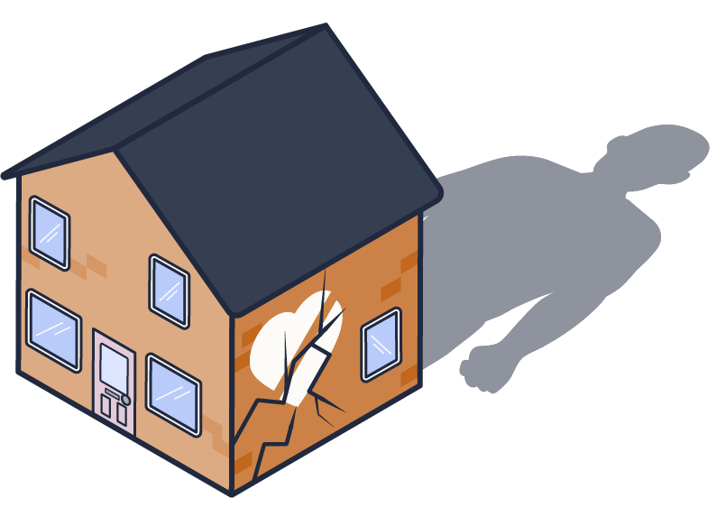
The NSPCC has reported a record number of calls to their helpline concerning children at risk of domestic abuse.
Domestic abuse
In the last year, they have received 7,825 calls from adults whose main concern was about children experiencing domestic abuse.
7,825
21 adults daily
That’s an average of 21 adults reaching out to the helpline every day with concerns about domestic abuse.
Notes:
Domestic abuse
Domestic abuse refers to the abuse that a person suffers in a domestic setting from a partner, spouse or family member. It refers to any type of controlling, coercive, threatening behaviour, violence or abuse.
Anyone can be subjected to domestic abuse regardless of their age, gender or sexuality.
Domestic abuse contacts to the NSPCC helpline have reached a record high.
Click to reveal that last year, the NSPCC responded to 7,825 contacts from adults whose main concern was about children experiencing domestic abuse. This is a 14% rise from 2023/24 and the highest annual total since they began recording domestic abuse as a main concern in 2021/22.
That’s an average of 21 adults reaching out to the helpline every day with concerns about domestic abuse.
Sources of information:
https://www.highspeedtraining.co.uk/hub/domestic-abuse-in-children/?utm_source=inset-pack-2025&utm_medium=inset-pack-2025&utm_campaign=inset-pack-2025
https://www.nspcc.org.uk/about-us/news-opinion/2025/Domestic-abuse-contacts-to-our-Helpline-reach-record-high/

Slide 53

Test your knowledge
Discuss whether the following statements are true or false
Witnessing domestic abuse is child abuse.
Domestic abuse is primarily an issue in low-income or disadvantaged households.
It is not legally defined as domestic abuse if a child younger than 16 is a victim of domestic abuse from their partner.
Once the abusive parent leaves the home, the child will
be fine.
TRUE
Regardless of whether a child is being harmed themselves, domestic abuse always has an impact on children.
The Domestic Abuse Act 2021 recognises that children are victims of domestic abuse if they see, hear or experience the effects of domestic abuse.
FALSE
The reality is that domestic abuse can occur in any relationship, affecting individuals across all socioeconomic backgrounds. We shouldn’t assume that this is only an issue in low-income or disadvantaged households.
TRUE
Children over the age of 16 may be victims of domestic abuse in their relationships. Children younger than 16 may also be victims of abuse from their partner but it is not legally defined as domestic abuse. It is sometimes referred to as teenage relationship abuse.
FALSE
It’s important to remember that the effects of experiencing domestic abuse can often last into adulthood.
Notes:
Test your knowledge
Explain to staff that you are going to present a number of statements and ask them to decide whether true or false.
Click to reveal the first statement and ask staff whether they believe this to be true or false. Then click to reveal the answer.
The statements that you will cover include:
Witnessing domestic abuse is child abuse.
TRUE - Regardless of whether a child is being harmed themselves, domestic abuse always has an impact on children. The Domestic Abuse Act 2021 recognises that children are victims of domestic abuse if they see, hear or experience the effects of domestic abuse.
Domestic abuse is primarily an issue in low-income or disadvantaged households.
FALSE - The reality is that domestic abuse can occur in any relationship, affecting individuals across all socioeconomic backgrounds. We shouldn’t assume that this is only an issue in low-income or disadvantaged households.
It is not legally defined as domestic abuse if a child younger than 16 is a victim of domestic abuse from their partner.
TRUE - Children over the age of 16 may be victims of domestic abuse in their relationships. Children younger than 16 may also be victims of abuse from their partner but it is not legally defined as domestic abuse. It is sometimes referred to as teenage relationship abuse.
Once the abusive parent leaves the home, the child will be fine.
FALSE - It’s important to remember that the effects of experiencing domestic abuse can often last into adulthood.

Slide 54

It can be an isolated event or a pattern of incidents
Signs that a child is being exposed to domestic abuse can include:
Bullying other children
Replicating or replaying what they see at home in school or clubs
Being easily startled
Nightmares or insomnia
Frequent sickness and/or truancy
Becoming aggressive or having violent outbursts
Difficulty communicating feelings and needs
Anxious about being away from home because they have to ‘protect’ their parent who is the victim of domestic abuse
Notes:
It can be an isolated event or a pattern of incidents.
Click to reveal some of the signs that a child is being exposed to domestic abuse.
Greater collective vigilance should ensure the relevant authorities are involved more quickly when a child is at risk.
It may also be worth mentioning Operation Encompass to staff. This is an initiative that connects the police with schools via the LA to ensure better outcomes for children who are subject or witness to police-attended incidents of domestic abuse.
Sources of information:
https://www.barnardos.org.uk/get-support/support-for-parents-and-carers/child-abuse-and-harm/children-affected-domestic-abuse-violence

Slide 55




How can we support a child who is being exposed to domestic abuse?
Create a safe and supportive environment
Teach children what a healthy relationship looks like
Seek advice from professionals and colleagues
Maintain an
ongoing relationship
Notes:
Here, you are going to look at how you can support a child who is being exposed to domestic abuse.
Some ideas might include:
Create a safe and supportive environment
Children and young people are more likely to share concerns about their home life in a safe environment. Providing a safe space will embolden them to share what they are witnessing and reach out for help.
Teach children what a healthy relationship looks like
If children are exposed to domestic abuse at home they may not realise that this behaviour is in fact abuse as it has been normalised throughout their childhood. Teaching children and young people what a healthy relationship looks like will help them to recognise signs of abuse in their own relationships and seek help before the situation escalates.
Seek advice from professionals and colleagues
Share any concerns that you have with colleagues and anyone else who comes into contact with the child. They may be able to provide further insight or they may share similar concerns. You can also seek advice from professionals such as the NSPCC or Barnardos.
Maintain an ongoing relationship
If a child has disclosed that they are being exposed to domestic abuse then you must ensure you maintain open communication with that child. This enables you to monitor the situation and assess whether it is escalating or placing the child in immediate danger. It also ensures that the child feels like they have an adult they can trust and turn to.
Sources of information:
https://www.highspeedtraining.co.uk/hub/domestic-abuse-in-children/?utm_source=inset-pack-2025&utm_medium=inset-pack-2025&utm_campaign=inset-pack-2025

Slide 56
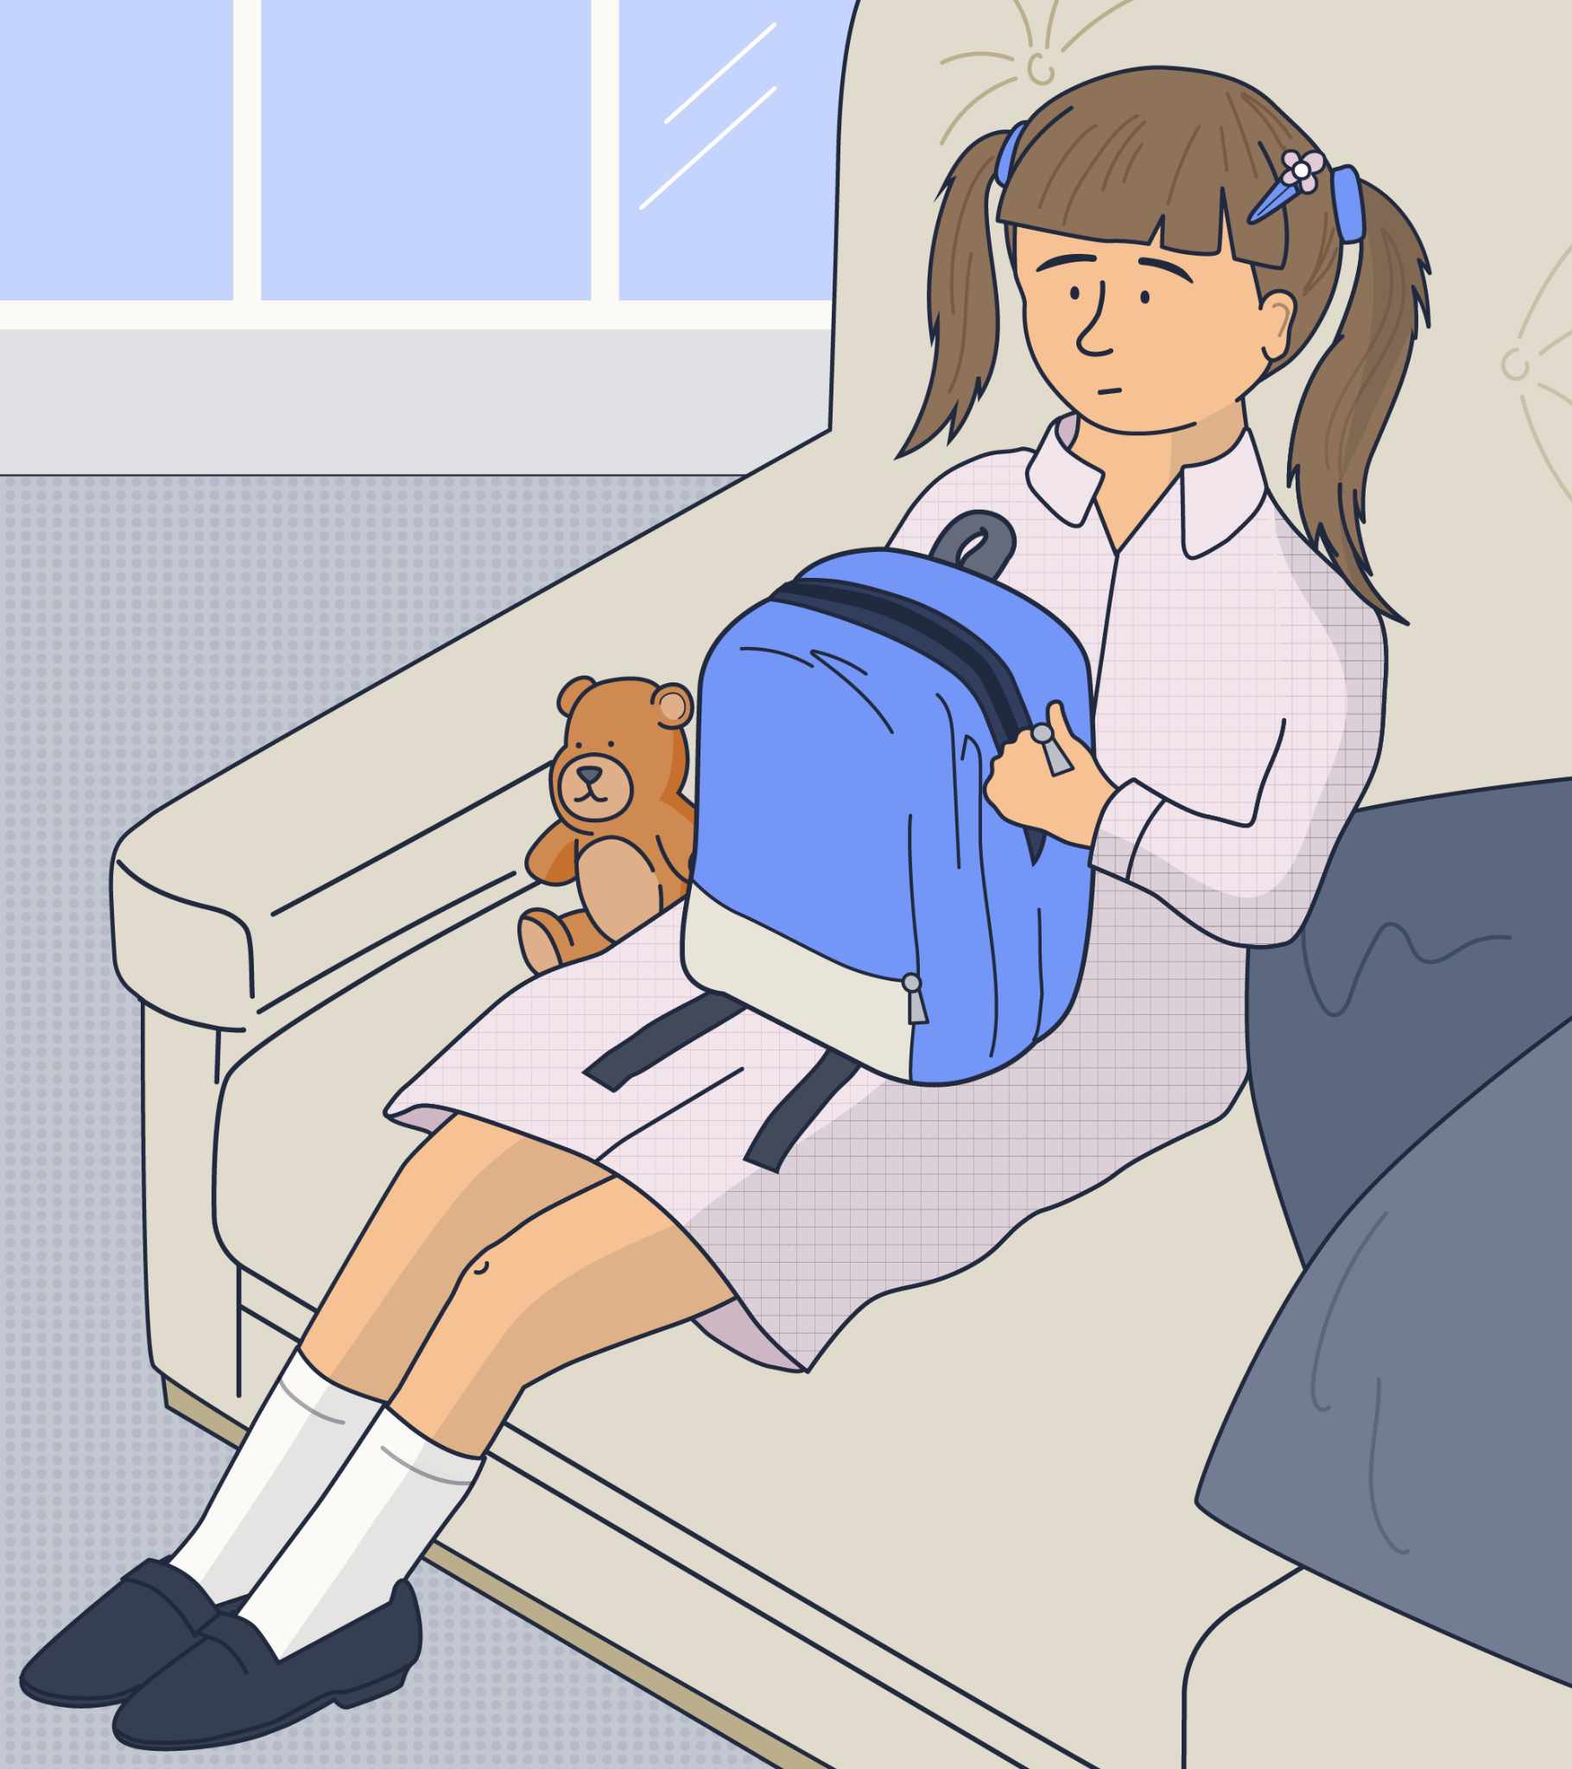
Tamara, aged 9
Tamara is autistic and thrives on clear routines and positive reinforcement, particularly in the form of tangible rewards like stickers and stamps. Members of staff like to use these to praise her for good work.
Lately, however, Tamara has become increasingly reluctant to receive stickers in the classroom. Her usual enthusiastic “thank you” has been replaced by a quiet mumbled acknowledgement.
During this afternoon’s class activity where the teacher was distributing stickers for effort, a small group of children at the back of the class were heard snickering. One pupil loudly whispered “Look, Maya’s getting another sticker!”, and another added,
“Only babies get stickers!”.
SCENARIO A
Notes:
Safeguarding scenario
Explain to staff that you are now going to look at two safeguarding scenarios.
Click to present Scenario A (Tamara, aged 9).
Ask staff to discuss the scenario. Do they feel that it constitutes a safeguarding issue? If so, what action might they take?

Slide 57


Leo, aged 7
Leo used to love coming into school, but lately you have noticed that he clings to his Mum when she drops him off in the morning and pleads with her to stay.
During lessons and at break time, there have been a number of incidents where Leo, seemingly unprovoked, has become intensely aggressive towards other children. An example of this is when he grabbed a child’s arm forcefully, pushing him to the ground and shouting “You listen to me!”. The teacher on lunchtime duty said that once she intervened, Leo was tearful but couldn’t explain his behaviour. His only comment was that “It’s not fair”.
SCENARIO B
Notes:
Safeguarding scenario
Click to present Scenario B to staff (Leo, aged 7).
Ask staff to discuss the scenario. Do they feel that it constitutes a safeguarding issue? If so, what action might they take?

Slide 58

Reflection point
Considering these safeguarding issues, where do you feel most confident and where might we need to strengthen our understanding?
Adultification
Attendance
Child-on-child abuse
Children missing education
Child criminal exploitation (CCE)
Child sexual exploitation (CSE)
Child trafficking and modern day slavery
County lines
Domestic abuse
FGM, forced marriage and honour-based abuse
Grooming
Harmful sexual behaviour
Online safety
Mental health and wellbeing
Radicalisation and extremism
Notes:
Reflection point
Ask staff to reflect: Considering these safeguarding issues, where do you feel most confident and where might we need to strengthen our understanding?
There will be an opportunity to speak about areas for continued professional development later in the session, so you could advise staff to make a note of any particular issues that stand out to them which they can discuss towards the end. It might be that staff feel they need further guidance on issues that have not been presented in today’s session (we have highlighted a wide range of safeguarding issues on the slide).

Slide 59
Key takeaways
There are many different types of maltreatment that a child might experience. Many of these overlap and
are interrelated.
By being aware of different types of maltreatment and the possible indicators, you are in a better position to recognise concerns.
If you would like to increase your understanding of any specific safeguarding issues, please speak to a member of our safeguarding team.
Notes:
Provide a summary of the section that you have just covered on safeguarding issues.
Offer the opportunity for staff to ask any questions that they may have following this section.

Slide 60
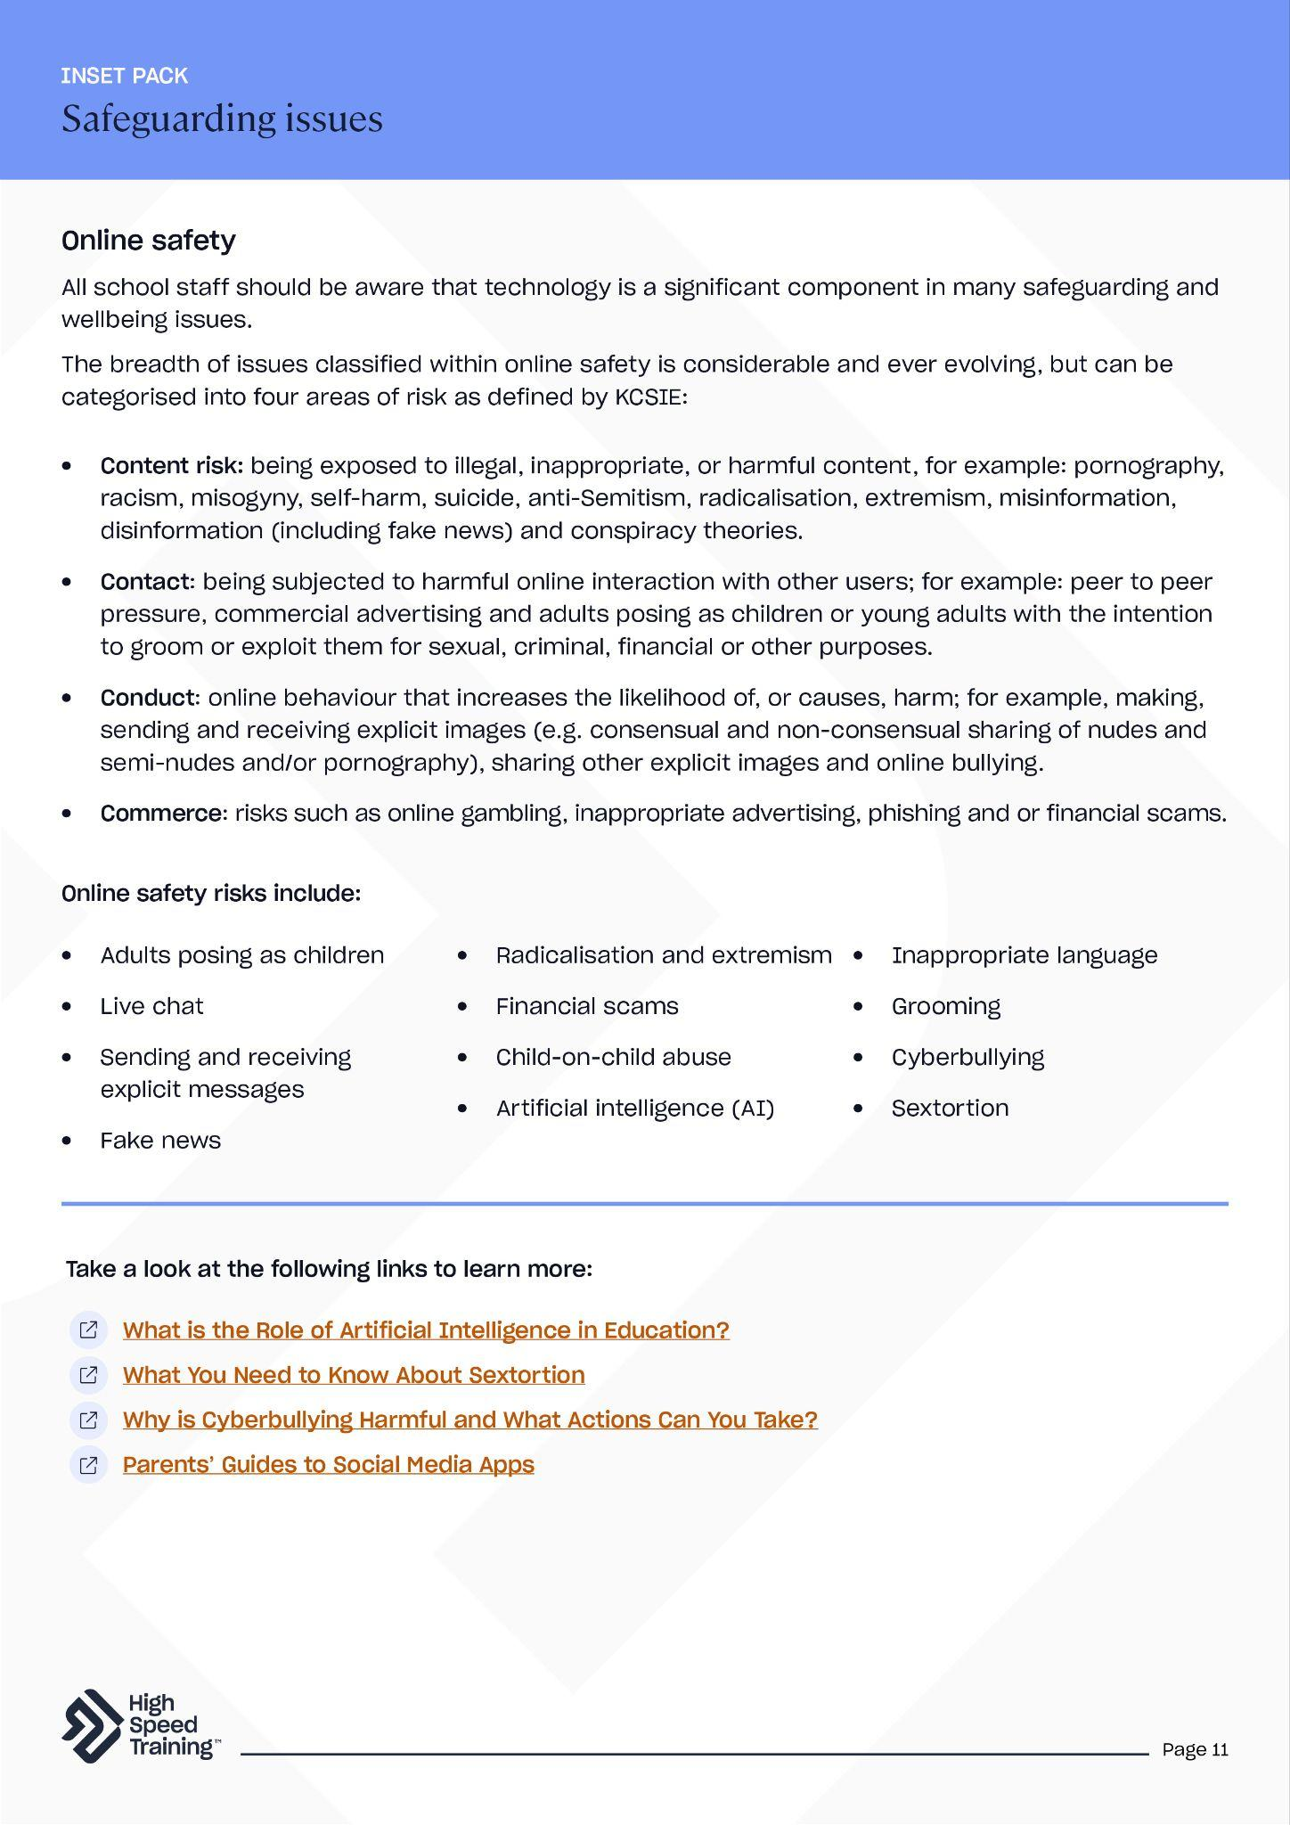
Further resources and support
If you’d like to learn more about the topics covered in this section, here are some useful resources:
What you need to know about child-on-child abuse
Guidance on filtering
and monitoring
How to tackle incel culture in schools
Understanding the impact of domestic
abuse in children
A guide to emojis and texting abbreviations (PDF)
Internet safety posters for your classroom (PDF)
Prevent duty course
What you need to
know about sextortion
Online safety and
harms course
Guidance on
misogyny in schools
How to support
SEMH in schools
Child mental
health course
Safeguarding issues
(PDF)
Notes:
If staff would like to find out more about topics covered in this section, advise them that they can visit the links as shown.
There’s a PDF summary of this section available for all staff included in the pack.

Slide 61
Creating and maintaining an
effective safeguarding culture
Write your school name here
5
Notes:
The fourth section of today’s session will focus on safeguarding culture.
You’ll cover the ways in which you can create and maintain an effective safeguarding culture.

Slide 62
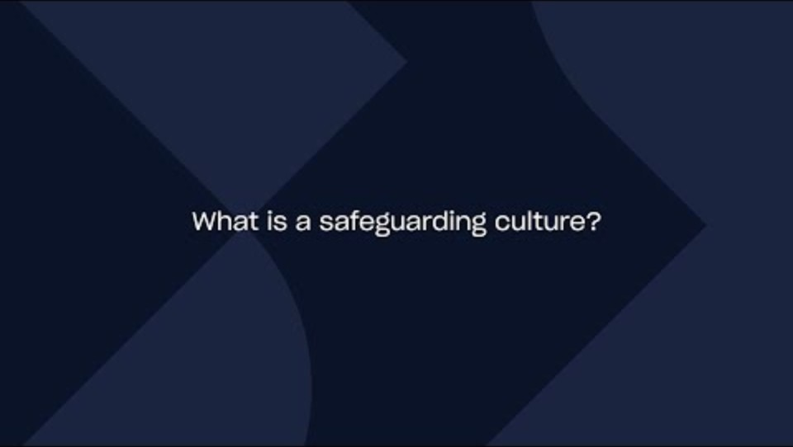
Notes:
Video content - when presenting the slide, click on the play icon to start the video (duration of 3:41). To enable captions, simply click on the ‘subtitles/closed captions’ icon that appears to the bottom right of the controls once the video begins to play.
This video will explore what a safeguarding culture is and why is it important in your school.
If you need the link to access the video, you can find it here: https://youtu.be/LA-wQE2U8Jg

Slide 63

Discussion point
How confident do you feel in the culture of safeguarding at our school?
Notes:
Discussion point
A safeguarding culture means that safeguarding is key to every aspect of a setting. It can be found at the heart of a schools’ values and ethos, and is subsequently reflected in its environments and practices.
Ask staff: How confident do you feel in the culture of safeguarding at our school?
Allow time for discussion and then take some of the answers to summarise thoughts from the group.

Slide 64
How do we create and maintain a culture of safeguarding?
Vigilance
Policies and procedures
Communication and effective relationships
Training
Continuous learning
Pupil voice
Contextual safeguarding
Professional curiosity
Notes:
Please note: We have included 8 points in this slide which will appear on click.
Vigilance
An effective safeguarding culture should be one of vigilance, and the cornerstone of vigilance is accepting that issues can occur in your setting. Whilst uncomfortable, appreciating the fact that you will be working with some children who are experiencing abuse, neglect or other safeguarding issues, means that your levels of vigilance will be higher.
Policies and procedures
It is essential that all policies and procedures are clearly understood, accessible and communicated effectively.
Communication and effective relationships
Clear lines of communication help to make sure all members of the school community are aware of safeguarding expectations, issues, policies and procedures – including how to raise concerns and access help. This includes relationships with pupils, staff, parents or carers, and other agencies or professionals.
Training
High quality, regular safeguarding training for all staff is essential. Revisiting your safeguarding knowledge is an important part of your continued professional development.
Professional curiosity
Showing professional curiosity means actively looking to understand a child’s full circumstances, maintaining an open mind, engaging with children and their families and proactively asking questions, seeking help and challenging decisions.
Contextual safeguarding
Contextual safeguarding is an approach to safeguarding that recognises that young people may be at risk of significant harm not only within their home environment, but also outside it. Create a safe space for young people to talk to you about their experiences. What they tell you about their community and the context that they are growing up in could help you to spot concerns that you may not have been aware of otherwise.
Pupil voice
Part of establishing an effective culture of safeguarding is regularly evaluating the safeguarding procedures that you have in place. It is impossible to do this properly without asking the pupils for their views. A setting may have all the correct statutory policies and procedures in place but if students do not feel safe or confident that they can access support, then the safeguarding is not effective. This could take the form of surveys or chatting to focus groups of pupils.
Continuous learning
Conversations should be ongoing, and include opportunities for reflection and evaluation. What opportunities do you have within your school? This might include regular sessions during staff meetings, email bulletins, organising specific staff development (for individuals or groups) or by sharing articles, guidance and research.
Sources of information:
https://www.highspeedtraining.co.uk/hub/culture-of-safeguarding-in-schools/?utm_source=inset-pack-2025&utm_medium=inset-pack-2025&utm_campaign=inset-pack-2025

Slide 65
Key takeaways
Safeguarding is everyone's responsibility.
This is not a matter of ticking boxes, and it should go beyond compliance.
For there to be effective safeguarding, it should be very well understood - lived, breathed and constantly revisited.
Whilst it is not a comfortable thought, it is essential that you take the view that it could happen to children in
our school.
Notes:
Provide a summary of the section that you have just covered on creating and maintaining an effective safeguarding culture.
Offer the opportunity for staff to ask any questions that they may have following this section.

Slide 66
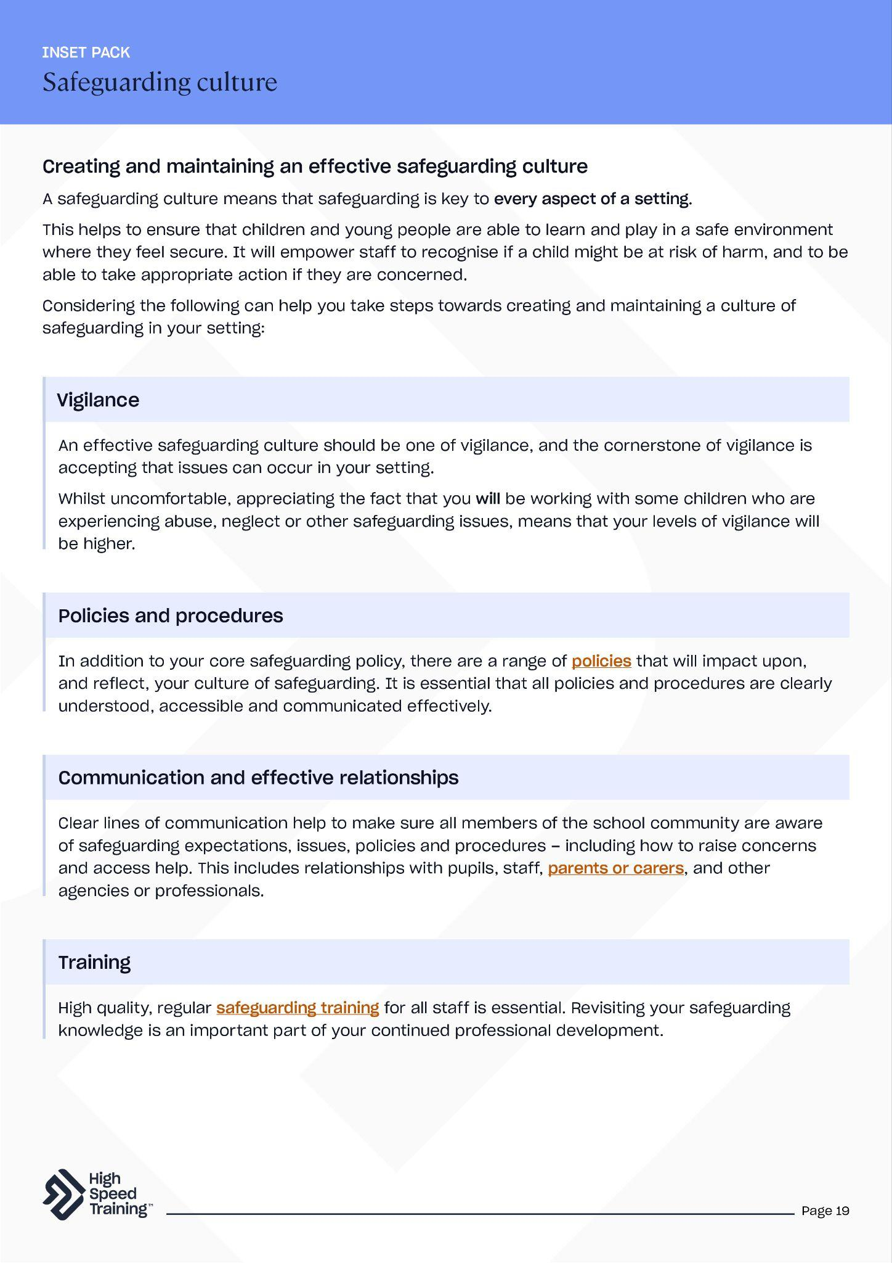
Further resources and support
If you’d like to learn more about the topics covered in this section, here are some useful resources:
How to create an effective culture of safeguarding
A guide to professional curiosity
A guide to contextual safeguarding
5 ways to maximise pupil voice
The purpose of school policies
CPD courses for teaching and education
Building and maintaining an effective
culture of safeguarding (PDF)
Notes:
If staff would like to find out more about topics covered in this section, advise them that they can visit the links as shown.
There’s a PDF summary of this section available for all staff included in the pack (you could send the summary sheets PDF to staff following the session).

Slide 67
Final thoughts for today’s session
Write your school name here
Notes:
This section will focus on some final thoughts for today’s session.
It will allow you to reflect on what you’ve covered in the presentation and think about next steps regarding your development.

Slide 68
Reflection point
It is important to find time for reflection within your role. Take some time to think about any areas of your own safeguarding and child protection knowledge that you would like to develop further.
Notes:
It’s important to find time for reflection within your role.
Reflection point: Take some time to think about any areas of your own safeguarding and child protection knowledge that you would like to develop further.
You can ask staff whether they have anything that they would like to share with the group, or advise that they will have the opportunity to process their thoughts over the next couple of slides.

Slide 69
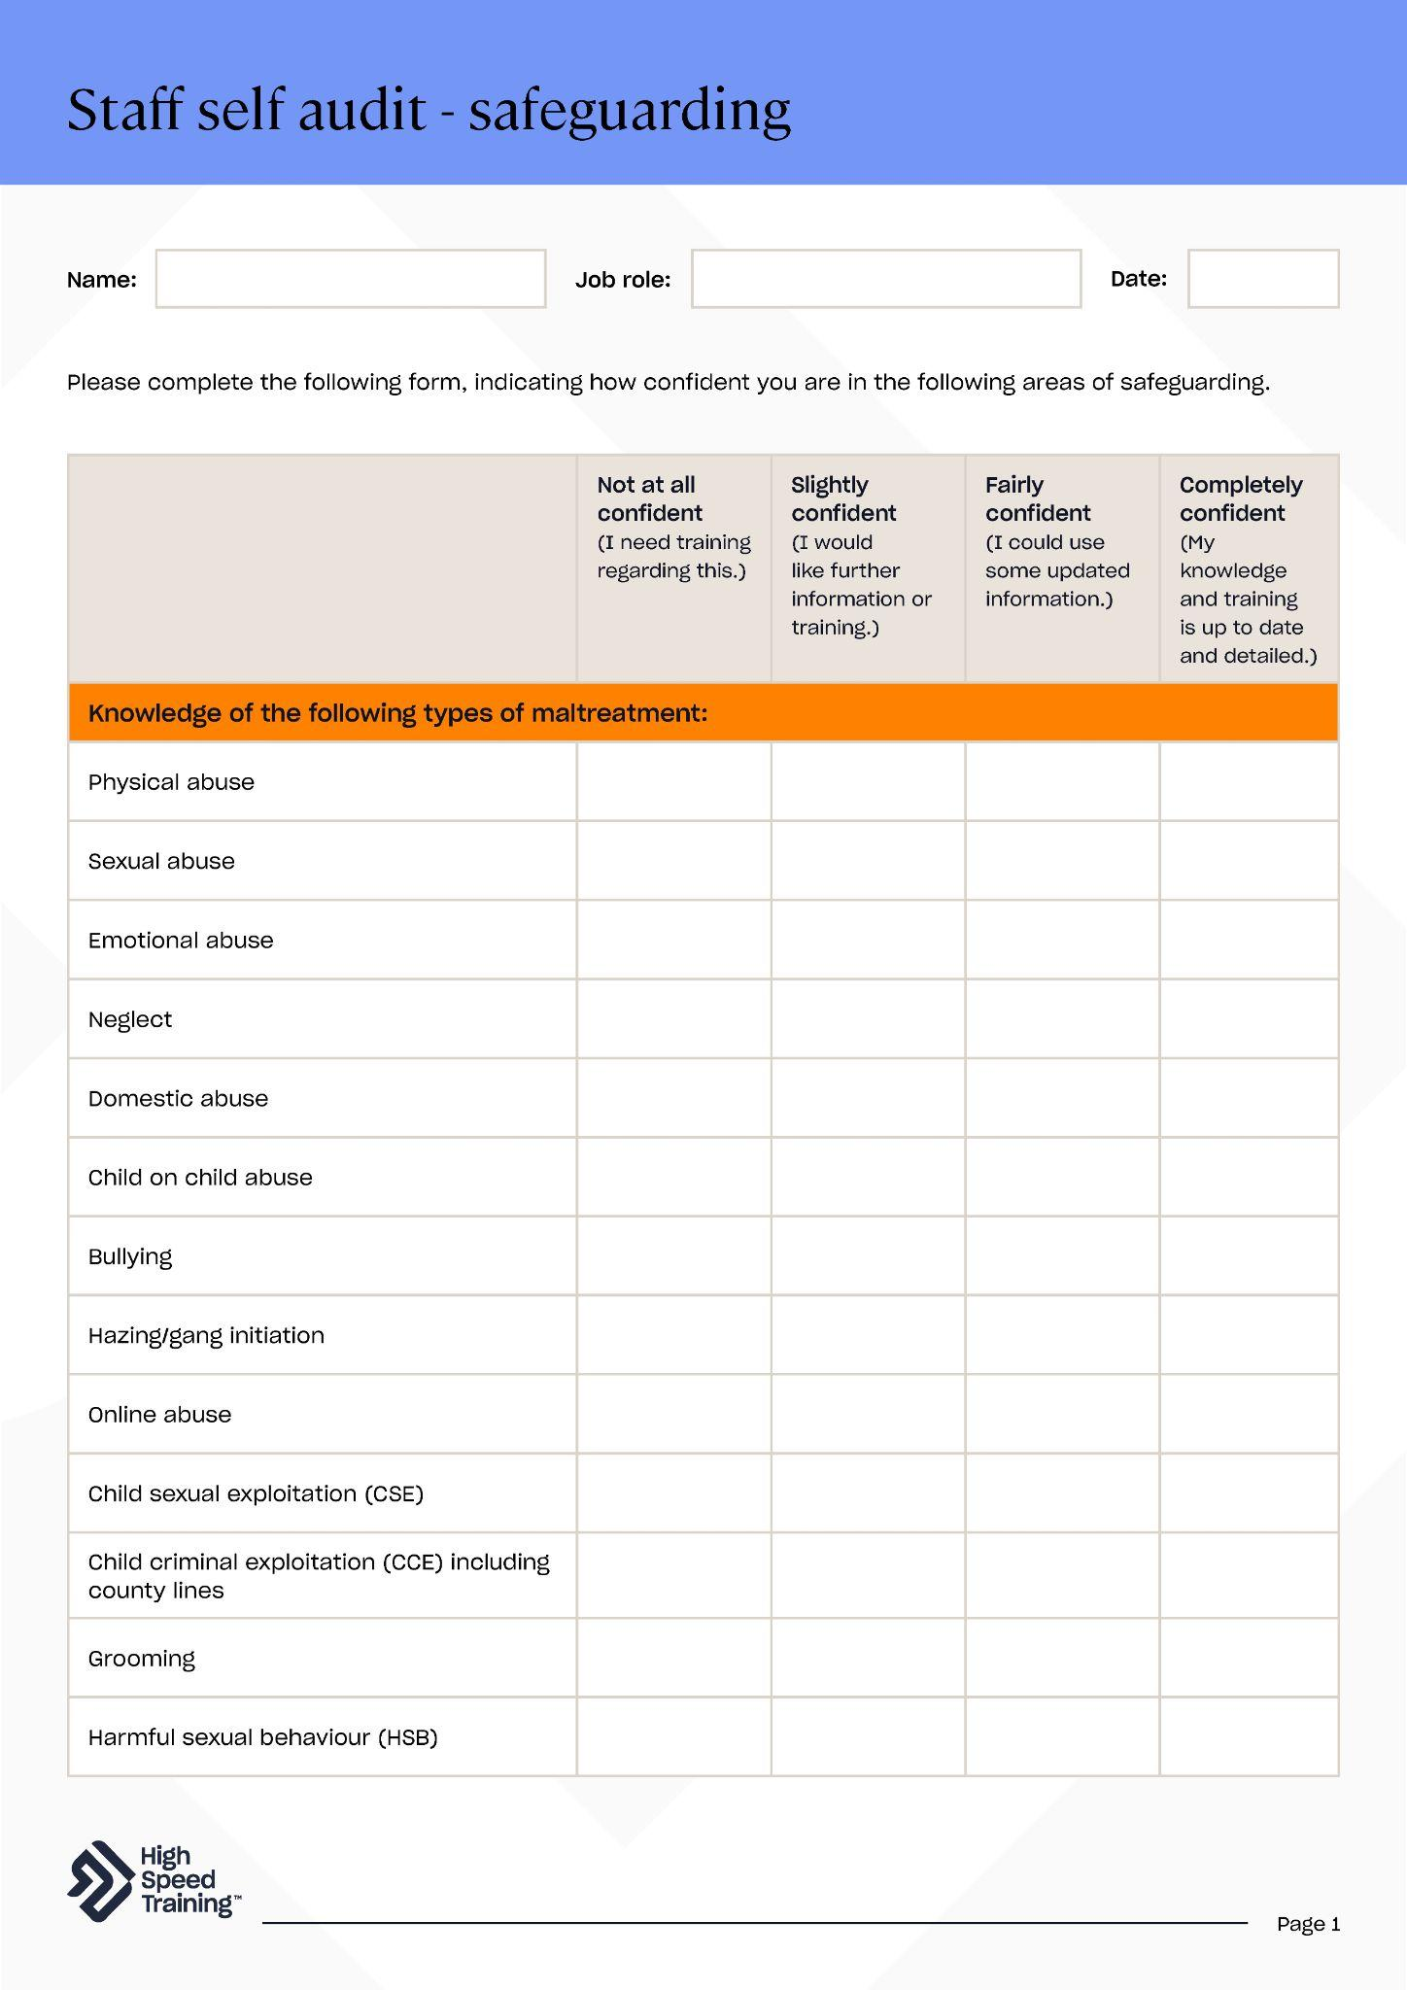

Staff self audit
Please assess your levels of confidence in the key areas of safeguarding by completing this form to help us review where we may be able to provide additional support.
Notes:
Please note: you can download this editable form within your pack.
Explain to staff that everyone should reflect on their levels of confidence in the key areas of safeguarding on a regular basis.
Distribute the form for staff to complete and ask them to return it to you to help highlight training priorities.
There’s also a variety of handouts in the pack that you may wish to distribute at this point, as you reach the end of the presentation.

Slide 70
Other useful tools for your professional development
Safeguarding scenarios and answers
Self-evaluation template
Professional development plan
Education articles and resources
CPD training courses
Enter own link here
Enter own link here
Notes:
Please note: you should edit this slide to include any other useful links that you have for staff before presenting.
Professional development can take many forms and a well thought out plan enables you to explore different methods to effectively support your growth.
We have included a number of links which will direct staff to useful tools for personal development.
Remember that a PDF containing all of the section summaries from today’s session can also be found in your pack.

Slide 71



High Speed Training is a leading provider of online training courses, designed to make training, compliance and development simple, effective
and rewarding.
Trusted by thousands of UK organisations, our fully accredited and award-winning online training and easy to use platform has seen over 3 million learners take the next steps in their careers.
You can also find the most up-to-date, practical information and resources produced by our experts to support you in your professional life on our company blog, the Hub.
Notes:
Brought to you by High Speed Training.
For over a decade High Speed Training has delivered online CPD courses to teachers, teaching assistants, and education professionals all across the UK.
You can browse the entire range of online training courses to build on existing knowledge or learn new skills to help you in the classroom.
In addition, you can find a wide range of free articles and resources on the Hub.

Slide 72
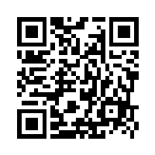

We’d love to hear your feedback!
https://forms.gle/djQ1bQuFzxvMa7dXA
Complete our quick survey with your thoughts on this safeguarding INSET pack for a chance to win a £100 Amazon voucher.
Notes:
We value your feedback to help us improve our resources to better meet your needs in the future (High Speed Training would love to hear from you!).
All members of staff in today’s session can complete a survey with their thoughts on this INSET pack for a chance to win a £100 Amazon voucher.
You can scan the QR code on the slide to fill out the form, or you can visit the link as shown (https://forms.gle/djQ1bQuFzxvMa7dXA).

