Slide 1


Please make a copy of this presentation so that you can personalise it to your school
You can do this by: File > Make a copy > Entire presentation
Notes:
Follow the instructions below to gain access to edit the slides. You should then delete this slide before presenting.
Make a copy of this presentation by selecting File > Make a copy > Entire presentation. This will allow you to edit the content to suit your setting.

Slide 2
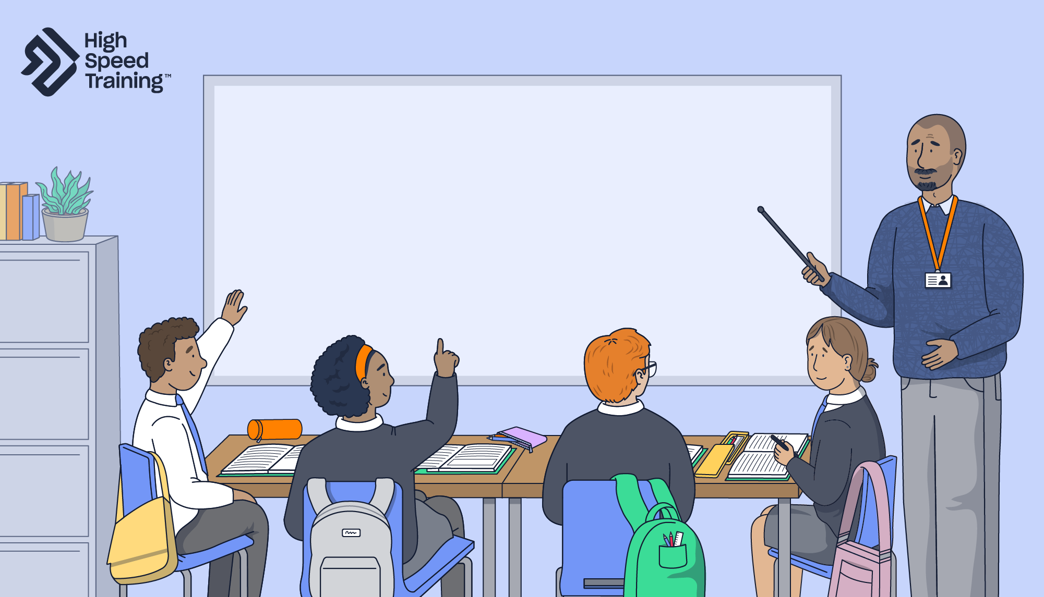
Write your school name here
INSET 2026
Safeguarding
Notes:
Please note: a document containing the facilitator notes can be found in your INSET pack and you can refer to these throughout the presentation.
Welcome staff to your safeguarding INSET.
Point out that staff may take a break from today’s session at any point if they find any details distressing.

Slide 3
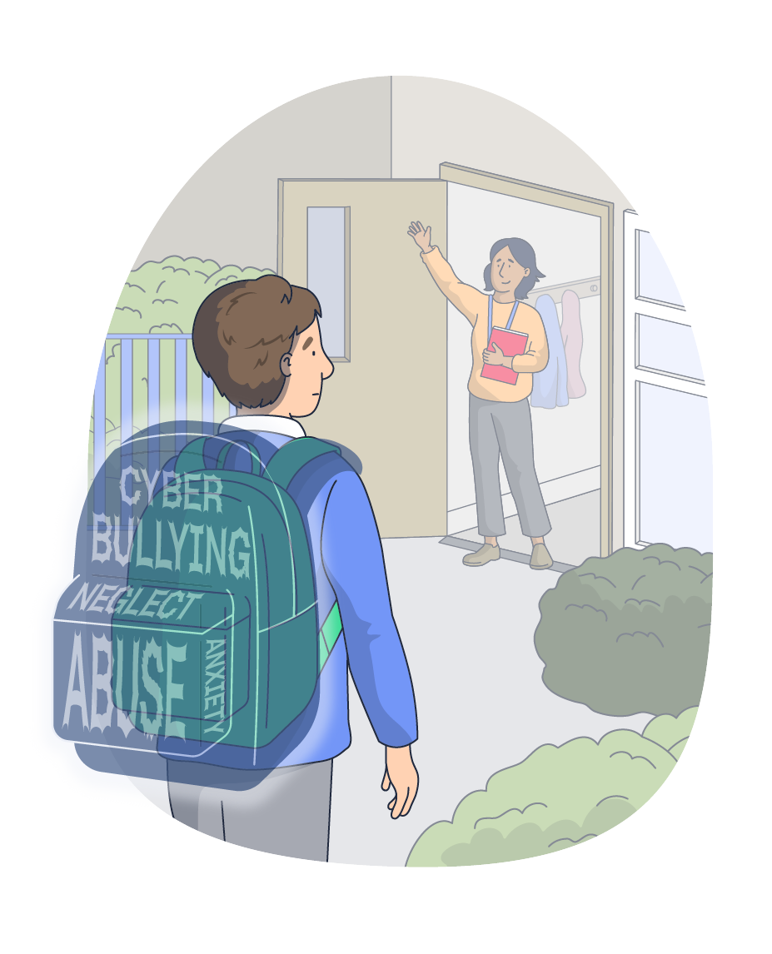

Every morning, a child will walk past us carrying things we can’t always see
Pause and reflect
What does keeping children safe
actually mean to you and your role?
Notes:
Pause and reflect
Every single morning, children walk through our school gates carrying an invisible weight.
Think of it as their ‘invisible backpack’ - filled with things we cannot see, but they must carry.
Ask staff to pause and reflect on that for a moment. What does keeping children safe actually mean to you and your role?

Slide 4
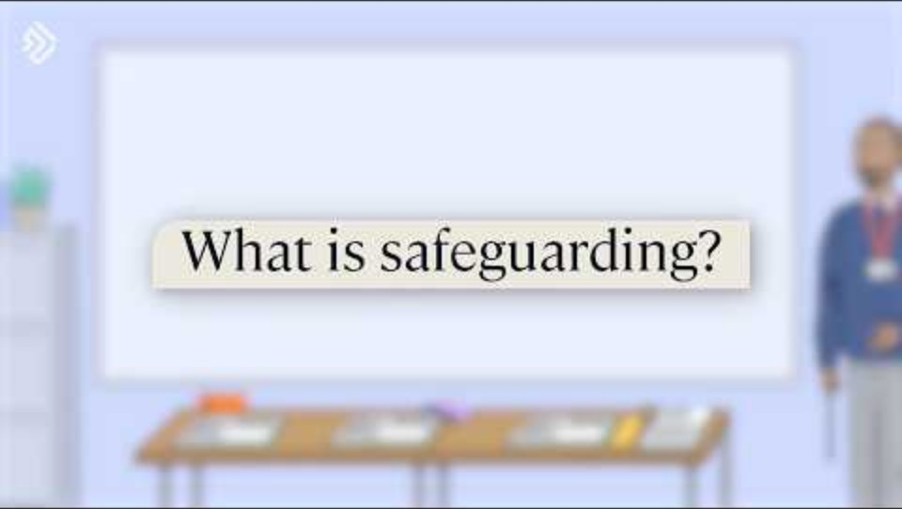
Notes:
Video content
Click on the play icon to start the video (duration of 1:43). To enable captions, simply click on the ‘subtitles/closed captions’ icon that appears to the bottom right of the controls once the video begins to play.
In today’s session, you will be presented with video content including two safeguarding experts.
Joanna Nicolas - a highly regarded safeguarding consultant, trainer and social worker with 30 years of experience in the sector.
Ian Curry - a former Deputy Headteacher and DSL with over 25 years of teaching experience.
This video will cover what safeguarding is, why it is so important, and your role in safeguarding children and young people.
If you need the link to access the video, you can find it here: https://youtu.be/nP7inoCIIVY

Slide 5






What we’ll explore today
1: Statutory guidance
Recent updates to statutory safeguarding guidance for 2026, including KCSIE and WTSC.
2. Types of abuse
The four main types of abuse
and signs to look out for.
3: Safeguarding issues
A variety of specific safeguarding issues to be aware of.
4: Responding to and
sharing concerns
How we should respond to, and share any safeguarding concerns in our school.
5: Safeguarding culture
Creating and maintaining an effective safeguarding culture.
6: Further resources
and support
Ensuring that you have access to the support you need, and looking at our next steps for CPD.
Notes:
What we’ll explore today
Read out the topics to cover in today’s session.
Statutory safeguarding guidance
Types of abuse
Safeguarding issues
Recording and reporting concerns
Safeguarding culture
Further resources and support
Throughout the presentation, there will be a number of opportunities for interactivity with video content, scenarios, discussion points and activities to test your knowledge.
If staff have questions at any point, advise that they can ask them in front of the group during the session, or wait until the end to speak to a member of the safeguarding team.

Slide 6


Write your school name here
Safeguarding team
>>INSERT NAME<< - Designated Safeguarding Lead (DSL)
>>INSERT NAME<< - Deputy DSL
If you have any questions, need advice, or feel overwhelmed by a situation,
please contact us.
Remember: You don’t have to be right, but if you have a concern, you must always act on it.
Never underestimate the part you play in protecting children.
Notes:
Please note: you should edit the details regarding your safeguarding team before presenting this slide.
Go through the details of team members that you have added into the slides, making sure staff are aware of who they should speak to about safeguarding.
Tell staff that you don’t have to be right, but if you have a concern, you must always act on it. You should never underestimate the part you play in protecting children.
If anyone has questions, needs advice, or feels overwhelmed by a situation, they should contact the safeguarding team.

Slide 7
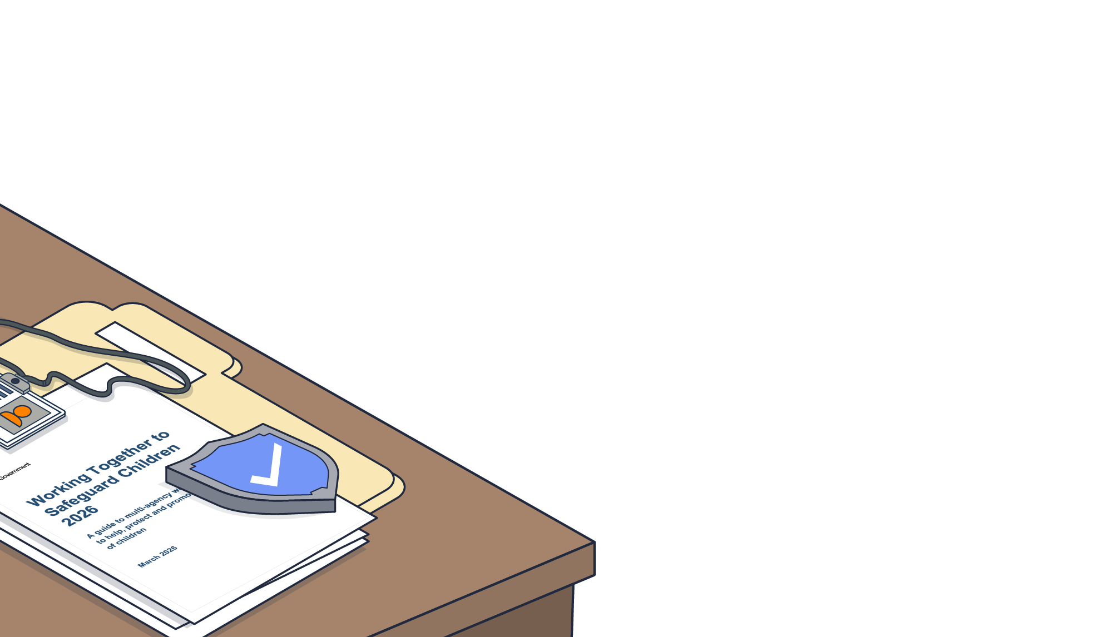
Statutory safeguarding guidance
Write your school name here
1
Notes:
The first section of today’s session will focus on updates to statutory safeguarding guidance.
You’ll cover the key updates for 2026 (including KCSIE and WTSC) and what the changes mean for your school.
This section also includes a quiz, and a useful pull-out document providing more information which can be forwarded onto staff.

Slide 8


Working Together to Safeguard Children (WTSC)
Introduction of Family Help. Family Help combines targeted early help and section 17 support to create a “seamless system of help and support for children and families”.
A focus on challenging racism and discrimination. It reinforces expectations on leaders to create inclusive, anti-discriminatory cultures and for practitioners “to challenge racism and discrimination”.
Stronger multi-agency safeguarding arrangements. This includes clearer detail on accountability structures and how safeguarding partners are inspected.
Learning from serious child safeguarding incidents. This section has been re-structured to ensure safeguarding partners better understand how and when to make “timely, accurate and comprehensive notifications” and engage in the learning process.
Updates from the 2026 guidance:
Recognises that safeguarding is most effective when everyone involved works together collaboratively.
Documents linked here
Notes:
Working Together to Safeguard Children (WTSC)
Working Together to Safeguard Children highlights the importance of multi-agency working and outlines the value of involving the whole family in the process, including the child.
Click to reveal the updates from the 2026 guidance. The 4 points will be revealed on click.
Sources of information:
https://assets.publishing.service.gov.uk/media/69fb1c28d0e316a40f269a5b/Working_together_to_safeguard_children_2026_a_guide_to_multi_agency_working.pdf
https://www.highspeedtraining.co.uk/hub/working-together-to-safeguard-children/?utm_source=inset-pack-2026&utm_medium=referral&utm_campaign=inset-pack-2026

Slide 9

Keeping Children Safe in Education (KCSIE)
Updated guidance on children who are questioning their gender. A new section states that schools “should take a very careful approach” in relation to social transition. It also covers the requirements for single-sex facilities.
New references to generative artificial intelligence in education. The four areas of online risk now reflect the threats of generative AI and further guidance has been provided to address the prevalence of deepfakes.
Mental health as a safeguarding concern. “All staff should be aware that mental health problems can, in some cases, develop into safeguarding concerns”, where there are indicators of self-harm, suicide, abuse, neglect or exploitation.
Updated filtering and monitoring guidance. Reinforces that schools must ensure “a review of their effectiveness is carried out at least once every academic year”.
Updates from the 2026 guidance:
The expectation for mobile-free environments. It reinforces the expectation that “all schools should be mobile phone-free environments by default” throughout the school day to mitigate online risks. It is for schools to decide how best to achieve this within their own unique contexts.
Addressing serious youth violence. This highlights the requirement for all staff to remain alert to indicators of serious youth violence. It states that “staff should report any concerns about a child carrying or using a weapon (or expressing intent to do so) to the DSL”.
Domestic abuse reporting process. This includes new details on Operation Encompass and emphasises the duty to “comply with the data protection laws” during the information-sharing process.
Statutory guidance for schools and colleges on safeguarding children.
Documents linked here
Notes:
Keeping Children Safe in Education (KCSIE)
KCSIE is statutory guidance for schools and colleges on safeguarding children.
Schools and colleges in England must have regard to it when carrying out their duties to safeguard and promote the welfare of children.
Click to reveal the updates from the 2026 guidance. The 7 points will be revealed on click.
Sources of information:
https://www.gov.uk/government/publications/keeping-children-safe-in-education--2
https://www.highspeedtraining.co.uk/hub/keeping-children-safe-in-education-changes/?utm_source=inset-pack-2026&utm_medium=referral&utm_campaign=inset-pack-2026

Slide 10

Test your knowledge
KCSIE categorises online safety issues into four areas of risk. Name the four areas.
A: Content, connection, cybersecurity, copyright
B: Cyberbullying, stranger danger, sexting, viruses
C: Content, contact, cruelty, control
D: Content, contact, conduct, commerce
D: Content, contact, conduct, commerce
Notes:
Test your knowledge
Explain to staff that you have some quick quiz questions to test their knowledge, and present the first multiple-choice question.
KCSIE categorises online safety issues into four areas of risk. Name the four areas.
A: Content, connection, cybersecurity, copyright
B: Cyberbullying, stranger danger, sexting, viruses
C: Content, contact, cruelty, control
D: Content, contact, conduct, commerce
Once staff have answered, click to reveal the answer on the slide.
Sources of information:
https://www.highspeedtraining.co.uk/campaign/inset-teacher-training-pack/kcsie-quiz/
https://www.gov.uk/government/publications/keeping-children-safe-in-education--2

Slide 11
Test your knowledge
If a child discloses information about abuse to you, what should you not do?
A: Reassure them that they are being taken seriously
B: Promise the child that you’ll keep it a secret
B: Promise the child that you’ll keep it a secret
C: Inform the DSL immediately
D: All of the above
Notes:
Test your knowledge
Click to reveal the next quiz question.
If a child discloses information about abuse to you, what should you not do?
A: Reassure them that they are being taken seriously
B: Promise the child that you’ll keep it a secret
C: Inform the DSL immediately
D: All of the above
Once staff have answered, click to reveal the answer on the slide.
Sources of information:
https://www.highspeedtraining.co.uk/campaign/inset-teacher-training-pack/kcsie-quiz/
https://www.gov.uk/government/publications/keeping-children-safe-in-education--2

Slide 12
Test your knowledge
What are the four main types of abuse?
A: Physical, emotional, sexual, neglect
A: Physical, emotional, sexual, neglect
B: Physical, sexual, neglect, child-on-child
C: Child-on-child, domestic, sexual, neglect
D: Physical, child-on-child, sexual, domestic
Notes:
Test your knowledge
Click to reveal the final quiz question in this quick ‘test your knowledge’ segment of the session.
What are the four main types of abuse?
A: Physical, emotional, sexual, neglect
B: Physical, sexual, neglect, child-on-child
C: Child-on-child, domestic, sexual, neglect
D: Physical, child-on-child, sexual, domestic
Once staff have answered, click to reveal the answer on the slide.
Sources of information:
https://www.highspeedtraining.co.uk/campaign/inset-teacher-training-pack/kcsie-quiz/
https://www.gov.uk/government/publications/keeping-children-safe-in-education--2

Slide 13
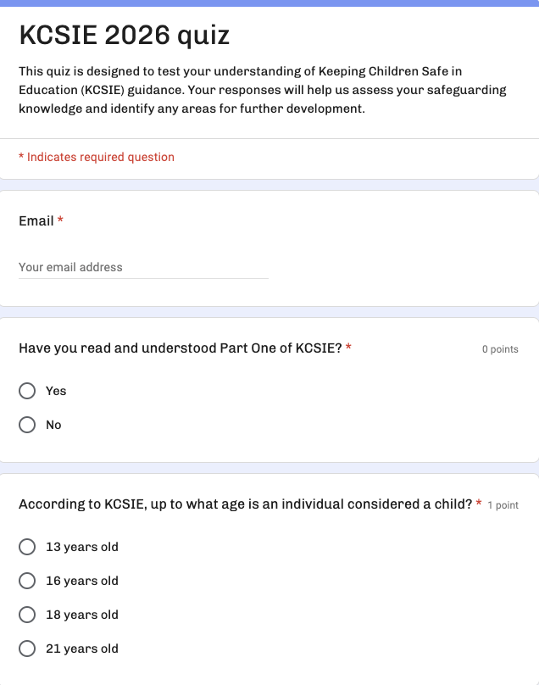
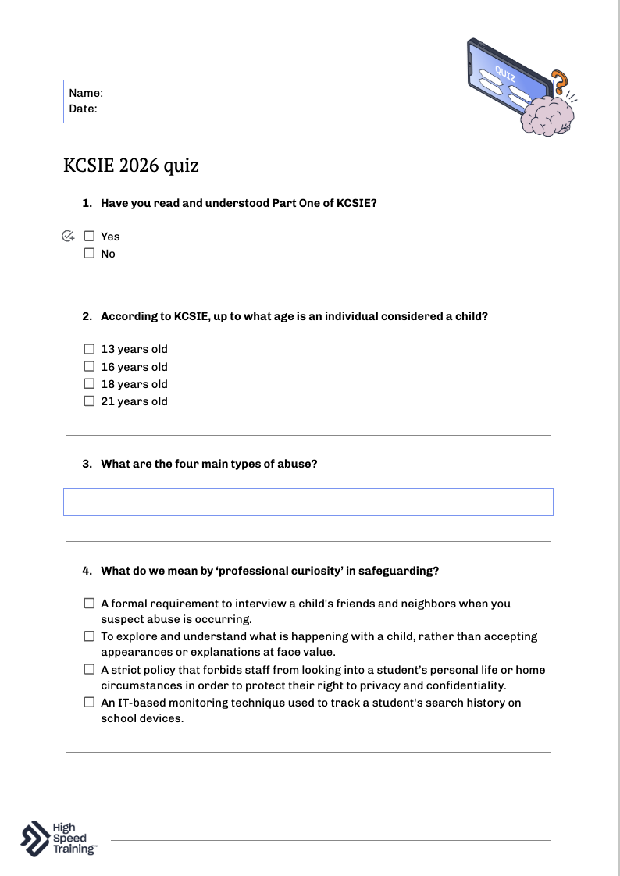

KCSIE 2026 quiz
Annex A (condensed Part one) has been removed. This means that all staff must now read Part one.
Every member of staff must complete this short quiz to confirm they have read and understood at least Part one of the new statutory guidance.
Please complete by [insert date here]
Notes:
Please note: you should edit the details regarding the completion date before presenting this slide.
Remind staff that it is essential that everybody working in a school or college understands their safeguarding responsibilities.
To support you in your responsibility to ensure that all members of staff read at least Part one KCSIE guidance, our pack includes a ready-to-use quiz for your team to complete. The responses will help you to assess safeguarding knowledge, evidence compliance, and identify any areas for further development.
The KCSIE quiz can be found in your INSET pack. Here’s the link: https://www.highspeedtraining.co.uk/campaign/inset-teacher-training-pack/kcsie-quiz/
This is available in a variety of formats including Google Docs, Microsoft Office, and Google Form so that you can choose the option best suited to your school.
Sources of information:
https://www.highspeedtraining.co.uk/campaign/inset-teacher-training-pack/kcsie-quiz/
https://www.gov.uk/government/publications/keeping-children-safe-in-education--2

Slide 14
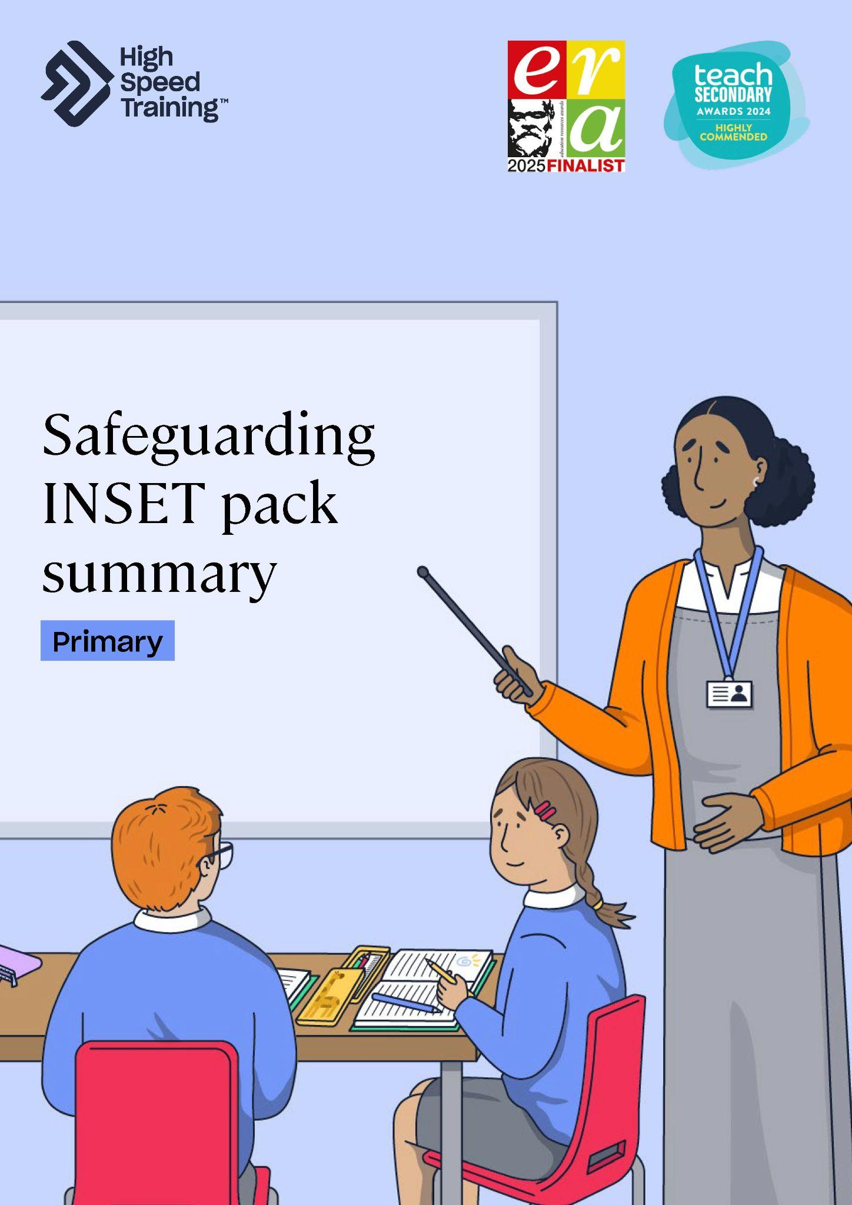

KCSIE and WTSC
Updates to both KCSIE and WTSC have been compiled in this document, using the headings, subheadings and paragraph references from the guidance.
Summary PDF
Notes:
Please note: you can find this document within your pack.
This pull-out document contains more detailed information on the updates.
You could distribute these during your session or send them afterward as a quick reference guide, complete with links to additional resources.

Slide 15
Key takeaways
Stay current to stay effective. It is a vital professional requirement that you remain up to date with legislation and statutory safeguarding guidance throughout the year.
Check your understanding. Please complete the KCSIE quiz to confirm that you have fully understood the guidance and log your completion with the
safeguarding team.
Ask questions. If you are unclear about any paragraph, definition, or threshold within safeguarding guidance,
let us know. A strong safeguarding culture relies on
open dialogue, never on assumptions.
Notes:
Key takeaways
Briefly recap the key takeaways from the statutory safeguarding section.
Stay current to stay effective.
Check your understanding.
Ask questions.
If you want to take a moment for reflection, you can ask staff one of the following questions:
Statutory guidance can feel like a lot of information at once. Thinking about what we just went through, what is one key shift or update that stands out as different or new compared to what we did last year?
Before we move on, I want to make sure everyone feels confident. In a chaotic, busy school day, which part of this statutory guidance do you think is actually the easiest to overlook?
I’ll pause here for a minute. Please feel free to ask a question, or check in with the person next to you about how this applies to your specific roles.
Open the floor to any specific questions about WTSC/KCSIE compliance, reporting paths, or internal school policy updates.

Slide 16
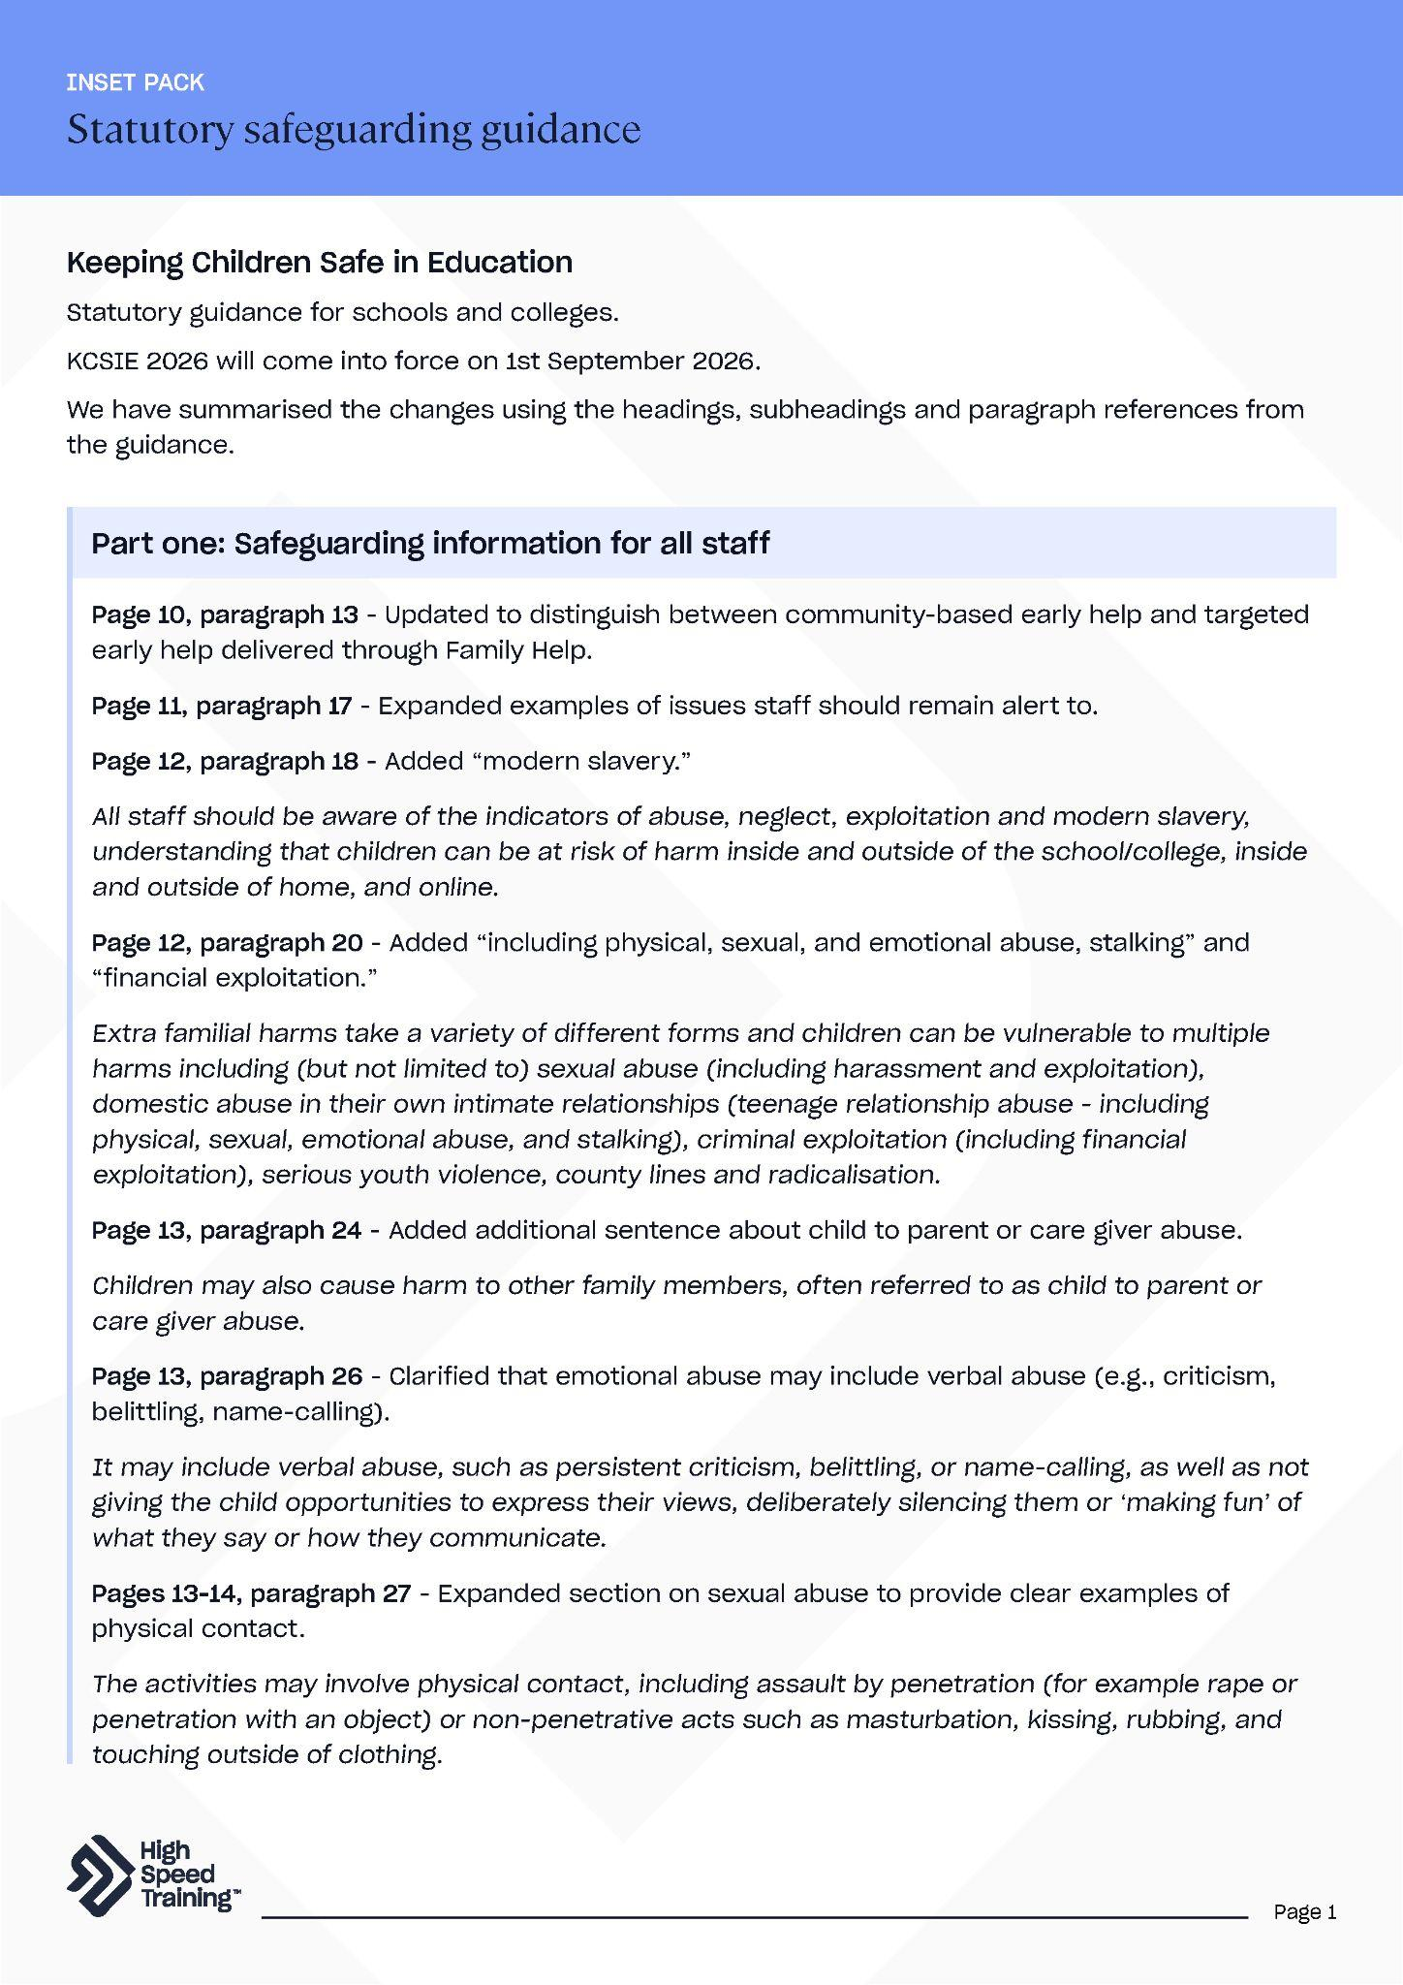
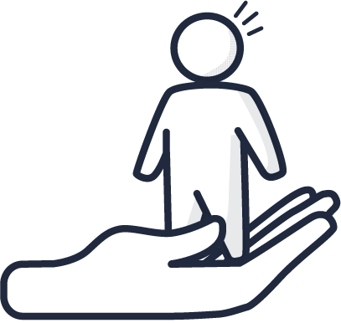

Further resources and support
If you’d like to learn more about the topics covered in this section, here are some useful resources:
PLACEHOLDER IMAGE
Essential guide to KCSIE
KCSIE staff knowledge quiz
What you need to know about gender questioning children guidance
Essential guide to WTSC
Key legislation and statutory safeguarding guidance
Safeguarding courses
Statutory safeguarding guidance (PDF)
Notes:
Further resources and support
If staff would like to find out more about topics covered in this section, advise them that they can visit the links as shown.
There’s a PDF summary of this section available for all staff included in the pack (you could send the summary sheets PDF to staff following the session).

Slide 17

Types of abuse
Write your school name here
2
Notes:
The second section of today’s session will focus on the four main types of abuse.
You’ll cover the different types of abuse, signs to look out for that may suggest a cause for concern, and discuss how to act on these.

Slide 18

Notes:
Video content
Click on the play icon to start the video (duration of 1:12). To enable captions, simply click on the ‘subtitles/closed captions’ icon that appears to the bottom right of the controls once the video begins to play.
This video will cover statistics related to child abuse, a real life case study, and why it is important to maintain an attitude of “it could happen here”.
If you need the link to access the video, you can find it here: https://youtu.be/OdcX3PTfDDQ
Please note: this video contains the real life case study of Arthur Labinjo-Hughes with details of abuse.
Sources of information:
https://www.ons.gov.uk/peoplepopulationandcommunity/crimeandjustice/bulletins/childabuseinenglandandwales/march2020#:~:text=The%20Crime%20Survey%20for%20England,years%20(8.5%20million%20people)
https://www.nspcc.org.uk/about-us/news-opinion/2023/more-safeguarding-referrals-risen-childhood-day-2023/

Slide 19

Physical signs
Bruises
Fractures or broken bones
Burns or scalds
Bite marks
Physical abuse
A form of abuse which may involve hitting, shaking, throwing, poisoning, burning or scalding, drowning, suffocating, or otherwise causing physical harm to a child.
Physical harm may also be caused when a parent or carer fabricates the symptoms of, or deliberately induces, illness in a child.
Behavioural signs
Refusal to discuss injuries
Keeping the body covered, even in
hot weather
Descriptions of excessive punishment
Notes:
Physical abuse
Define what physical abuse is.
A form of abuse which may involve hitting, shaking, throwing, poisoning, burning or scalding, drowning, suffocating, or otherwise causing physical harm to a child.
Physical harm may also be caused when a parent or carer fabricates the symptoms of, or deliberately induces, illness in a child.
Click to reveal the physical signs to look out for.
Click to reveal the behavioural signs to look out for.
Sources of information:
https://www.highspeedtraining.co.uk/hub/signs-abuse-children/?utm_source=inset-pack-2026&utm_medium=referral&utm_campaign=inset-pack-2026
https://www.highspeedtraining.co.uk/hub/disclosure-child-abuse/?utm_source=inset-pack-2026&utm_medium=referral&utm_campaign=inset-pack-2026

Slide 20

Is the injury consistent with the child's age and mobility?
Does the injury match the story the child (or parent) is telling you?
Many children sustain injuries from accidents, such as trips, falls and sports. But how do we actively demonstrate professional curiosity when a child in our care presents with an injury?
Always ask yourself…
Discussion point
Notes:
Reflection questions and group discussion
Always ask yourself…
Is the injury consistent with the child's age and mobility?
Does the injury match the story the child (or parent) is telling you?
Discussion point.
Many children sustain injuries from accidents, such as trips, falls and sports. But how do we actively demonstrate professional curiosity when a child in our care presents with an injury?

Slide 21

Physical signs
Delays in physical development
Marks on the body from self-harm
Behavioural signs
Lack of confidence
Struggle to regulate their emotions and have extreme outbursts
Being overly affectionate or clingy towards strangers
Being aggressive or unkind towards other children
Not having a close relationship with their parents or carers
Emotional abuse
Emotional abuse is 'the persistent emotional maltreatment of a child such as to cause severe and adverse effects on the child’s emotional development.’
Notes:
Emotional abuse
Define what emotional abuse is.
Emotional abuse is 'the persistent emotional maltreatment of a child such as to cause severe and adverse effects on the child’s emotional development.’
Click to reveal the physical signs to look out for.
Click to reveal the behavioural signs to look out for.
Sources of information:
https://www.highspeedtraining.co.uk/hub/signs-abuse-children/?utm_source=inset-pack-2026&utm_medium=referral&utm_campaign=inset-pack-2026
https://www.highspeedtraining.co.uk/hub/disclosure-child-abuse/?utm_source=inset-pack-2026&utm_medium=referral&utm_campaign=inset-pack-2026

Slide 22
Are we labelling a child's trauma response - like sudden aggression or severe withdrawal - as just "bad behaviour" or defiance?
Does the child’s presentation, anxiety level, or behaviour fundamentally shift when a specific parent, carer, or adult is present?
Since emotional abuse is often a pattern of behaviour rather than a single event, how can we ensure we are recording the 'small things' so that a larger picture can be spotted by the safeguarding team?
Always ask yourself…
Discussion point
Notes:
Reflection questions and group discussion
Always ask yourself…
Are we labelling a child's trauma response - like sudden aggression or severe withdrawal - as just "bad behaviour" or defiance?
Does the child’s presentation, anxiety level, or behaviour fundamentally shift when a specific parent, carer, or adult is present?
Discussion point.
Since emotional abuse is often a pattern of behaviour rather than a single event, how can we ensure we are recording the 'small things' so that a larger picture can be spotted by the safeguarding team?

Slide 23

Physical signs
Soreness of the genital area
Bleeding
Abdominal pain
Sexually transmitted infections (STIs)
Pregnancy
Sexual abuse
Behavioural signs
Sexual abuse involves forcing or enticing a child or young person to take part in sexual activities, not necessarily involving a high level of violence, whether or not the child is aware of what is happening.
Age inappropriate sexual knowledge and language
Avoid being alone with certain people
Appear to be frightened of someone
Reluctance to change in front of others
Notes:
Sexual abuse
Define what sexual abuse is.
Sexual abuse involves forcing or enticing a child or young person to take part in sexual activities, not necessarily involving a high level of violence, whether or not the child is aware of what is happening.
Click to reveal the physical signs to look out for.
Click to reveal the behavioural signs to look out for.
Sources of information:
https://www.highspeedtraining.co.uk/hub/signs-abuse-children/?utm_source=inset-pack-2026&utm_medium=referral&utm_campaign=inset-pack-2026
https://www.highspeedtraining.co.uk/hub/disclosure-child-abuse/?utm_source=inset-pack-2026&utm_medium=referral&utm_campaign=inset-pack-2026
https://www.highspeedtraining.co.uk/hub/child-sexual-abuse-guidance-for-schools/?utm_source=inset-pack-2026&utm_medium=referral&utm_campaign=inset-pack-2026

Slide 24
Is this child displaying sexual knowledge, language, or behaviours that are completely inappropriate for their developmental age?
Is there a sudden, unexplained shift in their behaviour, peer groups, or secrecy around their online life?
A child experiencing sexual abuse or exploitation may feel shame or fear, making them hide their situation. What subtle, non-verbal indicators or sudden behavioural shifts might tell us a child is hiding something, even if they are presenting as "fine" or quiet in our lessons?
Always ask yourself…
Discussion point
Notes:
Reflection questions and group discussion
Always ask yourself…
Is this child displaying sexual knowledge, language, or behaviours that are completely inappropriate for their developmental age?
Is there a sudden, unexplained shift in their behaviour, peer groups, or secrecy around their online life?
Discussion point.
A child experiencing sexual abuse or exploitation may feel shame or fear, making them hide their situation. What subtle, non-verbal indicators or sudden behavioural shifts might tell us a child is hiding something, even if they are presenting as "fine" or quiet in our lessons?

Slide 25

Physical signs
Appearing dirty or smelling
Wearing unwashed clothes
Ill-fitting clothes or shoes
Untreated injuries or medical issues
Tiredness
Constant hunger
Neglect
Behavioural signs
Poor self-esteem
Missing developmental milestones
Compulsive stealing
Frequent truancy
Poor relationships with peers
The persistent failure to meet a child’s basic physical and/or psychological needs, likely to result in the serious impairment of the child’s health or development.
Notes:
Neglect
Define what neglect is.
The persistent failure to meet a child’s basic physical and/or psychological needs, likely to result in the serious impairment of the child’s health or development.
Click to reveal the physical signs to look out for.
Click to reveal the behavioural signs to look out for.
Sources of information:
https://www.highspeedtraining.co.uk/hub/signs-abuse-children/?utm_source=inset-pack-2026&utm_medium=referral&utm_campaign=inset-pack-2026
https://www.highspeedtraining.co.uk/hub/disclosure-child-abuse/?utm_source=inset-pack-2026&utm_medium=referral&utm_campaign=inset-pack-2026
https://www.highspeedtraining.co.uk/hub/what-is-child-neglect/?utm_source=inset-pack-2026&utm_medium=referral&utm_campaign=inset-pack-2026

Slide 26
Is this a one-off bad day, or am I looking at a persistent pattern of neglect?
Is the child regularly lacking the basic essentials needed to learn and thrive - such as adequate food, appropriate clothing, or basic hygiene?
We know many families experience poverty or temporary crises that affect a child's appearance or punctuality. How do we distinguish between a family experiencing poverty and a child suffering from actionable neglect?
Always ask yourself…
Discussion point
Notes:
Reflection questions and group discussion
Always ask yourself…
Is this a one-off bad day, or am I looking at a persistent pattern of neglect?
Is the child regularly lacking the basic essentials needed to learn and thrive - such as adequate food, appropriate clothing, or basic hygiene?
Discussion point.
We know many families experience poverty or temporary crises that affect a child's appearance or punctuality. How do we distinguish between a family experiencing poverty and a child suffering from actionable neglect?

Slide 27
Key takeaways
Abuse is not a checklist, it’s a pattern. While a single disclosure requires immediate action, remember that emotional abuse and neglect are often identified by noticing small, persistent behavioural or physical shifts over time.
Context matters. Children may experience maltreatment within the home (familial), outside the home (known as extra-familial or contextual) or online.
Be professionally curious, not an investigator. Your job isn't to prove abuse, cross-examine a child, or judge a family's circumstances. Your legal duty under the 2026 framework is simply to notice the gaps, trust your instinct, and report it.
Notes:
Key takeaways
Briefly recap the key takeaways from the statutory safeguarding section.
Abuse is not a checklist, it’s a pattern.
Context matters.
Be professionally curious, not an investigator.
As you just highlighted in the discussion on neglect and poverty, you are not being asked to sit in judgment of families or try to crack the case yourself.
WTSC 2026 relies on us being the eyes and ears. We log the data, we maintain our professional curiosity, and we pass that picture to the safeguarding team so that the right action can be put in place.
Reiterate that if you have a gut feeling that something isn't right, that is enough. Log it.
If you want to take a moment for reflection, you can ask staff one of the following questions:
We do often talk about having a 'gut feeling' that something isn't right. Looking at the patterns of abuse we just discussed, what does a gut feeling actually look like in your daily interactions with pupils?
Sometimes people hesitate to log a concern because they worry they don't have 'proof' or might be misinterpreting a situation. How does shifting our mindset to being the 'eyes and ears' rather than 'investigators' change how you view making a report?
Open the floor to questions about specific signs of abuse.

Slide 28
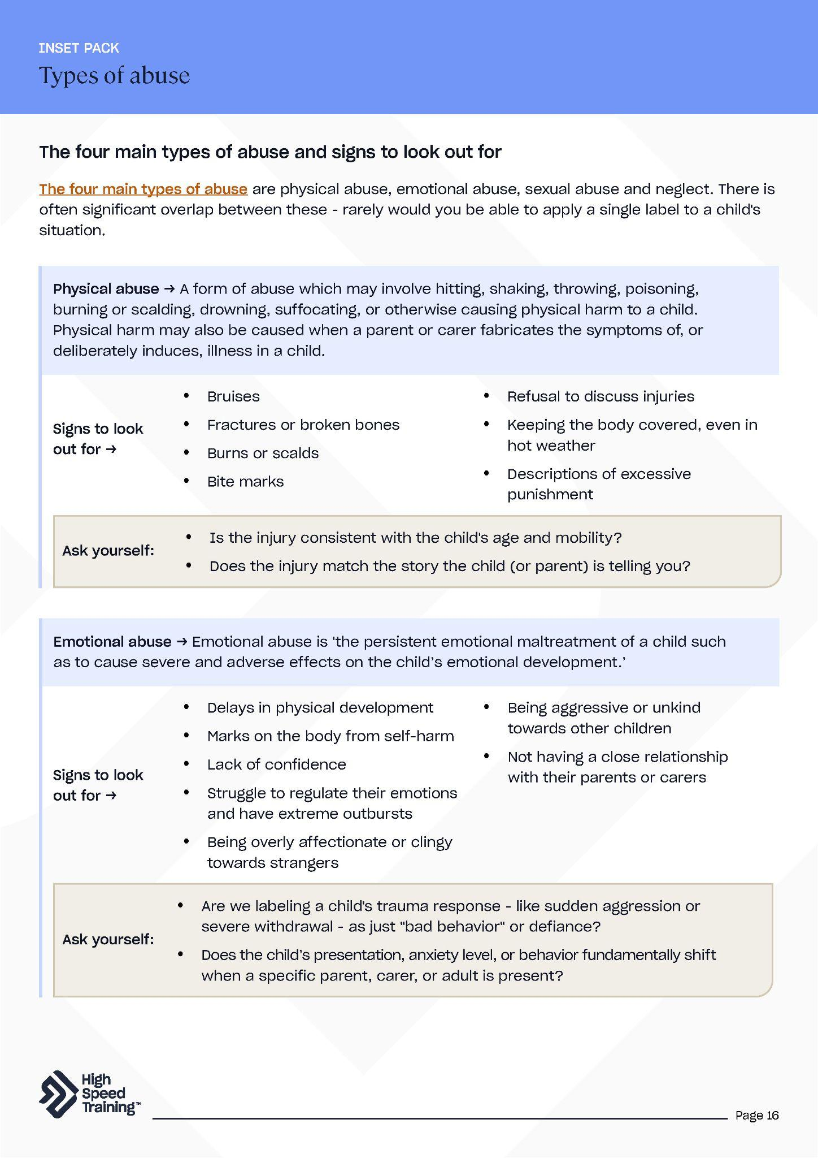
Further resources and support
If you’d like to learn more about the topics covered in this section, here are some useful resources:
PLACEHOLDER IMAGE
Safeguarding Children in Education course
Signs of abuse in children
Guidance on child neglect
Guidance on child sexual abuse
How to teach children about healthy relationships
Understanding why children may stay quiet about abuse
The four main types of abuse (PDF)
Notes:
Further resources and support
If staff would like to find out more about topics covered in this section, advise them that they can visit the links as shown.
There’s a PDF summary of this section available for all staff included in the pack (you could send the summary sheets PDF to staff following the session).

Slide 29
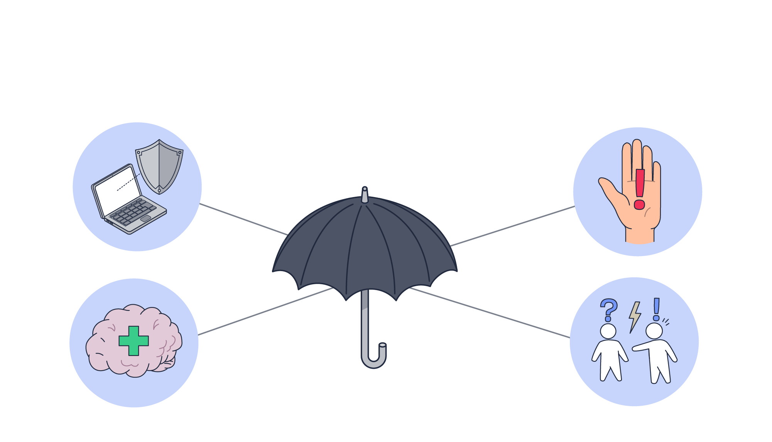
Safeguarding issues
Write your school name here
3
Notes:
Please note: you may want to ‘pick and choose’ from the topics included in this section of the presentation.
The second section of today’s session will focus on safeguarding issues.
You’ll cover a variety of specific safeguarding issues including:
Mental health
Online safety
Child-on-child abuse
Domestic abuse
Supporting pupils questioning their gender

Slide 30
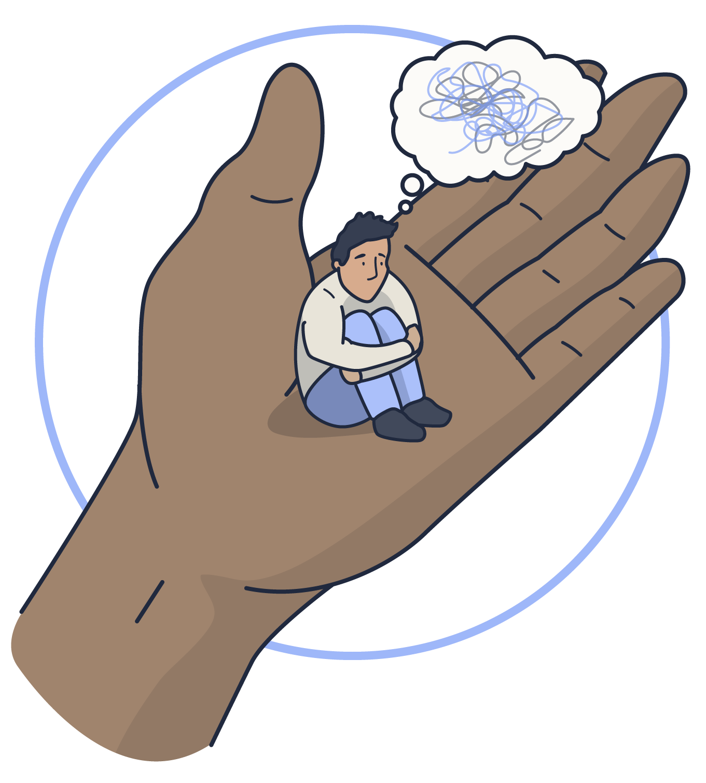


Mental health
Signs to look out for
Significant changes in attitude and behaviour.
Ongoing difficulty sleeping.
Withdrawing from social situations.
Not wanting to do things they usually like.
Physical signs of self-harm or neglecting themselves.
According to Mind, 1 in 5 children (aged 5 to 16) has a mental health problem.
This means that 6 children in any average class are likely to be experiencing mental health problems.
Notes:
Mental health
Click to reveal the statistic that 1 in 5 children (aged 5 to 16) has a mental health problem.
This means that 6 children in any average class are likely to be experiencing mental health problems.
Click to reveal some of the signs to look out for.
Sources of information:
https://www.highspeedtraining.co.uk/hub/promoting-mental-health-in-schools/?utm_source=inset-pack-2026&utm_medium=referral&utm_campaign=inset-pack-2026
https://www.england.nhs.uk/2023/11/one-in-five-children-and-young-people-had-a-probable-mental-disorder-in-2023/
https://www.mind.org.uk/information-support/a-z-mental-health/mental-health-facts-and-statistics/
https://assets.publishing.service.gov.uk/media/6a4cf903b7203c4c023fd2f3/Keeping_children_safe_in_education_2026_.pdf

Slide 31




Promote good mental wellbeing and prevent the onset of mental illness
Observe pupils and identify early those who may be experiencing mental health problems or being at risk of developing one
Ensure early targeted support is provided
Liaise with and/or refer to specialist services where needed
KCSIE 2026 expects every member of staff to support the fulfilment of 4 key roles:
If you have a concern about a child’s mental
health that is also a safeguarding concern,
follow our child protection policy and speak
to a DSL or deputy.
If a child needs help urgently for their
mental health, but it's not an emergency,
get help from NHS 111 online or call 111 and
select the mental health option.
If you feel that a child is in danger, call 999
or arrange for them to be taken to A&E
immediately by a parent/carer or other
suitable person.
Notes:
4 key roles
KCSIE 2026 expects every member of staff to support the fulfilment of 4 key roles.
Click to reveal the 4 key roles.
Promote good mental wellbeing and prevent the onset of mental illness
Observe pupils and identify early those who may be experiencing mental health problems or being at risk of developing one
Ensure early targeted support is provided
Liaise with and/or refer to specialist services where needed
Click to reveal 3 actions advised in KCSIE regarding concerns around a child’s mental health.
If you have a concern about a child’s mental health that is also a safeguarding concern, follow our child protection policy and speak to a DSL or deputy.
If a child needs help urgently for their mental health, but it's not an emergency, get help from NHS 111 online or call 111 and select the mental health option.
If you feel that a child is in danger, call 999 or arrange for them to be taken to A&E immediately by a parent/carer or other suitable person.
Sources of information:
https://www.highspeedtraining.co.uk/hub/promoting-mental-health-in-schools/?utm_source=inset-pack-2026&utm_medium=referral&utm_campaign=inset-pack-2026
https://assets.publishing.service.gov.uk/media/6a4cf903b7203c4c023fd2f3/Keeping_children_safe_in_education_2026_.pdf
https://www.highspeedtraining.co.uk/hub/suicide-prevention-in-schools/?utm_source=inset-pack-2026&utm_medium=referral&utm_campaign=inset-pack-2026

Slide 32

What do we currently do to support vulnerable pupils and foster an environment where they feel safe to talk about how they are feeling?
How can we improve our collective approach to spotting early indicators and providing Early Help before a pupil reaches a mental health crisis?
Discussion point
Pause and reflect
If a pupil in your class was struggling with mental health
right now, do they know exactly who to go to in this building,
and do they trust that process?
Notes:
Discussion point
KCSIE recognises that “mental health problems can, in some cases, develop into safeguarding concerns. This could include self-harm, suicidal ideation or risk of suicide. They could also be an indicator that a child has suffered or is at risk of suffering abuse, neglect or exploitation”. Any child who is showing indicators of having mental health difficulties must be supported appropriately.
What do we currently do to support vulnerable pupils and foster an environment where they feel safe to talk about how they are feeling?
How can we improve our collective approach to spotting early indicators and providing Early Help before a pupil reaches a mental health crisis?
Click to reveal a point for staff to pause and reflect on before moving onto the action slide next.
If a pupil in your class was struggling with mental health right now, do they know exactly who to go to in this building, and do they trust that process?
Sources of information:
https://assets.publishing.service.gov.uk/media/6a4cf903b7203c4c023fd2f3/Keeping_children_safe_in_education_2026_.pdf

Slide 33





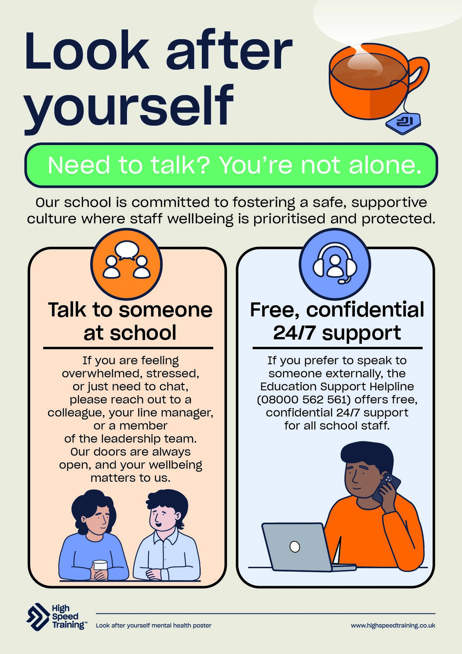
How can we promote positive mental health?
Make mental health known
Integrate wellbeing themes into
assemblies, PSHE, and classroom
check-ins to keep the
conversation continuous.
Celebrate awareness days
Use events like World Mental Health
Day or Children’s Mental Health Week
to promote positive mental health and
run pupil-led campaigns.
Signpost visible support
Display posters around the
school to clearly show
internal contacts, like our
DSLs, and external helplines.
Prioritise early help and collaboration
Record low-level or emerging mental
health changes on our internal system
early, ensuring we catch vulnerable
pupils before a crisis hits.
Notes:
How can we promote positive mental health?
Make mental health known
Integrate wellbeing themes into assemblies, PSHE, and classroom check-ins to keep the conversation continuous.
Celebrate awareness days
Use events like World Mental Health Day or Children’s Mental Health Week to promote positive mental health and run pupil-led campaigns.
Signpost visible support
Display posters around the school to clearly show internal contacts, like our DSLs, and external helplines.
Prioritise early help and collaboration
Record low-level or emerging mental health changes on our internal system early, ensuring we catch vulnerable pupils before a crisis hits.
We have produced a mental health resource pack including free posters that may be useful to share with staff.
Sources of information:
https://www.highspeedtraining.co.uk/hub/promoting-mental-health-in-schools/?utm_source=inset-pack-2026&utm_medium=referral&utm_campaign=inset-pack-2026

Slide 34



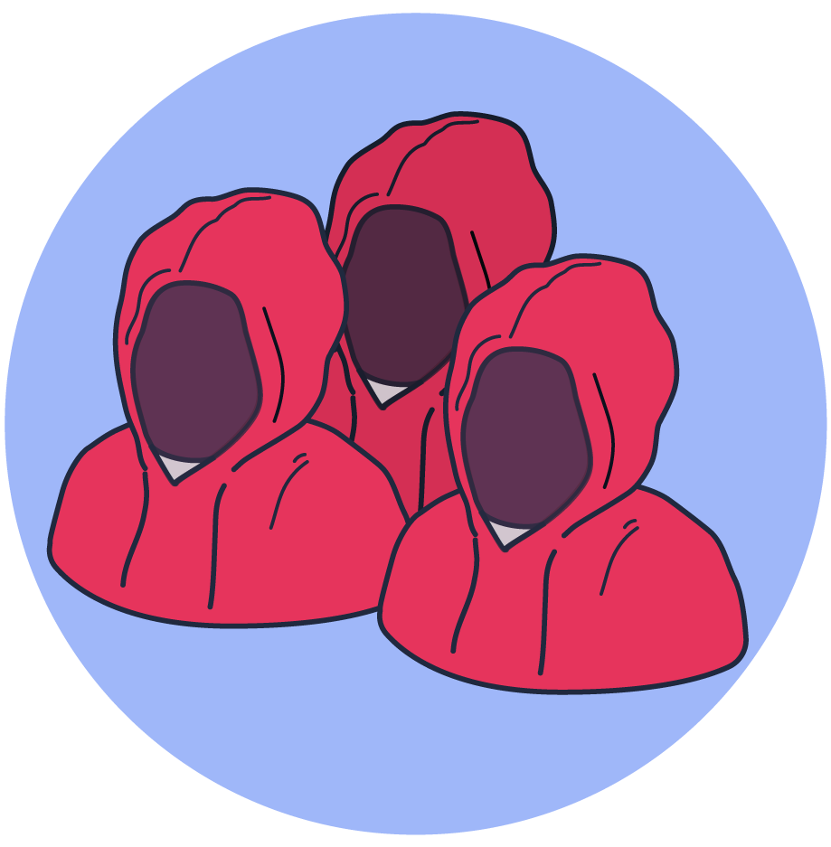
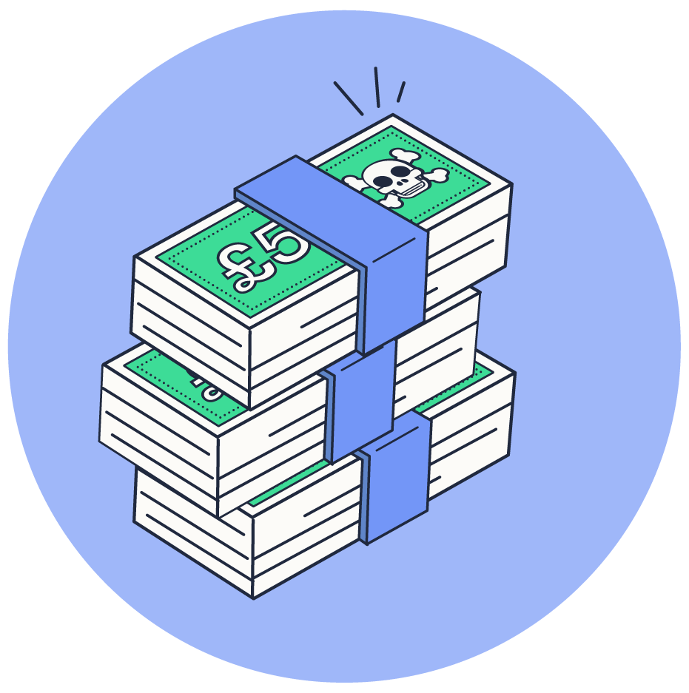
The four categories of online risks as defined by KCSIE:
ONLINE SAFETY
Pornography
Racism
Misogyny
Self-harm and suicide
Content risks –
being exposed to illegal, inappropriate or
harmful content.
Conduct risks –
online behaviour that increases the likelihood of, or causes, harm.
Antisemitism
Radicalisation
Extreme sexual or physical violence
Extremism
Contact risks –
being subjected to harmful online interaction with other users or generative AI applications that simulate this *KCSIE 2026
Commerce risks –
risks such as online gambling, inappropriate advertising, phishing and or financial scams.
Misinformation, disinformation and conspiracy theories
Notes:
Online safety
All staff should be aware that technology is a significant component in many safeguarding and wellbeing issues.
Click to reveal the four categories of online risks as defined by KCSIE.
You could encourage staff to say these aloud before you reveal them on screen.
This includes content, contact, conduct and commerce risks.
Content: being exposed to illegal, inappropriate, or harmful content, for example: pornography, racism, misogyny, self-harm, suicide, antisemitism, radicalisation, extremism, extreme sexual or physical violence, misinformation, disinformation (including fake news) and conspiracy theories,
Contact: being subjected to harmful online interaction with other users or generative AI applications that simulate this; for example: peer to peer pressure, commercial advertising and adults posing as children or young adults with the intention to groom or exploit them for sexual, criminal, financial or other purposes,
The updated KCSIE guidance recognises the rapidly evolving safeguarding risks associated with AI technologies.
Conduct: online behaviour that increases the likelihood of, or causes, harm; for example, making, sending and receiving explicit images, including those generated using AI and online bullying, and
Commerce: risks such as online gambling, inappropriate advertising, phishing and or financial scams. If you feel your pupils, students or staff are at risk, please report it to the Anti-Phishing Working Group.
Click to reveal some of the risks that children may be exposed to online.
Sources of information:
https://assets.publishing.service.gov.uk/media/6a4cf903b7203c4c023fd2f3/Keeping_children_safe_in_education_2026_.pdf

Slide 35
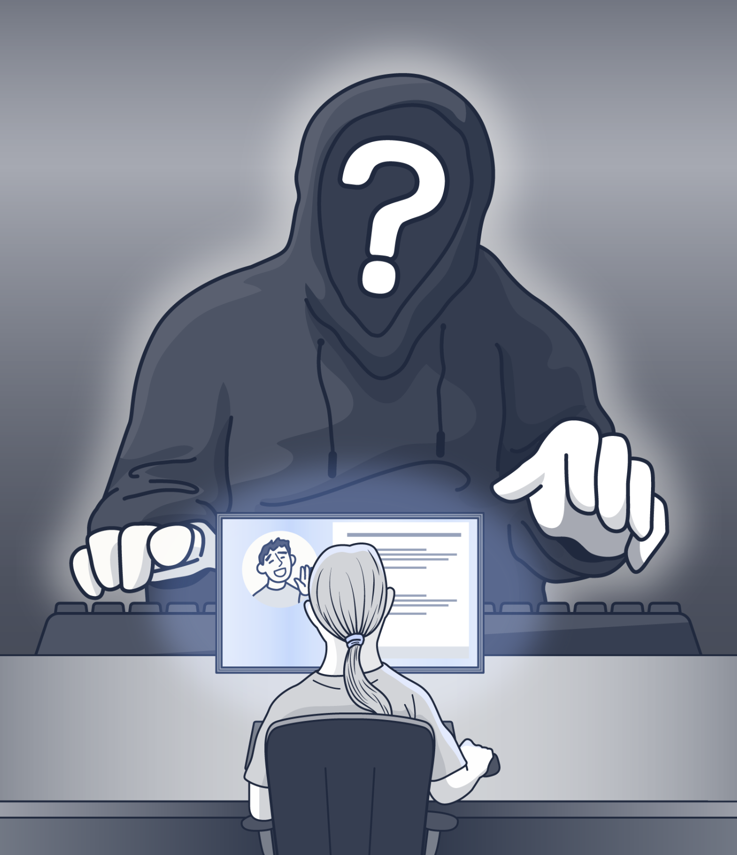
ONLINE SAFETY
Misogynistic content and online influencers
Young people are exposed to toxic misogynistic content online. The views expressed in this content negatively impacts young people’s behaviour and attitudes towards women and girls.
“We see these ideologies moving off screens and into school yards” [2024 research by UCL]
KCSIE states that hostile or dismissive gender-based attitudes must never be minimised as "boys being boys" or "part of growing up." Staff must treat these behaviours as explicit indicators of online harm and peer abuse.
Notes:
Misogynistic content and online influencers
As referenced on the slide from the 2024 research by UCL, harmful views and tropes are now becoming normalised among young people. Online consumption is impacting young people’s offline behaviours, as we see these ideologies moving off screens and into school yards.
Principal investigator Dr Kaitlyn Regehr (UCL Information Studies) said: “Algorithmic processes on TikTok and other social media sites target people’s vulnerabilities – such as loneliness or feelings of loss of control – and gamify harmful content. As young people microdose on topics like self-harm, or extremism, to them, it feels like entertainment.”
When young pupils see sexist content online and then come to school to share and discuss it, they echo the same views and biases. If this is then left unchallenged, the attitude is normalised and female pupils are subjected to increasingly misogynistic behaviour. This contributes to the normalisation of rape culture.
KCSIE states that “early intervention in inappropriate behaviour such as misogyny can help to prevent escalation to more serious abuse such as sexual harassment and sexual violence”.
If you want to take a moment for reflection, you can ask staff one of the following questions:
How are we actively challenging misogynistic language or "influencer tropes" used by pupils in our school?
Do we recognise this as an online safeguarding indicator?
Sources of information:
https://www.highspeedtraining.co.uk/hub/misogyny-in-schools/?utm_source=inset-pack-2026&utm_medium=referral&utm_campaign=inset-pack-2026
https://www.highspeedtraining.co.uk/hub/what-is-the-manosphere/?utm_source=inset-pack-2026&utm_medium=referral&utm_campaign=inset-pack-2026
https://www.highspeedtraining.co.uk/hub/incel-culture-in-schools/?utm_source=inset-pack-2026&utm_medium=referral&utm_campaign=inset-pack-2026
https://assets.publishing.service.gov.uk/media/6a4cf903b7203c4c023fd2f3/Keeping_children_safe_in_education_2026_.pdf
https://www.ucl.ac.uk/news/2024/feb/social-media-algorithms-amplify-misogynistic-content-teens

Slide 36

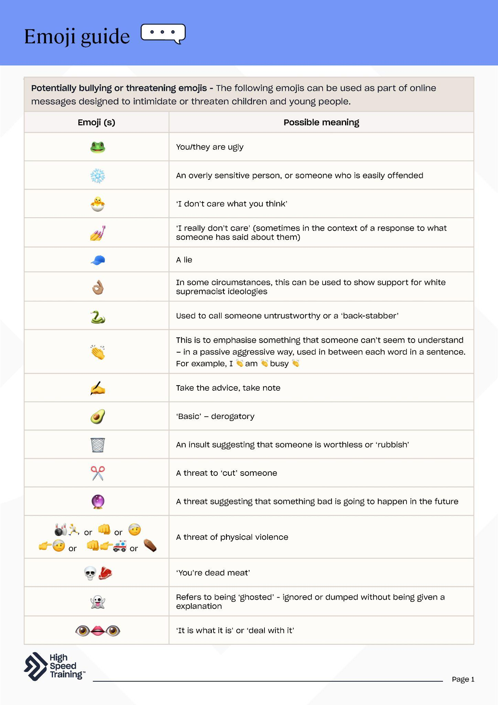
Knowledge check
SDR
💜
KYS
🐍
AWALT
🔴 / 💊
Stands for ‘all women are
like that’
Refers to the ‘red pill’ and a reference to the film The Matrix.
To have ‘taken the red pill’ means to have realised the ‘truth’ about women and society.
Send to receive (in relation to explicit photographs).
The purple heart emoji can be used to show a message was sent in a flirtatious way, or that the sender is horny.
This stands for “kill yourself” and is used to make of fun of someone after they do something embarrassing, or can be used as a form of harassment.
Used to call someone untrustworthy or a ‘back-stabber’
Emoji and abbreviations guide
Notes:
Knowledge check
Emojis and text abbreviations are forming a fast-growing hidden language amongst young people - of which many adults are completely unaware.
This can bring a variety of complex safeguarding risks, so it is important that anyone who works with, or cares for, young people is aware of the potential hidden meanings of these messages.
Explain to staff that you are going to present a number of emojis and text abbreviations that might indicate a safeguarding risk.
Click to reveal the first emoji and take answers from staff on what they think this means, then click to reveal the answer on screen. There’s a total of 6 including:
AWALT - Stands for ‘all women are like that’
🔴 / 💊 - Refers to the ‘red pill’ and a reference to the film The Matrix. To have ‘taken the red pill’ means to have realised the ‘truth’ about women and society.
SDR - Send to receive (in relation to explicit photographs).
💜 - The purple heart emoji can be used to show a message was sent in a flirtatious way, or that the sender is horny.
KYS - This stands for “kill yourself” and is used to make of fun of someone after they do something embarrassing, or can be used as a form of harassment.
🐍 - Used to call someone untrustworthy or a ‘back-stabber’
We have produced a downloadable emoji guide, alongside an abbreviations download. It may be useful to provide these PDFs to staff.
Highlight that you don't need staff to become urban dictionary experts, but it’s important to recognise the ‘hidden language’ if you see anything written on a desk, typed in a school chat, or spoken in a corridor.
Sources of information:
https://www.highspeedtraining.co.uk/hub/a-guide-to-emojis-and-texting-abbreviations/?utm_source=inset-pack-2026&utm_medium=referral&utm_campaign=inset-pack-2026

Slide 37




How can we help pupils navigate the online world safely and confidently?
Embed online safety and digital
resilience across the curriculum
Integrate media literacy into PSHE.
Teach pupils how to spot extreme influencer
rhetoric and misinformation, while equipping
them with clear strategies to report harm.
Engage and support parents
and carers
Regularly share resources and
advice to bridge the safety gap
between school and home.
Signpost visible support
Display internet safety posters and refer
to useful content so pupils know exactly
how to report concerns or seek help.
Understand our filtering and
monitoring systems
Ensure our systems actively block
harmful online content while
monitoring any concerning behaviour
to catch patterns of concern early.
Notes:
How can we help pupils navigate the online world safely and confidently?
The DfE states that schools should 'help pupils to navigate the online world safely and confidently'
Embed online safety and digital resilience across the curriculum
Integrate media literacy into PSHE. Teach pupils how to spot extreme influencer rhetoric and misinformation, while equipping them with clear strategies to report harm.
Engage and support parents and carers
Regularly share resources and advice to bridge the safety gap between school and home.
Signpost visible support
Display internet safety posters and refer to useful content so pupils know exactly how to report concerns or seek help. Download our range of free posters here.
Understand our filtering and monitoring systems
Ensure our systems actively block harmful online content while monitoring any concerning behaviour to catch patterns of risk early.
KCSIE expects schools to review the effectiveness of their filtering and monitoring arrangements at least once every academic year, and this is one of the key messages introduced in the 2026 guidance - making this a critical focus for our leadership and safeguarding teams this year.
Download our free filtering and monitoring checklist here to ensure staff fully understand their responsibilities and recognise the role they play in establishing an effective filtering and monitoring system.
As you’ll know from the news, the Government has announced a possible social media ban for under 16s. However KCSIE and DfE guidance are clear that our job doesn’t stop. Young people will still access the digital world through gaming and messaging services, and age-bypassing will still occur. Filtering systems must remain incredibly robust, and PSHE lessons on media literacy are more critical than ever to ensure children are resilient when they transition onto these platforms.
Sources of information:
https://www.highspeedtraining.co.uk/hub/internet-safety-posters-for-schools/?utm_source=inset-pack-2026&utm_medium=referral&utm_campaign=inset-pack-2026
https://www.highspeedtraining.co.uk/hub/what-is-media-literacy/?utm_source=inset-pack-2026&utm_medium=referral&utm_campaign=inset-pack-2026
https://www.highspeedtraining.co.uk/hub/parents-guide-to-social-media/?utm_source=inset-pack-2026&utm_medium=referral&utm_campaign=inset-pack-2026
https://www.highspeedtraining.co.uk/hub/how-to-explain-internet-safety-to-children/?utm_source=inset-pack-2026&utm_medium=referral&utm_campaign=inset-pack-2026
https://www.highspeedtraining.co.uk/hub/filtering-and-monitoring-in-schools/?utm_source=inset-pack-2026&utm_medium=referral&utm_campaign=inset-pack-2026

Slide 38

KCSIE explicitly states that child-on-child abuse must never be downplayed, passed off as an inevitable part of growing up, or dismissed as "just banter." This can include:
Bullying
Abuse in intimate personal relationships between children
Physical abuse such as hitting, kicking, hair pulling, or otherwise causing physical harm
Sexual harassment
Consensual and non-consensual making or sharing of nudes or semi-nudes
Upskirting
Initiation/hazing type violence and rituals
CHILD-ON-CHILD ABUSE
It can happen anywhere - inside school, outside school, and online.
Notes:
Child-on-child abuse
All staff should be aware that children can abuse other children.
It is essential that staff understand the importance of challenging inappropriate behaviours between children that are abusive in nature.
Downplaying certain behaviours, for example dismissing sexual harassment as “just banter”, “just having a laugh”, “part of growing up” or “boys being boys” can lead to a culture of unacceptable behaviour, misogyny, an unsafe environment for children and in worst case scenarios a culture that normalises abuse leading to children accepting it as normal and not coming forward to report it.
All staff should be aware that child-on-child abuse is a safeguarding issue for both the victim and alleged perpetrator.
Sources of information:
https://assets.publishing.service.gov.uk/media/6a4cf903b7203c4c023fd2f3/Keeping_children_safe_in_education_2026_.pdf
https://www.highspeedtraining.co.uk/hub/child-on-child-abuse/?utm_source=inset-pack-2026&utm_medium=referral&utm_campaign=inset-pack-2026

Slide 39

AI and deepfakes
CHILD-ON-CHILD ABUSE
Generating, altering, or distributing fake intimate content of peers is a form of sexual harassment and child-on-child abuse.
As stated in KCSIE, this includes consensual and non-consensual making or sharing of nudes and seminudes, including those generated using AI.
Notes:
AI and deepfakes
It’s important to note that the definition of child-on-child abuse now specifically includes the sharing of AI generated images and videos, including deepfakes.
For the purposes of KCSIE guidance, the term ‘making or sharing nudes and seminudes’ refers to the creation, sending or posting of nude or semi-nude images by young people under the age of 18.
Images may be taken by the child themselves (sometimes referred to as ‘self-generated imagery’) or taken or created by another person. They may also be digitally altered or wholly generated using artificial intelligence, including what are sometimes described as ‘deepfakes’ or ‘deep nudes’
Taking and sharing nude photographs of those aged under 18, including those generated using AI, is a criminal offense.
Sources of information:
https://www.highspeedtraining.co.uk/hub/ai-generated-abuse-deepfakes/?utm_source=inset-pack-2026&utm_medium=referral&utm_campaign=inset-pack-2026
https://assets.publishing.service.gov.uk/media/6a4cf903b7203c4c023fd2f3/Keeping_children_safe_in_education_2026_.pdf

Slide 40
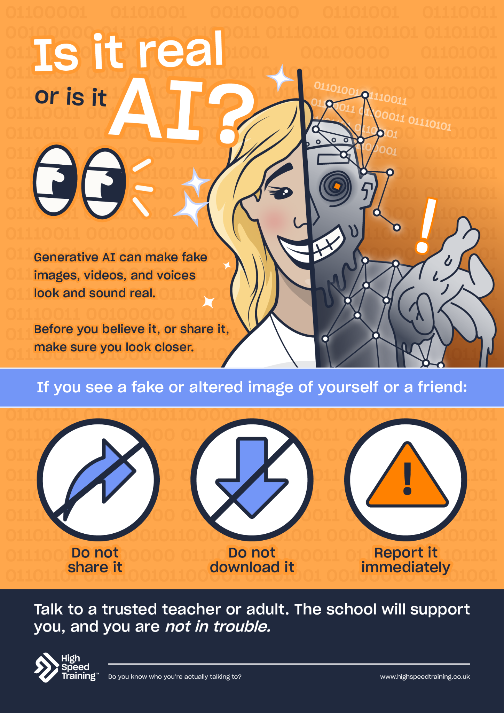

SCENARIO
If a pupil in your class became the victim of a malicious, AI-generated ‘deepfake’ prank by a peer today, what steps would you take?
Pause and reflect
Do our pupils know exactly how
to protect themselves, including
how to report a deepfake, block
perpetrators, and save evidence
without sharing the media further?
If a pupil tells you about an altered image, deepfake, or online extortion attempt,
do not view or share the media. Report it to a DSL immediately.
AI Safety Poster
Notes:
Scenario
Give staff 60 seconds to look at the scenario.
If a pupil in your class became the victim of a malicious, AI-generated ‘deepfake’ prank by a peer today, what steps would you take?
Click to reveal a line of text explaining the following point.
If a pupil tells you about an altered image, deepfake, or online extortion attempt, do not view or share the media. Report it to a DSL immediately.
Click to reveal a pause and reflect point.
Do our pupils know exactly how to protect themselves, including how to report a deepfake, block perpetrators, and save evidence without sharing the media further?
You could ask staff to share their thoughts, and also explain that they can download and use the poster shown on screen to help pupils know exactly how to report concerns or seek help.
Sources of information:
https://www.highspeedtraining.co.uk/hub/ai-generated-abuse-deepfakes/?utm_source=inset-pack-2026&utm_medium=referral&utm_campaign=inset-pack-2026

Slide 41



How can we help prevent child-on-child abuse?
Be clear and consistent
Make sure to be clear regarding
what is acceptable behaviour,
language, and peer interaction.
Know the high risk “blind spots”
Try to be alert to when children might be
at highest risk around the school day.
Maintain professional curiosity
Never assume that if there
are no reports in our school,
it is not happening.
Challenge inappropriate behaviours
It should never be ignored, accepted,
dismissed or downplayed as “just having
a laugh”.
Notes:
How can we help prevent child-on-child abuse?
Be clear and consistent
Make sure to be clear regarding what is acceptable behaviour, language, and peer interaction.
Know the high risk “blind spots”
Try to be alert to when children might be at highest risk around the school day (for example immediately after school as highlighted in KCSIE).
Maintain professional curiosity
Never assume that if there are no reports in our school, it is not happening.
Challenge inappropriate behaviours
It should never be ignored, accepted, dismissed or downplayed as “just having a laugh”.
As well as knowing how to respond to concerns, all staff should know that child-on-child abuse is preventable. As well as knowing how to recognise behaviours and indicators of risk early, staff should know that timely, evidence based support can be key to preventing children from going on to commit abuse or violence.
Sources of information:
https://assets.publishing.service.gov.uk/media/6a4cf903b7203c4c023fd2f3/Keeping_children_safe_in_education_2026_.pdf

Slide 42
Children can be victims of domestic abuse
DOMESTIC ABUSE
They may see, hear, or experience the effects of abuse at home and/or suffer domestic abuse in their own intimate relationships
Women’s Aid estimate that 160,000 children are currently living in households where domestic abuse is taking place.
Notes:
Domestic abuse
Domestic abuse creates an unsafe living environment for children and young people, regardless of whether they themselves are being physically harmed.
Experiencing domestic abuse is child abuse. Regardless of whether a child is being harmed themselves, domestic abuse always has an impact on children and witnessing it can have a seriously harmful effect. The extent of this impact is recognised by the Domestic Abuse Act 2021 which identifies children who have been exposed to domestic abuse as victims themselves, rather than solely witnesses.
An estimated 160,000 children in England are currently living in households where domestic abuse is taking place.
Sources of information:
https://www.highspeedtraining.co.uk/hub/domestic-abuse-in-children/?utm_source=inset-pack-2026&utm_medium=referral&utm_campaign=inset-pack-2026
https://womensaid.org.uk/what-we-do/hiddenvictims/#:~:text=An%20estimated%20160%2C000%20children%20in,domestic%20abuse%20is%20taking%20place.&text=This%20is%20why%20we've,victims%20of%20domestic%20abuse%3A%20children.

Slide 43

Signs that a child is being exposed to domestic abuse can include:
DOMESTIC ABUSE
Replicating or replaying what they see at home in school or clubs
Being easily startled
Nightmares or insomnia
Frequent sickness and/or truancy
Becoming aggressive or having violent outbursts
Anxious about being away from home because they have to ‘protect’ their parent who is the victim of domestic abuse
Notes:
Signs of domestic abuse
Click to reveal some signs that a child is being exposed to domestic abuse.
It can be difficult to spot signs of domestic abuse, especially if a child is not being physically harmed. Nevertheless, witnessing domestic abuse can cause emotional and psychological damage, the signs of which you must be able to recognise in order to act accordingly.
Sources of information:
https://www.highspeedtraining.co.uk/hub/domestic-abuse-in-children/?utm_source=inset-pack-2026&utm_medium=referral&utm_campaign=inset-pack-2026

Slide 44
What is our responsibility?
What is it?
Why do we
receive it?
If the DSL team shares a notification with you, it is strictly confidential. Your role is to provide a supportive environment, avoid questioning the child about the incident, and monitor
their presentation.
A safeguarding, information sharing partnership between the police and schools. The police are required to notify a school’s DSL of an incident of domestic abuse before the start of the next school day.
It seeks to support children who are experiencing domestic abuse by identifying children in need of support and ensuring that immediate, appropriate support is put in place in a timely manner.
Notes:
Operation Encompass
Click to reveal the answers to three questions, one at a time.
What is it?
A safeguarding, information sharing partnership between the police and schools. The police are required to notify a school’s DSL of an incident of domestic abuse before the start of the next school day.
Why do we receive it?
It seeks to support children who are experiencing domestic abuse by identifying children in need of support and ensuring that immediate, appropriate support is put in place in a timely manner.
What is our responsibility?
If the DSL team shares a notification with you, it is strictly confidential. Your role is to provide a supportive environment, avoid questioning the child about the incident, and monitor their presentation.
Operation Encompass was created in 2010 by head teacher Elisabeth Carney-Haworth and her husband, police officer David Carney-Haworth. You can read more about this here.
Sources of information:
https://www.highspeedtraining.co.uk/hub/operation-encompass/?utm_source=inset-pack-2026&utm_medium=referral&utm_campaign=inset-pack-2026
https://www.highspeedtraining.co.uk/hub/domestic-abuse-in-children/?utm_source=inset-pack-2026&utm_medium=referral&utm_campaign=inset-pack-2026

Slide 45


How can we support a child who is being exposed to domestic abuse?
Stay alert and use professional curiosity
Children often do not recognise controlling or
violent households as "abuse" because it is
their normal. Use professional curiosity
to read between the lines of subtle
behaviour changes.
Explain healthy relationships
Teaching children and young people
what a healthy relationship looks like
will help them to recognise signs of
abuse in their own relationships.
Maintain an ongoing, trusted relationship
If a child discloses domestic abuse,
ensure you maintain open, non-judgmental communication. Never use victim-blaming
language.
Support Operation Encompass
When information is shared with you,
ensure you provide appropriate support
in the classroom and stay alert to the child's behaviour.
Notes:
How can we support a child who is being exposed to domestic abuse?
Stay alert and use professional curiosity
Children often do not recognise controlling or violent households as "abuse" because it is their normal. Use professional curiosity to read between the lines of subtle behaviour changes.
Explain healthy relationships
Teaching children and young people what a healthy relationship looks like will help them to recognise signs of abuse in their own relationships.
Maintain an ongoing, trusted relationship
If a child discloses domestic abuse, ensure you maintain open, non-judgmental communication. Never use victim-blaming language.
Support Operation Encompass
When information is shared with you, ensure you provide appropriate support in the classroom and stay alert to the child's behaviour.
Sources of information:
https://www.highspeedtraining.co.uk/hub/domestic-abuse-in-children/?utm_source=inset-pack-2026&utm_medium=referral&utm_campaign=inset-pack-2026

Slide 46
SUPPORTING PUPILS QUESTIONING THEIR GENDER
KCSIE suggests that schools should generally take a cautious and individualised approach to supporting children who are questioning their gender. The guidance also states:
Schools should not initiate any action regarding social transition.
Parents or carers should usually be involved.
Schools should focus on safeguarding and wellbeing.
Where a child’s wellbeing or safety may be affected, schools should look to secure coordinated support, early help pathways and multi-agency involvement where appropriate, in line with Working Together to Safeguard Children guidelines.
Notes:
Supporting pupils who are questioning their gender
In recent years, we have seen a significant increase in the number of children who are questioning the way they feel about being a boy or a girl, including the physical attributes of their sex and the related ways in which they fit into society.
KCSIE guidance states:
Schools and colleges should not initiate any action regarding social transition. Accommodating social transition is an active intervention so schools and colleges should take a very careful approach
Parents and carers should be actively involved and their views treated with importance. It is important that the views of the child’s parents or carers should carry great weight and be properly considered. However, in the rare circumstances where involving parents or carers would constitute a greater risk to the child than not involving them, the school should involve their designated safeguarding lead to determine what action is needed to safeguard the child, before the parents or carers are contacted or any decisions are taken.
Schools and colleges have statutory duties to safeguard and promote the welfare of all children. They should consider how best to fulfil that duty towards a child who is questioning their gender, as well as their peers, ensuring that any agreed course of action takes account of the impact on all of those affected.
Where a child’s wellbeing or safety may be affected, schools should look to secure coordinated support, early help pathways and multi-agency involvement where appropriate, in line with Working Together to Safeguard Children guidelines.
Sources of information:
https://assets.publishing.service.gov.uk/media/6a4cf903b7203c4c023fd2f3/Keeping_children_safe_in_education_2026_.pdf
https://assets.publishing.service.gov.uk/media/69fb1c28d0e316a40f269a5b/Working_together_to_safeguard_children_2026_a_guide_to_multi_agency_working.pdf

Slide 47
Our responsibilities to support pupils questioning their gender
Offer strong pastoral care
All children should feel safe, listened to
and protected from bullying or harassment.
Take a cautious, safeguarding-led and
case-by-case approach.
No informal accommodations
Individual staff members must not
make ad-hoc or informal adjustments
in the classroom.
Follow the formal process
Avoid making immediate decisions in
response to requests and instead ensure
that concerns are managed through our
safeguarding procedures.
Uphold single-sex spaces
To comply with statutory duties, children
must not be permitted into toilets, changing
rooms, or boarding or residential
accommodation designated for the opposite
biological sex.
Notes:
Our responsibilities to support pupils questioning their gender
Offer strong pastoral care
All children should feel safe, listened to and protected from bullying or harassment. Take a cautious, safeguarding-led and case-by-case approach.
No informal accommodations
Individual staff members must not make ad-hoc or informal adjustments in the classroom.
Follow the formal process
Avoid making immediate decisions in response to requests and instead ensure that concerns are managed through our safeguarding procedures.
Uphold single-sex spaces
To comply with statutory duties, children must not be permitted into toilets, changing rooms, or boarding or residential accommodation designated for the opposite biological sex.
Sources of information:
https://assets.publishing.service.gov.uk/media/6a4cf903b7203c4c023fd2f3/Keeping_children_safe_in_education_2026_.pdf
https://www.gov.uk/government/publications/including-guidance-on-children-who-are-questioning-their-gender-in-kcsie/including-guidance-on-children-who-are-questioning-their-gender-in-keeping-children-safe-in-education-kcsie
https://www.stonewall.org.uk/shaping-policy/dont-repeat-history-protect-lgbtq-inclusive-education/gender-questioning-children-guidance

Slide 48
Amara, aged 12
Amara, usually a bright and high-achieving student, has recently become extremely socially isolated. Her school attendance has dropped significantly, and her form tutor has noticed that sometimes she wears oversized, heavy clothing even in warm weather and often refuses to engage in PE.
During a lesson, Amara becomes visibly overwhelmed by a simple task and runs out of the classroom. Later that afternoon, a classmate privately confides in you. They are terrified because Amara has been posting dark messages on a WhatsApp group, including a message from last night suggesting she "won't be around much longer anyway."
SCENARIO A
Notes:
Scenario A
Explain to staff that you are now going to look at two safeguarding scenarios.
Click to present Scenario A (Amara, aged 12).
Ask staff to discuss the scenario. Do they feel that it constitutes a safeguarding issue? If so, what action might they take?

Slide 49
Leo, aged 14
Leo is a popular student whose behaviour has deteriorated over the past few months. He has become increasingly argumentative, particularly with female members of staff.
During a recent class discussion, Leo loudly challenged a female teacher’s authority, dismissing her views and repeating controversial rhetoric he claimed to have learned online about "alpha males."
Later that week, a teacher on duty overhears Leo in the corridor surrounded by a group of younger boys. He is loudly mocking a female classmate's appearance and when challenged by the teacher, Leo rolls his eyes.
SCENARIO B
Notes:
Scenario B
Click to present Scenario B to staff (Leo, aged 14).
Ask staff to discuss the scenario. Do they feel that it constitutes a safeguarding issue? If so, what action might they take?

Slide 50
Statutory guidance requires that all staff remain vigilant to a wide range of specific safeguarding risks. For example:
Which of these specific areas do you feel you might need more insight on, signs to look for, or resources to support you?
Children missing education (CME)
County lines
Child criminal exploitation (CCE)
Domestic abuse
Child-on-child abuse
Female genital mutilation (FGM)
Online safety
Child sexual exploitation (CSE)
Honour-based abuse (HBA)
Prevent (radicalisation and extremism)
Mental health
Discussion point
Notes:
Reflecting on safeguarding issues
Statutory guidance requires that all staff remain vigilant to a wide range of specific safeguarding risks.
All staff should have an awareness of safeguarding issues that often overlap and can put children at risk of harm, as clarified in KCSIE 2026.
Click to reveal the issues on screen.
Allow staff some time to take a look at the wide variety of issues presented.
Click to reveal the discussion point.
Which of these specific areas do you feel you might need more insight on, signs to look for, or resources to support you?
There will be an opportunity to speak about areas for CPD towards the end of the session, so you could advise staff to make a note of any particular issues that stand out to them which they can discuss later.

Slide 51
Further resources and support
If you’d like to learn more about the topics covered in this section, here are some useful resources:
Mental health resource pack and posters (PDFs)
How to promote positive mental health
Child mental health quiz
Child mental health training
Internet safety posters
for schools (PDFs)
Understanding AI-generated abuse: deepfakes
A guide to emojis and texting abbreviations (PDFs)
Online safety and harms training
What you need to know about child-on-child abuse
A guide to misogyny in schools
What you need to know about Operation Encompass
The impact of domestic abuse on children
Guidance for teachers on gender questioning children
Guidance on filtering and monitoring in schools (PDF)
Safeguarding scenarios and answers for education
Safeguarding courses
Notes:
Further resources and support
If staff would like to find out more about topics covered in this section, advise them that they can visit the links as shown.
There’s a PDF summary of this section available for all staff included in the pack (you could send the summary sheets PDF to staff following the session).
We have a range of useful downloadable resources which include:
Mental health resource pack and posters
Internet safety posters
Emoji and texting abbreviations guide
Filtering and monitoring checklist

Slide 52

Responding to and sharing concerns
Write your school name here
4
Notes:
The third section of today’s session will focus on responding to and sharing concerns.
You’ll cover the key actions to take when concerns about a child arise.
We are going to use the 4Rs of safeguarding in this section to talk about our responsibilities.

Slide 53
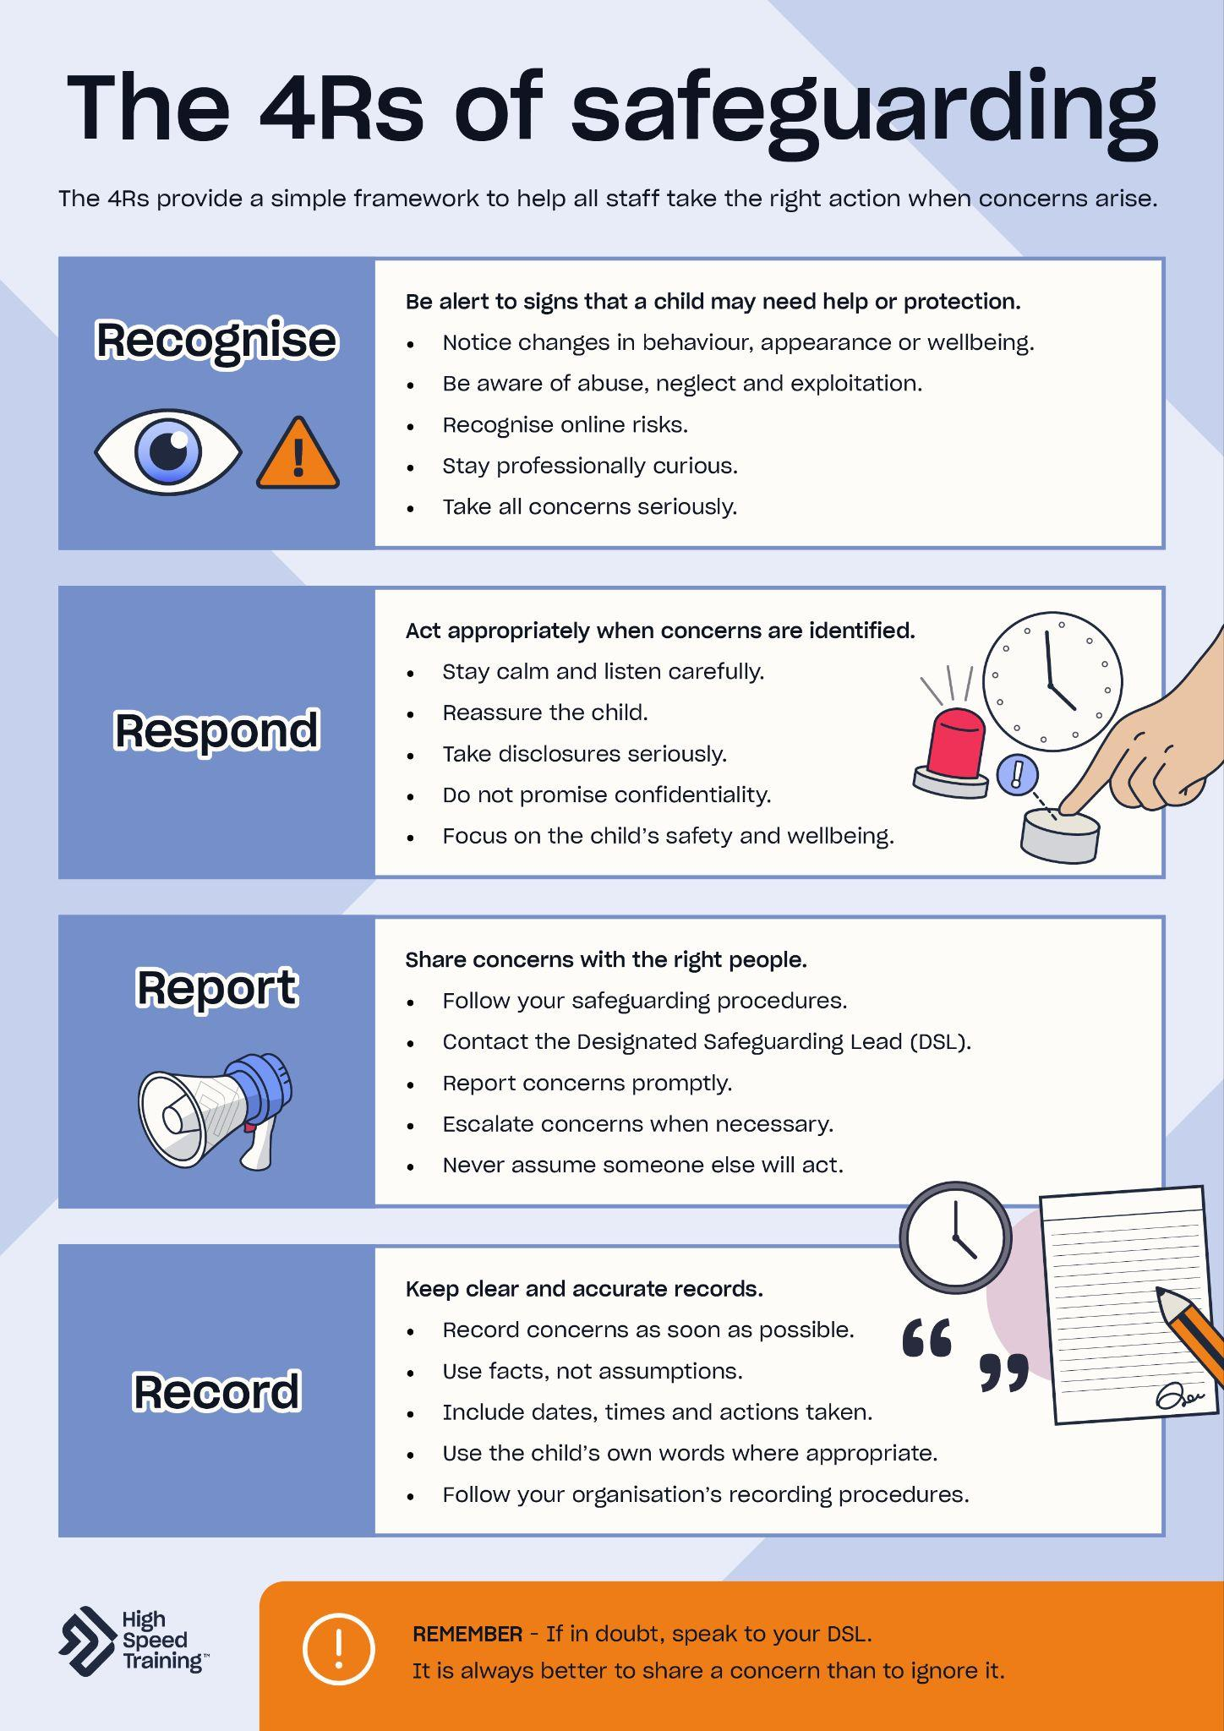
The 4Rs of safeguarding
provide a simple framework that can help all staff remember the key actions they should take when concerns about a child arise.
The 4R's of Safeguarding Poster
Notes:
The 4Rs of safeguarding
Introduce the 4Rs of safeguarding as a simple framework that helps ensure important safeguarding steps are not missed when concerns arise.
The 4Rs of safeguarding are:
Recognise
Respond
Report
Record
Importantly, the 4Rs are not just relevant to DSLs or senior leaders - every adult working with children should understand how to apply them in practice.
Sources of information:
https://www.highspeedtraining.co.uk/hub/4rs-of-safeguarding/?utm_source=inset-pack-2026&utm_medium=referral&utm_campaign=inset-pack-2026

Slide 54



Recognise
Witnessing something first-hand
A direct disclosure
Receiving information from another source
An indirect disclosure
Notes:
Recognise
The first step in safeguarding is recognising when a child may be experiencing abuse, neglect or another safeguarding concern.
Best practice includes:
Remaining alert to changes in behaviour, appearance or presentation.
Understanding the signs and indicators of different forms of abuse and neglect.
Being professionally curious when concerns arise.
Considering patterns, rather than isolated incidents.
Taking low-level concerns seriously.
Staying informed about emerging safeguarding risks.
Listening to children and taking their concerns seriously.
The latest KCSIE guidance also reinforces the need for staff to understand both offline and online risks that children may face.
Sources of information:
https://www.highspeedtraining.co.uk/hub/4rs-of-safeguarding/?utm_source=inset-pack-2026&utm_medium=referral&utm_campaign=inset-pack-2026

Slide 55
Respond
Do’s
Don'ts
✓ Remain calm and level-headed
✓ Reassure the child
✓ Listen carefully and actively
✓ Let them know that you are taking
what they say seriously
✓ Tell them what will happen next
and be honest about what you do
and do not know about what
might happen as a result of
their disclosure
✓ Make a note of exactly what
they have told you as soon as
possible with dates and times
✓ Share the concern
following procedure
✘ Promise to keep secrets
✘ Rush the child’s account
✘ Ask leading questions or try
to interview the child
✘ Make assumptions
✘ Show that you are upset
or angry
✘ Show disbelief or dismiss them
✘ Talk negatively about the potential abuser
Notes:
Respond
You should aim to create an effective culture of safeguarding where children feel able to share their concerns and where they know that they will be listened to and taken seriously.
It is important that you are aware of how a child might disclose information and be confident about what to do if they choose to make a disclosure to you.
Click to reveal the do’s.
Click to reveal the don’ts.
Sources of information:
https://www.highspeedtraining.co.uk/hub/4rs-of-safeguarding/?utm_source=inset-pack-2026&utm_medium=referral&utm_campaign=inset-pack-2026

Slide 56
How do we ensure our reporting pathways are truly visible and approachable for children with SEND or communication barriers?
Discussion point
Notes:
Discussion point
How do we ensure our reporting pathways are truly visible and approachable for children with SEND or communication barriers?

Slide 57
If you have any concerns about a child, or they disclose information to you, then you should report your concerns to your DSL straight away. It should be within 24 hours of it coming to your attention, if not sooner.
Report
Procedures for Responding to Safeguarding Concerns Flowchart
Notes:
Report
Reporting concerns promptly ensures that appropriate action can be taken and that children receive the support and protection they need. Depending on the circumstances, this may involve:
Internal safeguarding support.
Discussions with parents or carers.
Referrals to children’s social care.
Contact with the police.
Consultation with other safeguarding agencies.
Community-based early help or Family Help interventions (which we will go on to discuss more in the next slide).
Staff should:
Report concerns as soon as possible.
Follow organisational safeguarding procedures.
Share concerns even if they seem minor in isolation.
Escalate concerns if appropriate action is not taken.
Seek guidance when unsure.
Understand local referral pathways.
Recognise when concerns may require multi-agency involvement.
The latest WTSC guidance emphasises the importance of multi-agency safeguarding, noting that effective safeguarding relies on professionals sharing information appropriately and working together to support children and families.
Sources of information:
https://www.highspeedtraining.co.uk/hub/4rs-of-safeguarding/?utm_source=inset-pack-2026&utm_medium=referral&utm_campaign=inset-pack-2026

Slide 58
Family Help within the continuum of support
Universal services and community-based Early Help
  A system of support delivered by local authorities and their partners working together to improve a family's resilience and outcomes as soon as problems emerge.
Family Help (targeted support)
  Coordinated multi-agency support that brings together targeted
  Early Help and Section 17 (Child in Need) support into a single, coordinated Family Help plan.
Child protection
  Activity undertaken to protect specific children who are suspected to be suffering, or likely to suffer, significant harm.
Move straight to child protection if a child is suffering,
or likely to suffer, significant harm.
Notes:
Family Help within the continuum of support
As mentioned in the statutory safeguarding guidance section of the session, Family Help combines targeted early help and section 17 support to create a “seamless system of help and support for children and families”. This slide aims to help staff understand exactly where Family Help sits within the wider safeguarding framework.
Universal services and community-based early help
A system of support delivered by local authorities and their partners working together to improve a family's resilience and outcomes as soon as problems emerge.
Family Help (targeted support)
Coordinated multi-agency support that brings together targeted Early Help and Section 17 (Child in Need) support into a single, coordinated Family Help plan.
Child protection
Activity undertaken to protect specific children who are suspected to be suffering, or likely to suffer, significant harm.
Remind staff that you must move straight to child protection if a child is suffering, or likely to suffer, significant harm.
Sources of information:
https://assets.publishing.service.gov.uk/media/69fb1c28d0e316a40f269a5b/Working_together_to_safeguard_children_2026_a_guide_to_multi_agency_working.pdf
https://www.gov.uk/government/publications/keeping-children-safe-in-education--2

Slide 59

Record
The name, age, gender, religion and ethnicity of the child.
Any contextual information you know about the child or their life – for example, do they have a disability? Are there factors outside of the home that have caused further concern?
Details of the concern. Include as much relevant information as possible, whilst keeping the record concise.
The date and time of the incident or disclosure.
Who was involved or present at the time.
Who said what: use their exact words. Remember, do not shy away from recording offensive language, if that is what has been said.
Your name, role and contact details, as the person sharing the concern.
Details of any immediate or agreed actions taken and whether or not a referral was made.
Any conclusions that were drawn from the concern, incident or disclosure (separate out facts and professional opinion).
If you are sharing this with the DSL, they will also add details of their decision process.
Notes:
Record
Records help build a clear picture of a child’s circumstances and can provide important evidence for safeguarding decisions.
Staff should:
Record information promptly.
Be accurate and objective.
Use the child’s own words where appropriate.
Separate facts from opinions.
Include dates, times and actions taken.
Follow organisational recording procedures.
Ensure records remain confidential and secure.
When recording a concern, it’s really important to remember to separate out facts and professional opinion. When noting down a professional opinion, include details of why you formed that opinion. Do not use value judgement terms, which have no meaning, such as ‘inappropriate’.
Poor record keeping can result in important information being missed, delayed or misunderstood.
Sources of information:
https://www.highspeedtraining.co.uk/hub/4rs-of-safeguarding/?utm_source=inset-pack-2026&utm_medium=referral&utm_campaign=inset-pack-2026

Slide 60
Key takeaways
Never ignore a concern. You do not have to be right or sure or have definitive evidence.
Timely reporting is important. Always make sure to log your concerns on [insert school system name here] within 24 hours.
If in doubt, speak to your DSL. You are never alone in making these decisions.
Notes:
Please note: you should edit the details regarding your school system name before presenting this slide.
Key takeaways
Briefly recap the key takeaways from the recording and reporting concerns section.
Never ignore a concern.
Timely reporting is important.
If in double, speak to your DSL.
If you want to take a moment for reflection, you can ask staff one of the following questions:
Knowing how vital timely reporting is, what practical steps can we take as a team to ensure urgent safeguarding concerns are logged immediately, rather than waiting until the end of the day or the next morning?
Would you all know exactly where to find the DSL if you had an emergency issue, and do you feel confident using our internal logging systems?
Open the floor to questions about your specific school reporting systems.
Going back to the start of the session, remind staff that every piece of data you record helps lighten that invisible backpack our children may be carrying.

Slide 61
Further resources and support
If you’d like to learn more about the topics covered in this section, here are some useful resources:
Safeguarding flowchart (PDF)
Answering common questions about whistleblowing
Child protection body map template (PDF)
A guide to data protection for schools
Responding to a disclosure poster (PDF)
Advanced safeguarding children training
Responding to and sharing concerns (PDF)
Notes:
Further resources and support
If staff would like to find out more about topics covered in this section, advise them that they can visit the links as shown.
There’s a PDF summary of this section available for all staff included in the pack (you could send the summary sheets PDF to staff following the session).
We have a range of useful downloadable resources which include:
Safeguarding flowchart
Child protection body map template
Responding to a disclosure poster

Slide 62
Safeguarding culture
Write your school name here
5
Notes:
The fifth section of today’s session will focus on safeguarding culture.
You’ll cover the ways in which you can create and maintain an effective safeguarding culture.
This is about your lived, daily environment and mindset, not just compliance.

Slide 63
Notes:
Video content
A safeguarding culture means that safeguarding is key to every aspect of a setting. It can be found at the heart of a school’s values and ethos, and is subsequently reflected in its environments and practices.
Click on the play icon to start the video (duration of 2:45). To enable captions, simply click on the ‘subtitles/closed captions’ icon that appears to the bottom right of the controls once the video begins to play.
This video will cover what a safeguarding culture is, why it is important, and the role of professional curiosity.
If you need the link to access the video, you can find it here: https://youtu.be/CFZDl4rrUAc
Following the video, you can remind staff that as Ian and Joanna just outlined, safeguarding isn't a job for one person. Ian showed us where the pieces are - at the gates, in the transitions. Joanna showed us that everyone from the kitchen to the playground holds them. Your job isn't to solve the whole puzzle; it's just to pass your piece to the DSL.

Slide 64
Professional curiosity
  The practice of looking past the surface.
  It means noticing when an explanation doesn't quite match reality, and gently probing rather than accepting it at face value.
“It could happen here”
Remember: You don't need the whole picture to notice when something doesn't look right.
Notes:
“It could happen here”
If we assume issues like abuse, grooming, or neglect don’t happen in our community, we stop looking for the jigsaw pieces. That’s why we must always maintain an attitude of “it could happen here and may well be happening”.
Maintain an open mind, ask proactive questions, and - crucially - have the confidence to respectfully challenge decisions if your gut tells you that something isn't right.
Remember: You don't need the whole picture to notice when something doesn't look right.
The next slide looks at putting curiosity into practice with a scenario for the team to discuss.

Slide 65
Putting curiosity into practice
Liam (Year 9) who has always been a quiet but steady student, has started falling asleep during his lessons. When his form tutor gently challenges him about it, Liam shrugs it off and mutters: "Sorry, I was just up late playing video games with some mates. I lost track of time."
SCENARIO
Notes:
Scenario
Think, pair, share. Ask staff to take 60 seconds with the person next to them to look at this scenario.
The surface explanation sounds harmless, and it is very easy to accept when you are busy.
“No worries, Liam. I hope you’ll get to bed much earlier tonight!”
But if we apply a professionally curious lens to this, what doesn’t sit quite right? What is the potential jigsaw piece that might help the safeguarding team connect it to wider indicators?

Slide 66
Safeguarding isn't just waiting for a disclosure.
It's creating an environment where children feel safe enough to speak up.
Centering the pupil voice
Pause and reflect
If a child or a colleague walked into our
school today with a hidden burden, what is it
about your daily behaviour, body language, or
environment that signals to them: 'You are
safe to speak to me'?
Notes:
Pupil voice
When we talk about centering the pupil voice, it’s not just about waiting for a child to come to you with a major disclosure. It’s about the routine, everyday questions that we ask that show them we are actively looking out for them. Safeguarding experts like Ian Curry (from the earlier videos) often focus heavily on this during school reviews. When you are doing your ‘meet and greets’ in the morning, or chatting with students during transitions, keep these core questions in mind. They may help you to find the pieces of the jigsaw that you might otherwise miss.
Safety: "Do you feel safe in school? Is there anywhere in the school building where you don’t feel safe?"
Environment: "What are the toilets or stairwells like during break times? How does it feel in those spaces?"
Culture and bullying: "Does bullying happen here? If it does, do you feel like staff deal with it quickly and consistently?"
Behaviour: "Are you aware of our behaviour policy, and do you feel it's fair?"
Attendance: "How is your attendance? Do you know why being here every day matters so much?"
Online safety: "How are you taught to stay safe, and what can you tell me about online safety?”
If we want children to answer those questions honestly, they have to trust us. So, let’s take a moment to look at our next discussion point.
Click to reveal the pause and reflect box on screen.
If a child or a colleague walked into our school today with a hidden burden, what is it about your daily behaviour, body language, or environment that signals to them: 'You are safe to speak to me'?

Slide 67
Key takeaways
Every piece of the jigsaw matters.
A culture of safeguarding means recognising that your small observation might be the final piece a colleague needs to protect a child.
Develop a professionally curious approach. Look past the surface of easy explanations - always be prepared to respectfully explore what isn't being said.
Notes:
Key takeaways
As you close this section, remind staff to remember that safeguarding is not a matter of ticking boxes, and it must go far beyond simple compliance. For your school to have an effective safeguarding culture, these principles have to be lived, breathed, and constantly revisited. Whilst it is never a comfortable thought, it is essential that you always operate under the view that it could happen to children in your school.
Briefly recap the key takeaways from the culture of safeguarding section.
Every piece of the jigsaw matters.
Develop a professionally curious approach.
If you want to take a moment for reflection, you can ask staff one of the following questions:
How confident do you feel in the culture of safeguarding at our school?
It’s very easy to accept a quick explanation like 'Oh, they're just tired today' or 'They're just having a bad week.' How can we challenge ourselves to look past those easy explanations and dig a little deeper with professional curiosity?
Open the floor to any final questions before heading into the last section of today’s session.

Slide 68
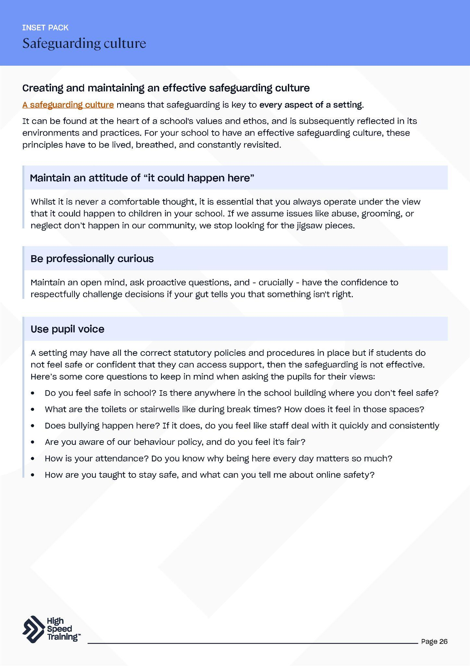
Further resources and support
If you’d like to learn more about the topics covered in this section, here are some useful resources:
How to create an effective culture of safeguarding
A guide to professional curiosity
A guide to contextual safeguarding
5 ways to maximise pupil voice
The purpose of school policies
CPD courses for teaching and education
Culture of safeguarding (PDF)
Notes:
Further resources and support
If staff would like to find out more about topics covered in this section, advise them that they can visit the links as shown.
There’s a PDF summary of this section available for all staff included in the pack (you could send the summary sheets PDF to staff following the session).

Slide 69
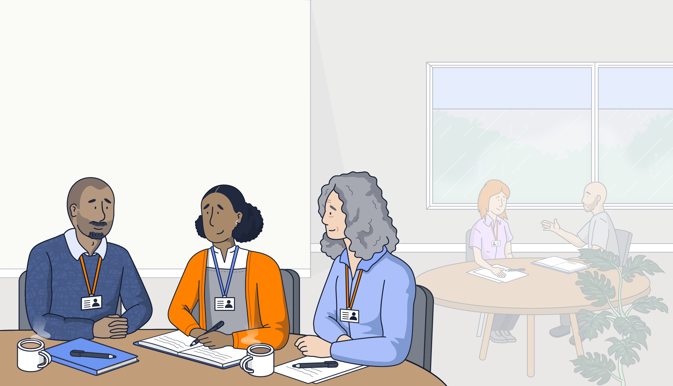
Final thoughts for today’s session
Write your school name here
Notes:
This section will focus on some final thoughts for today’s session.
It will allow you to reflect on what you’ve covered in the presentation and think about next steps regarding your development.

Slide 70
Reflection and discussion
If a colleague couldn't make it today, and you could only give them one single takeaway about our session today, what would it be?
Notes:
Reflection and group discussion
If a colleague couldn't make it today, and you could only give them one single takeaway about our session today, what would it be?
Encourage staff to share their thoughts and provide you with feedback on areas where they have strengthened understanding, and possible gaps in their knowledge.

Slide 71


Looking after yourself
Our school is committed to fostering a supportive, safe culture where staff wellbeing is prioritised and protected.
Recognise the impact - Safeguarding can be emotionally demanding and we must ensure that your wellbeing is supported.
You are not alone - If anything discussed today has raised concerns, or if you feel overwhelmed by a current case, please speak up. Our safeguarding team is here to help.
Help us improve - Wellbeing is a shared responsibility. If you have feedback on how we can better support staff wellbeing or strengthen our safeguarding processes, share your ideas with us.
The Education Support helpline (08000 562 561) offers free, confidential 24/7 support should you need it.
Notes:
Looking after yourself
This slide focuses on staff wellbeing and your commitment to provide a supportive, safe culture where staff wellbeing is prioritised and protected.
Remind staff that:
Safeguarding can be emotionally demanding, so make sure you recognise this impact.
No member of staff is alone and our safeguarding team is always here to support you.
Wellbeing is a shared responsibility. If staff members have any feedback on how to better provide support, encourage them to share with you.
The Education Support helpline (08000 562 561) offers free, confidential 24/7 support should you need it.
Sources of information:
https://www.highspeedtraining.co.uk/hub/wellbeing-in-schools-for-staff/?utm_source=inset-pack-2026&utm_medium=referral&utm_campaign=inset-pack-2026

Slide 72
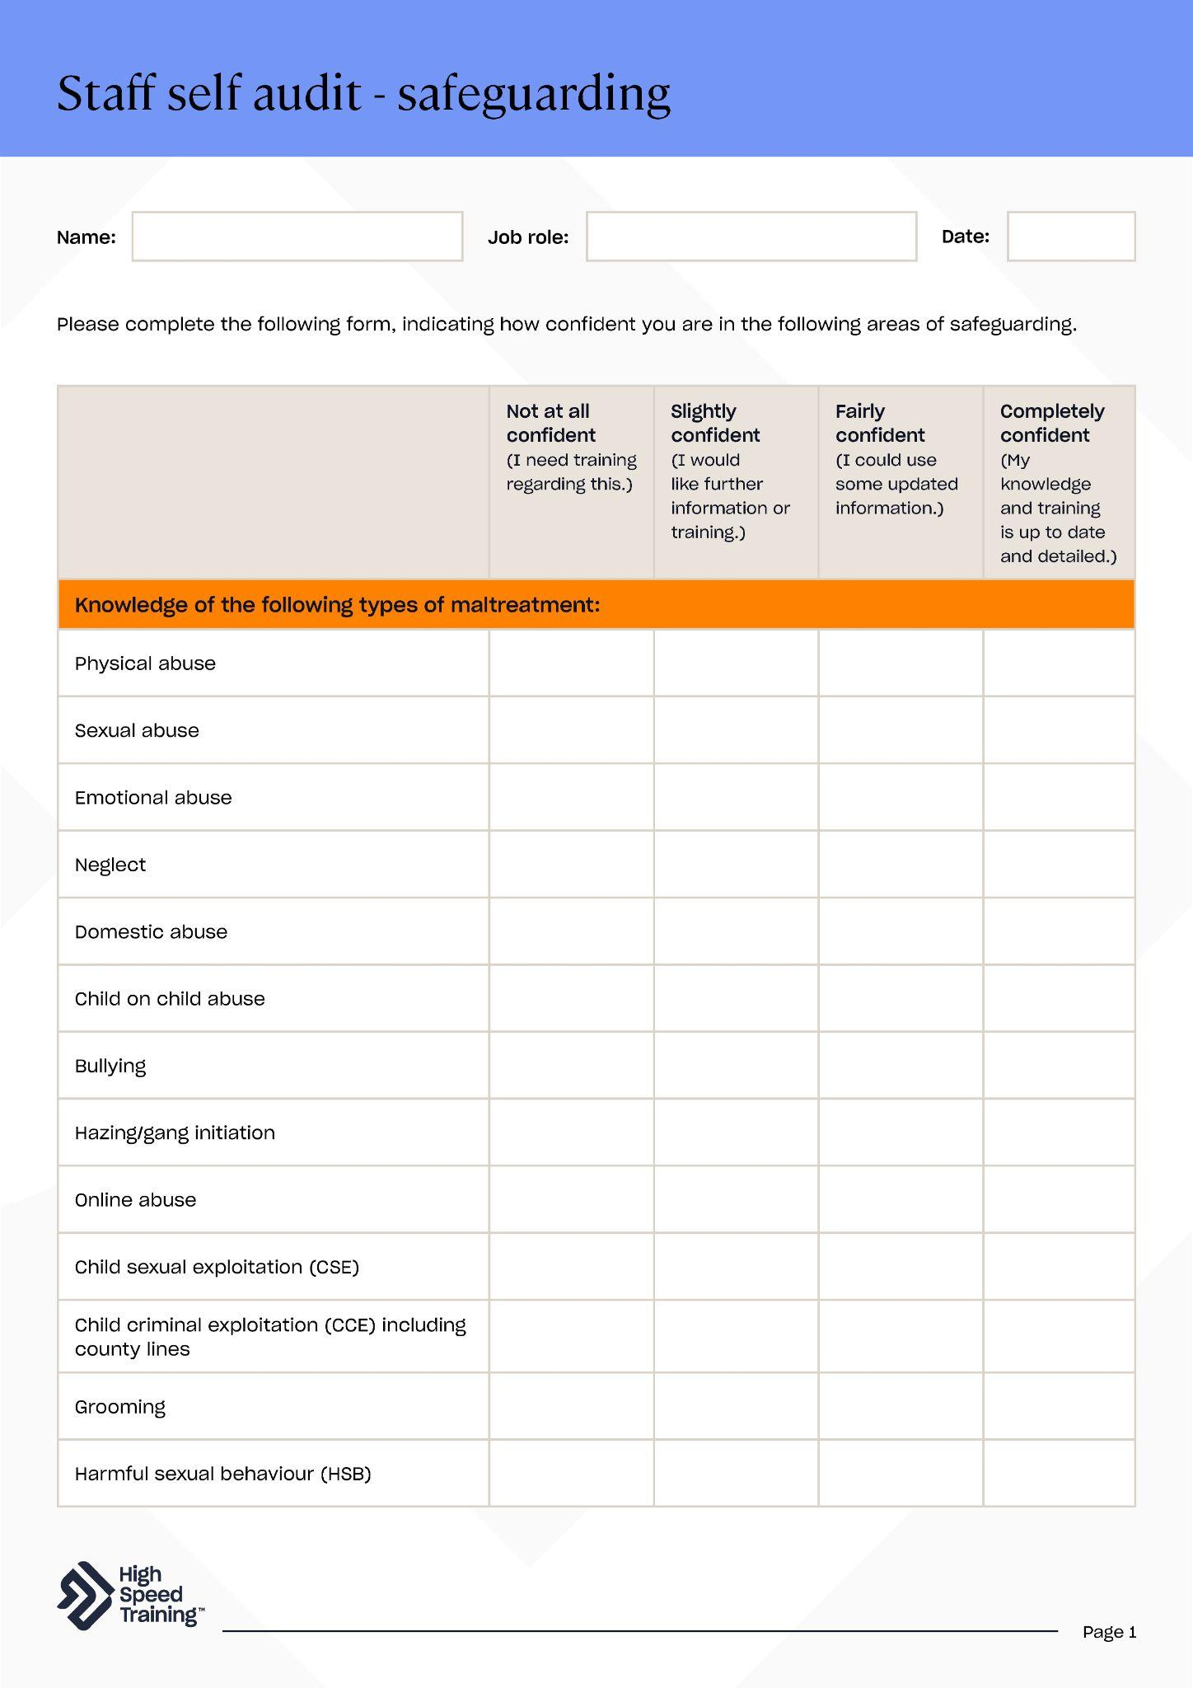


Next steps and resources for CPD
Complete your staff self-audit
Read Part one of KCSIE 2026 and complete the quiz
Review our policies and procedures
Notes:
Next steps and resources for CPD
Click to reveal three steps on the slide which include:
Complete your staff self-audit
Read Part one of KCSIE and complete the quiz
Review policies and procedures
You could also advise staff to read through the section summaries from today’s session, provided as a handy PDF in your pack, which includes links to a wide range of further resources and support.

Slide 73
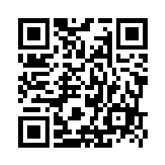

We’d love to hear your feedback!
https://forms.gle/djQ1bQuFzxvMa7dXA
Please scan the QR code to share your thoughts on this safeguarding INSET pack. Your insights directly shape our future content.
Every completed survey enters our
draw to win a £50 Amazon voucher.
Notes:
We value your feedback to help us improve our resources to better meet your needs in the future (High Speed Training would love to hear from you!).
All members of staff in today’s session can complete a survey with their thoughts on this INSET pack for a chance to win a £50 Amazon voucher.
You can scan the QR code on the slide to fill out the form, or you can visit the link as shown (https://forms.gle/djQ1bQuFzxvMa7dXA).

Slide 74

High Speed Training is a leading provider of online training courses, designed to make training, compliance and development simple, effective
and rewarding.
Trusted by thousands of UK organisations, our fully accredited and award-winning online training and easy to use platform has seen over 4 million learners take the next steps in their careers.
We are dedicated to keeping people safe
You can also find the most up-to-date, practical information and resources produced by our experts to support you in your professional life on our company blog, the Hub.
Notes:
Brought to you by High Speed Training.
For over a decade High Speed Training has delivered online CPD courses to teachers, teaching assistants, and education professionals all across the UK.
You can browse the entire range of online training courses to build on existing knowledge or learn new skills to help you in the classroom.
In addition, you can find a wide range of free articles and resources on the Hub.

